Slide 1


How to apply for college

Slide 2
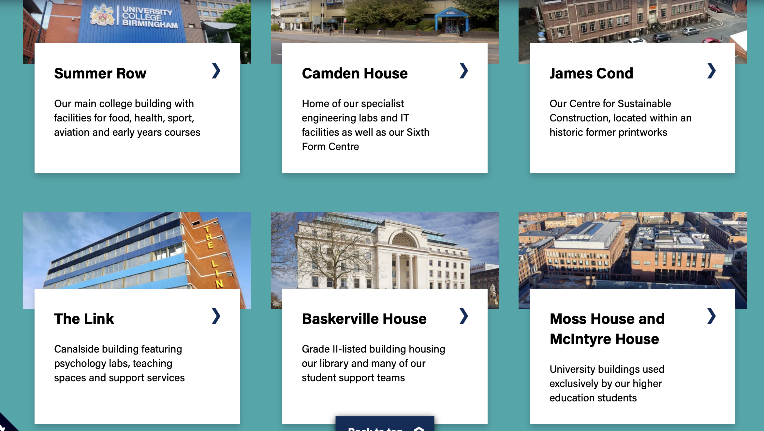
https://www.ucb.ac.uk/college-and-sixth-form/
UCB provides post 16 AND post 18 education, offering Sixth Form courses, College courses and University level courses at a variety of campuses. Pupils can only apply for the post 16 level courses at this point.

Slide 3

How to navigate to the areas you want to look at:
At the top of the website, click College and Sixth Form.

Slide 4
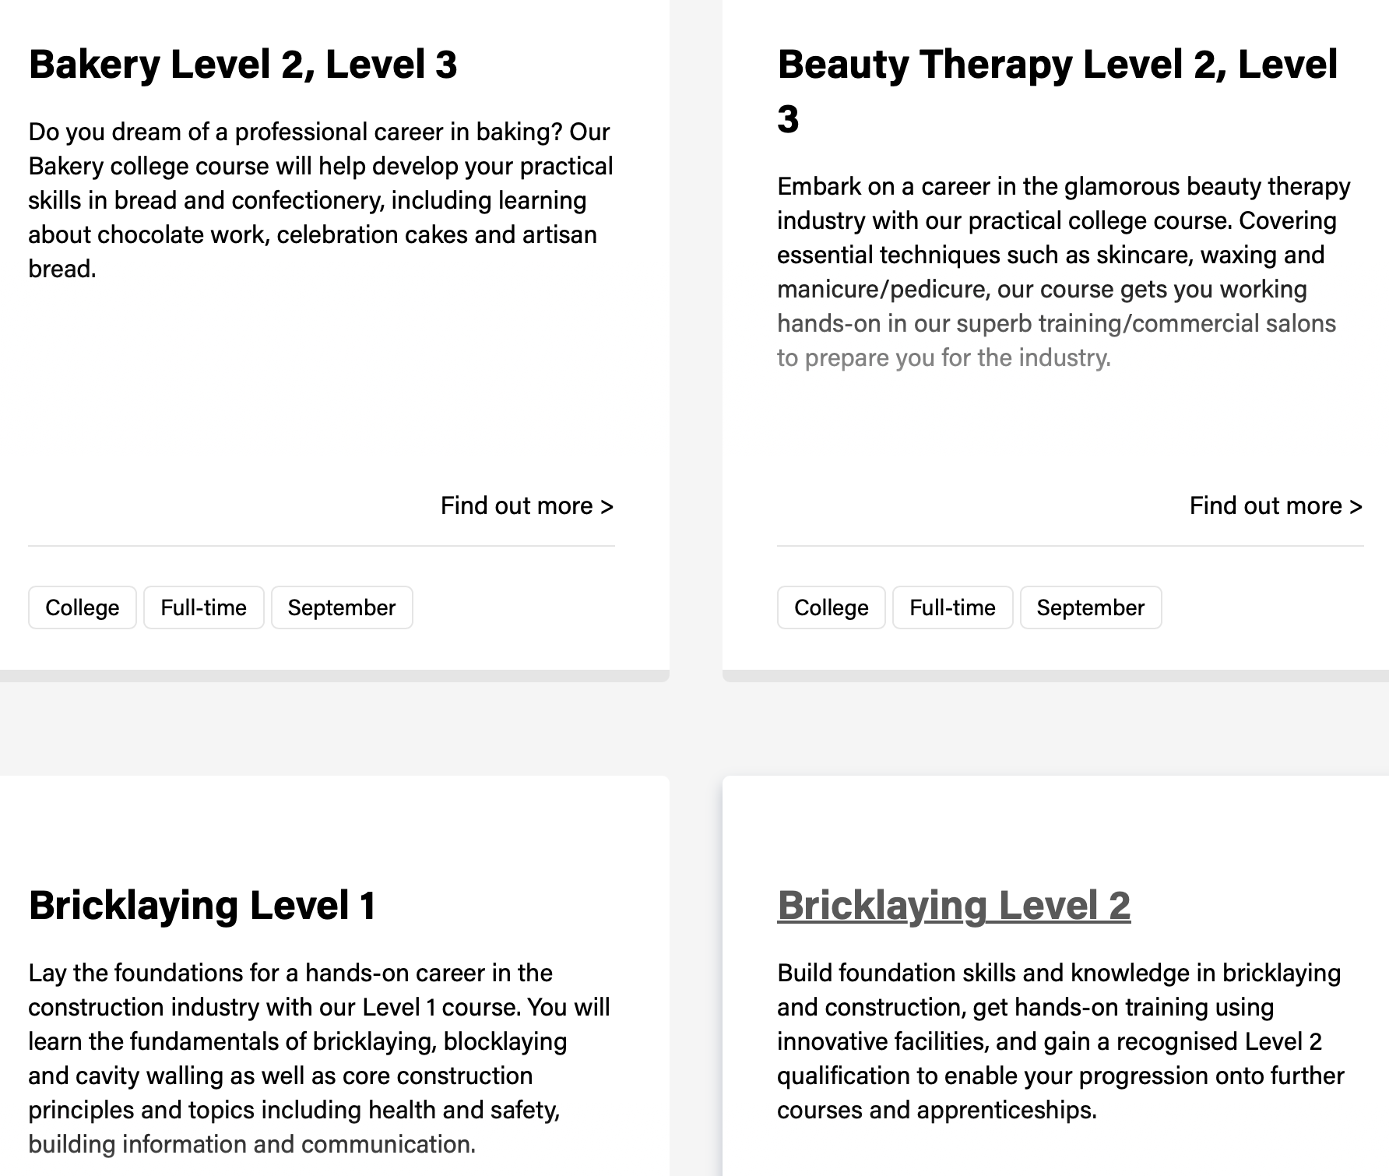
What is the difference between the different offers?
College courses: https://www.ucb.ac.uk/college-and-sixth-form/college/courses/
The courses offered here are vocational courses. These are more practical subjects, which are aligned to specific careers.
On the website, click the find out more to look at entry requirements and what the course involves.
Examples of these courses are:

Slide 5

UCB College offers several T Level courses:

Slide 6
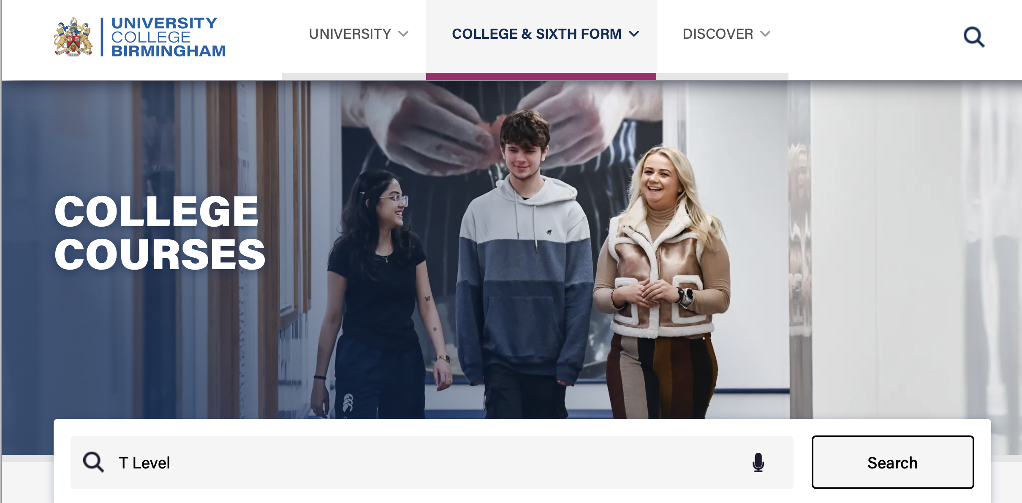
You can find the T Levels they offer by searching for “T Levels” in the college section:

Slide 7
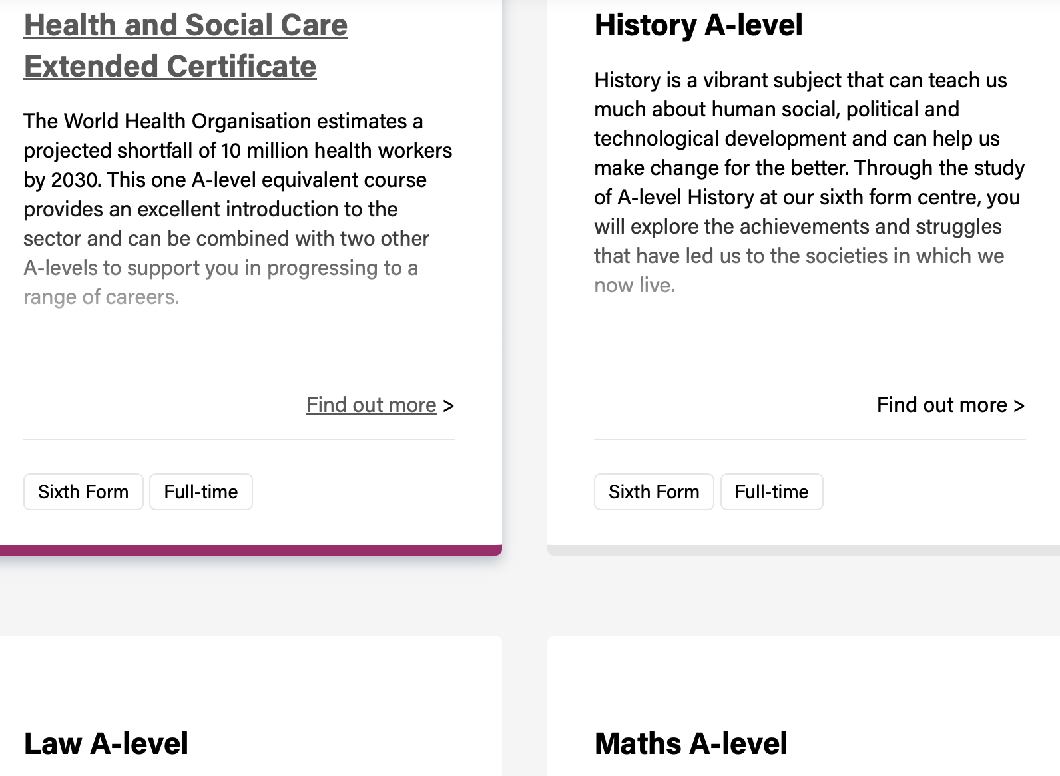
What is the difference between the different offers?
Sixth Form.
At UCB’s Sixth Form, they primarily offer A Level courses, with some vocational qualifications, such as Criminology and Health and Social Care.
On the website, click the find out more to look at entry requirements and what the course involves.
Examples of these courses are:

Slide 8
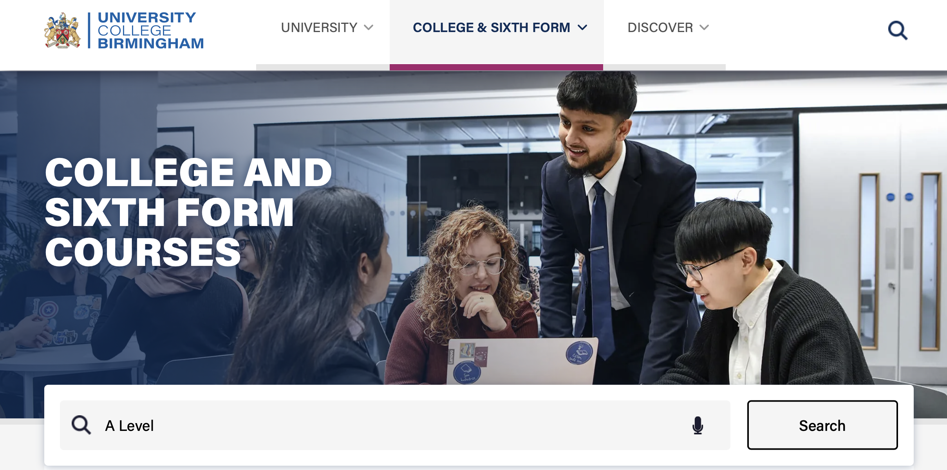
How to find Sixth Form courses on the UCB website:
Either click College & Sixth Form at the top of the website, or search A Level in the search box.

Slide 9

How to apply:
When you have found the course that interests you and you have checked that you meet the entry requirements, click apply within that course

Slide 10
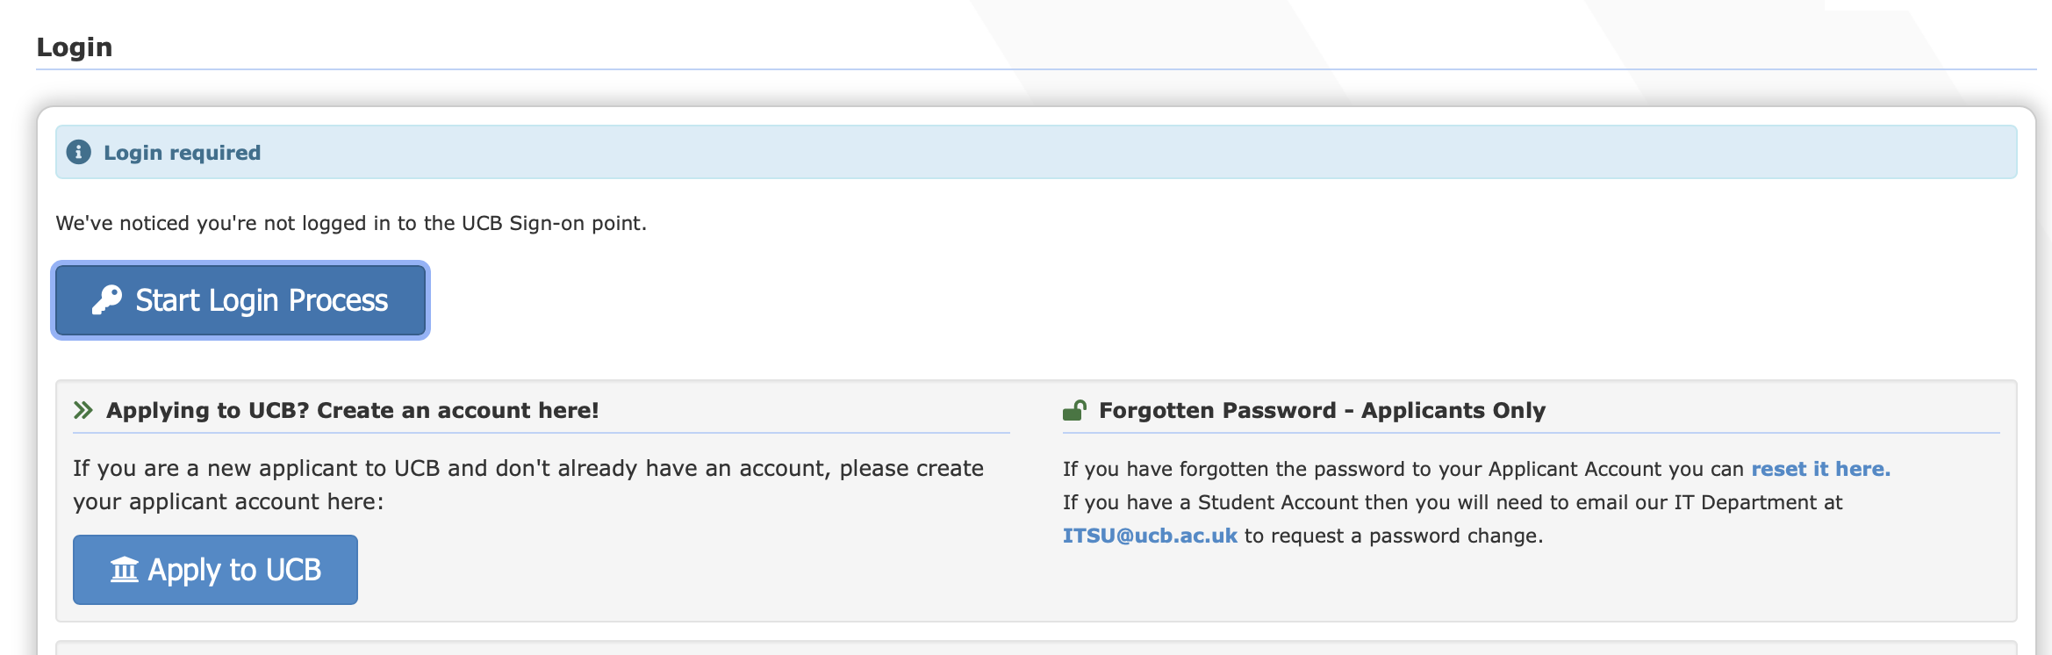
You need to create an account:

Slide 11
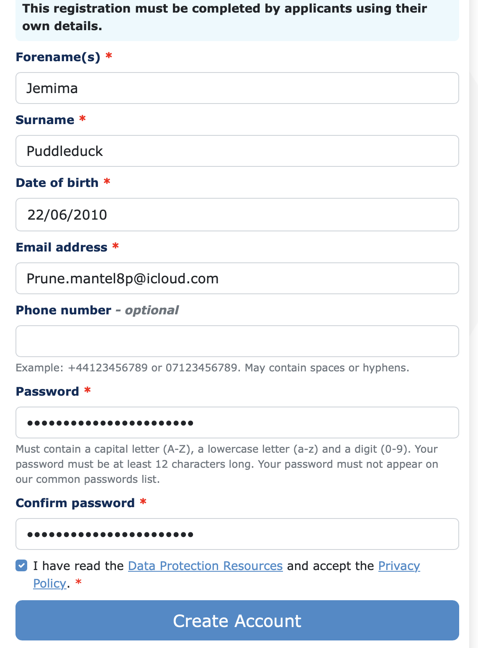
Fill in your details. Do not use pupil’s school email address. Pupils will lose access to this after they leave.
Click Create Account

Slide 12
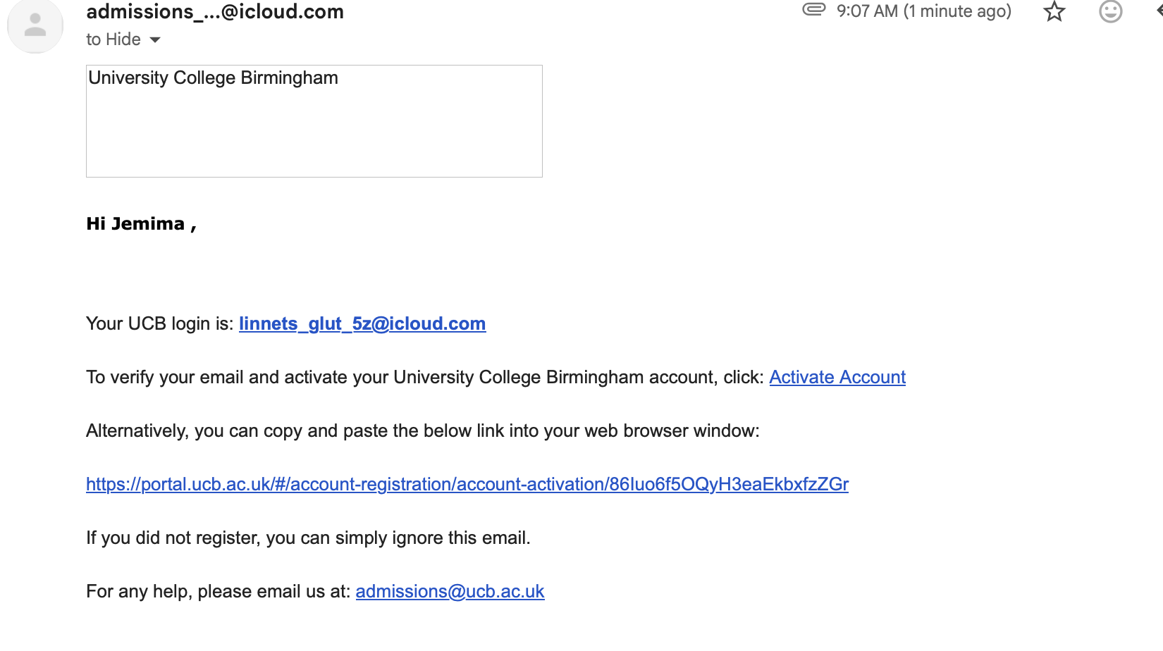
Email confirmation
You will get an email to verify your account. Click activate account in that email.

Slide 13
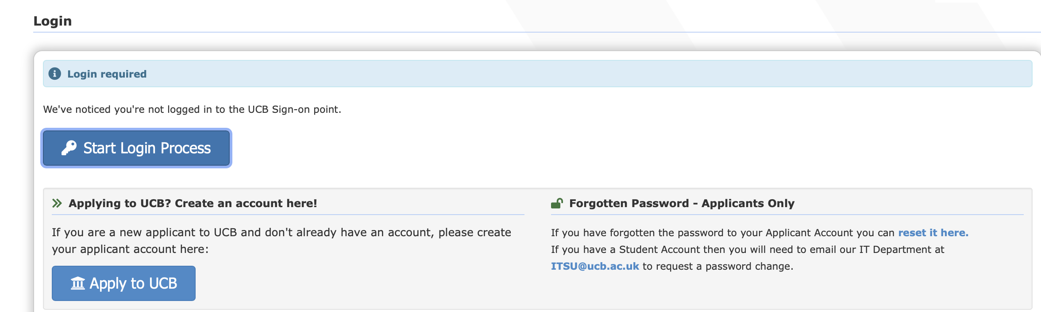
It will take you back to the log in page.
Use your email address and Password to log in.

Slide 14
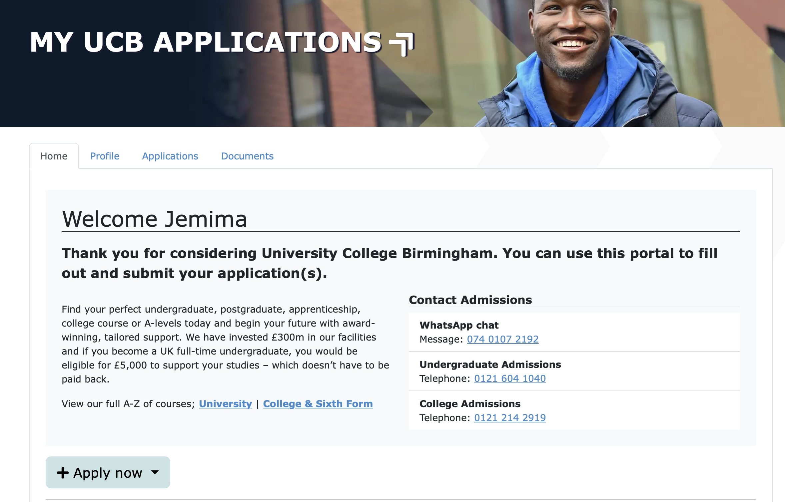
Click: apply now

Slide 15
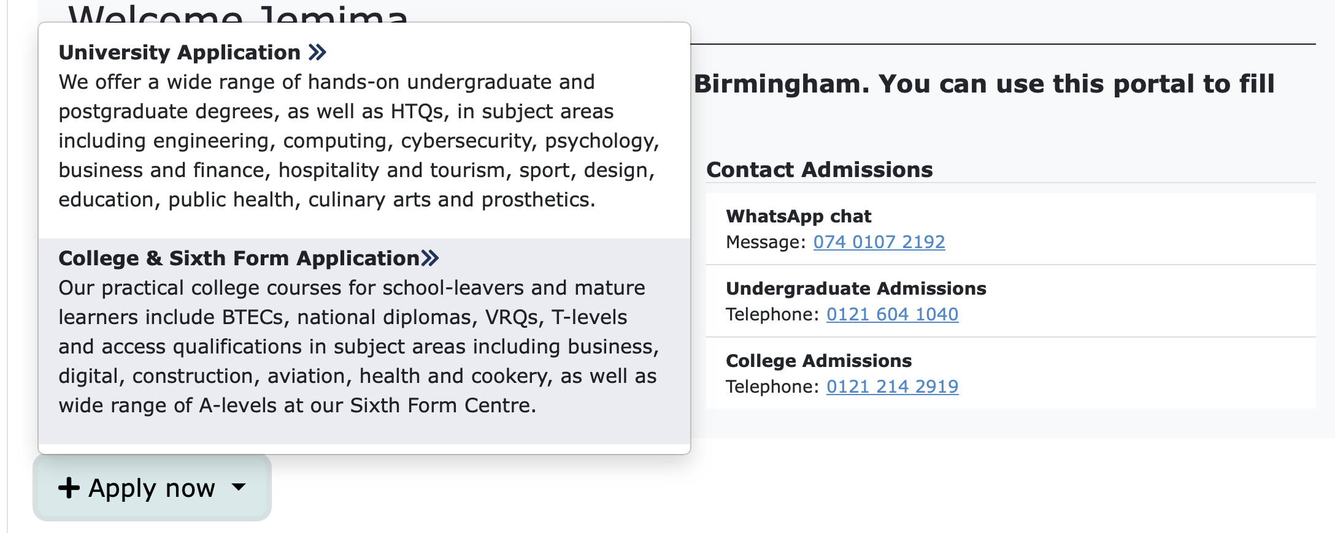
Select College and Sixth Form Application.

Slide 16
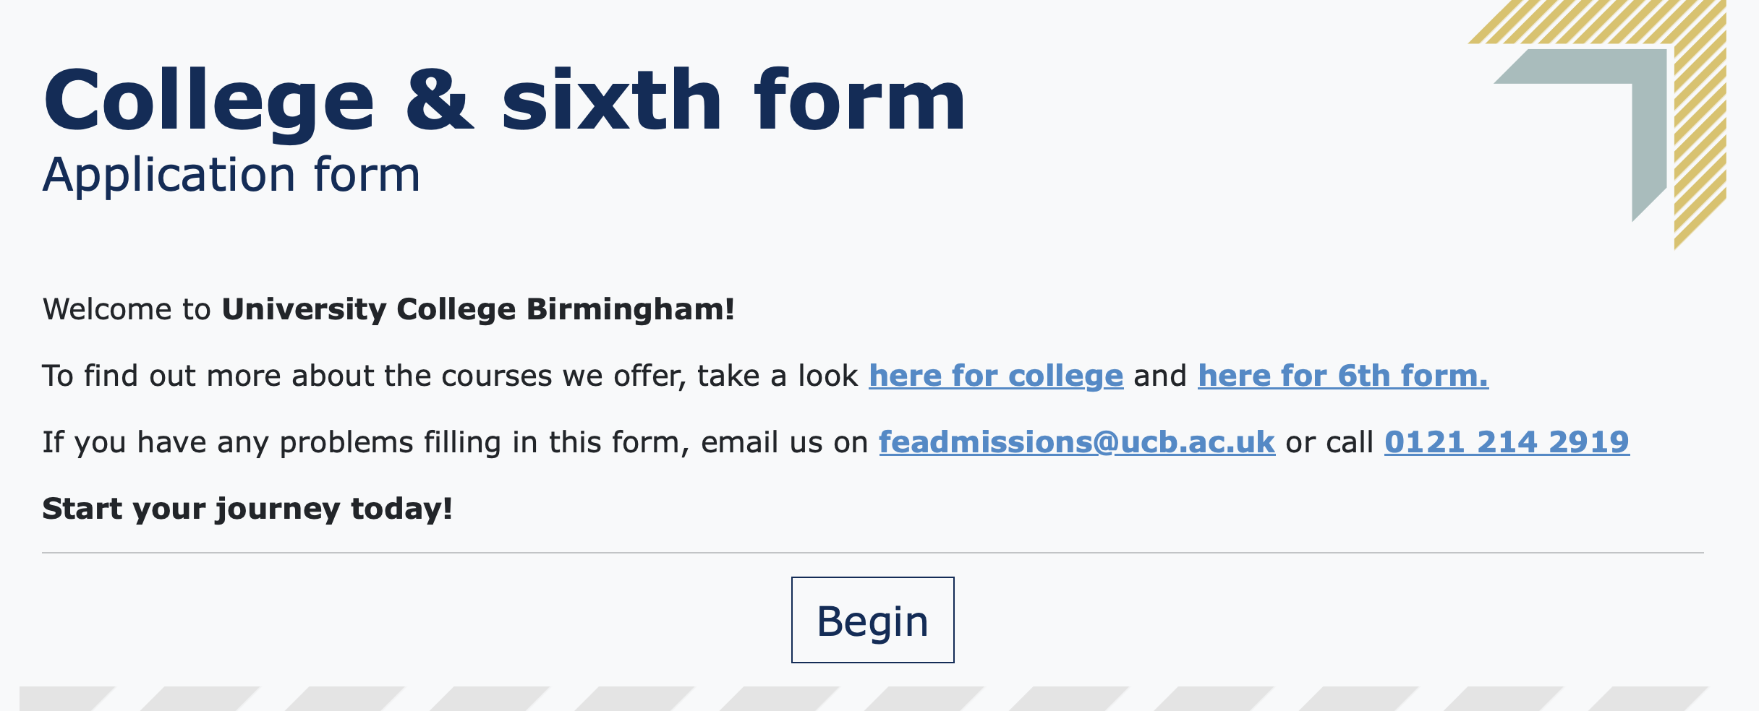
Click Begin.

Slide 17
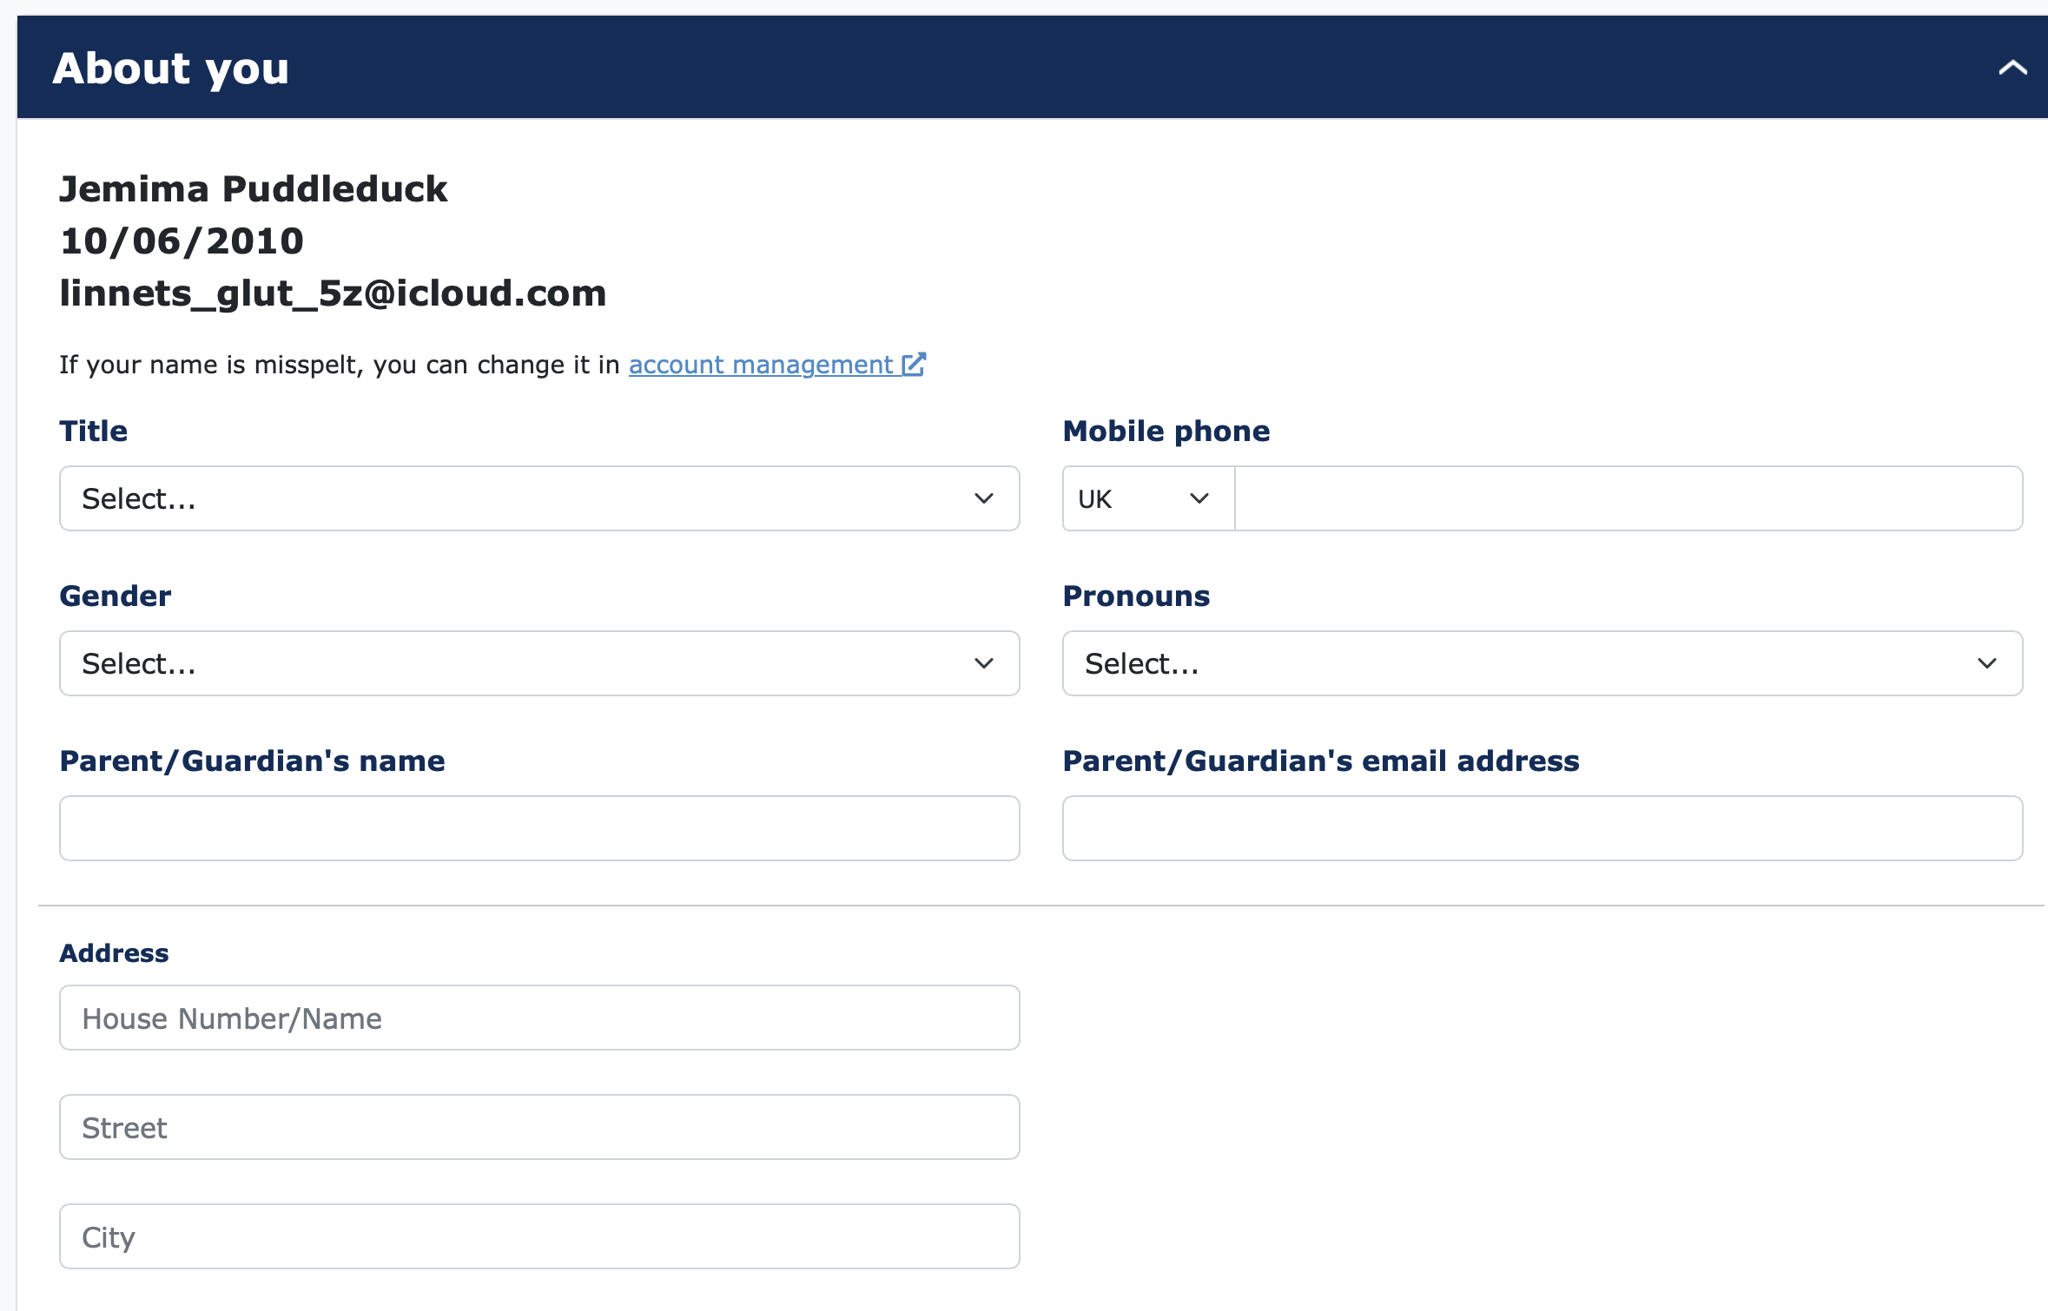
Fill out your details.

Slide 18
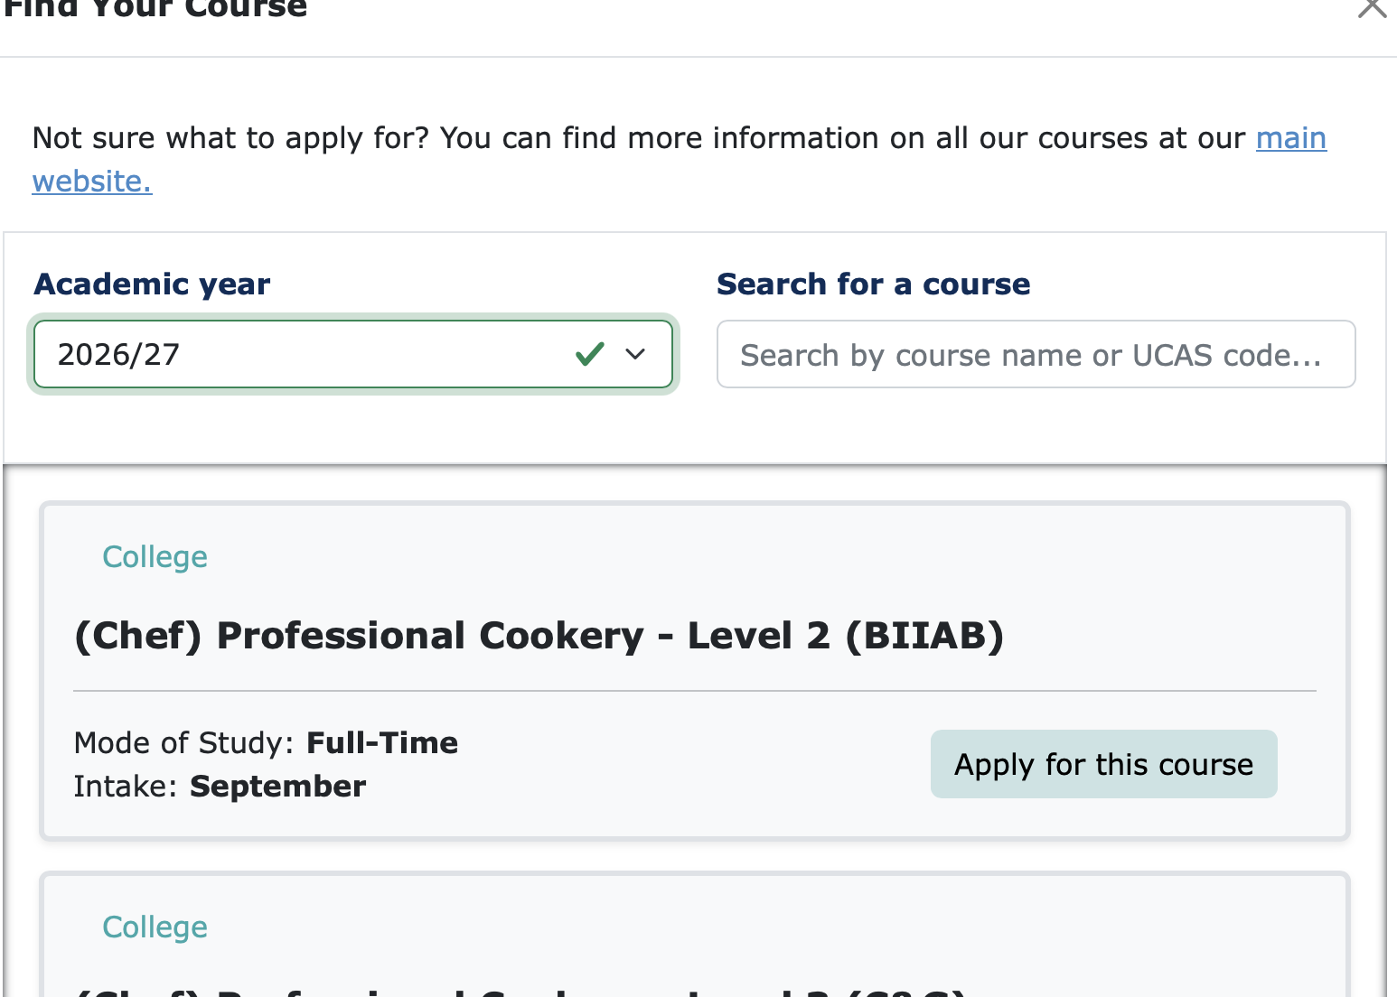
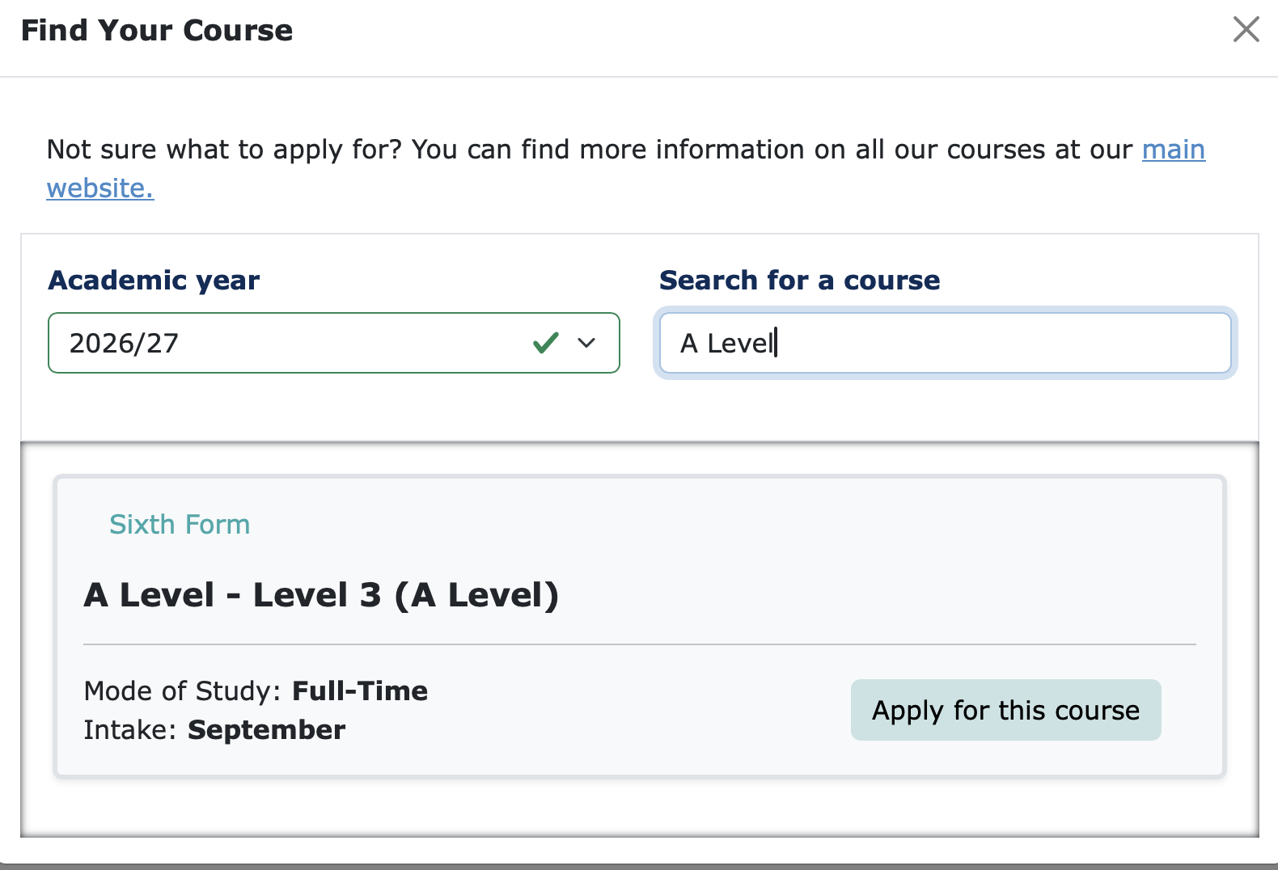
Click the correct academic year for when you plan to START the course.
Then, either search for the course you are interested in, or scroll through the list. For A Level, search A Level. You make your subject choices later.

Slide 19
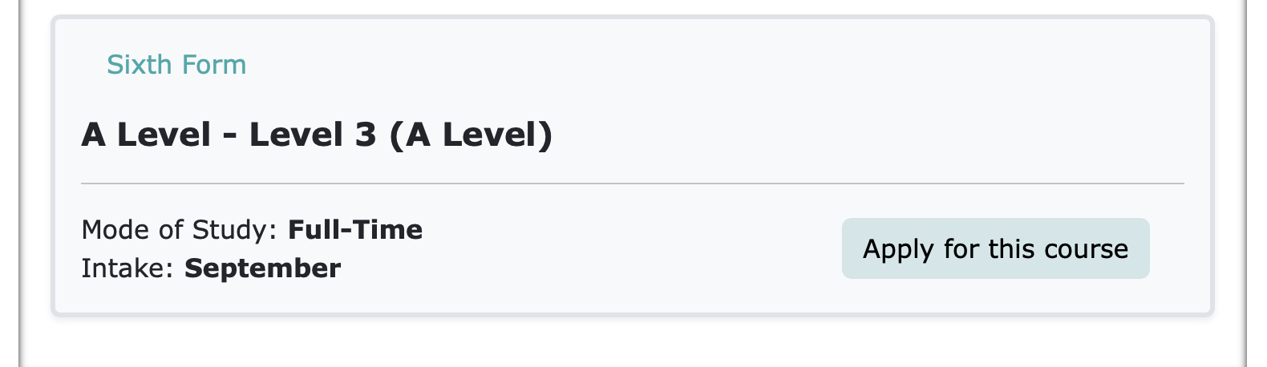
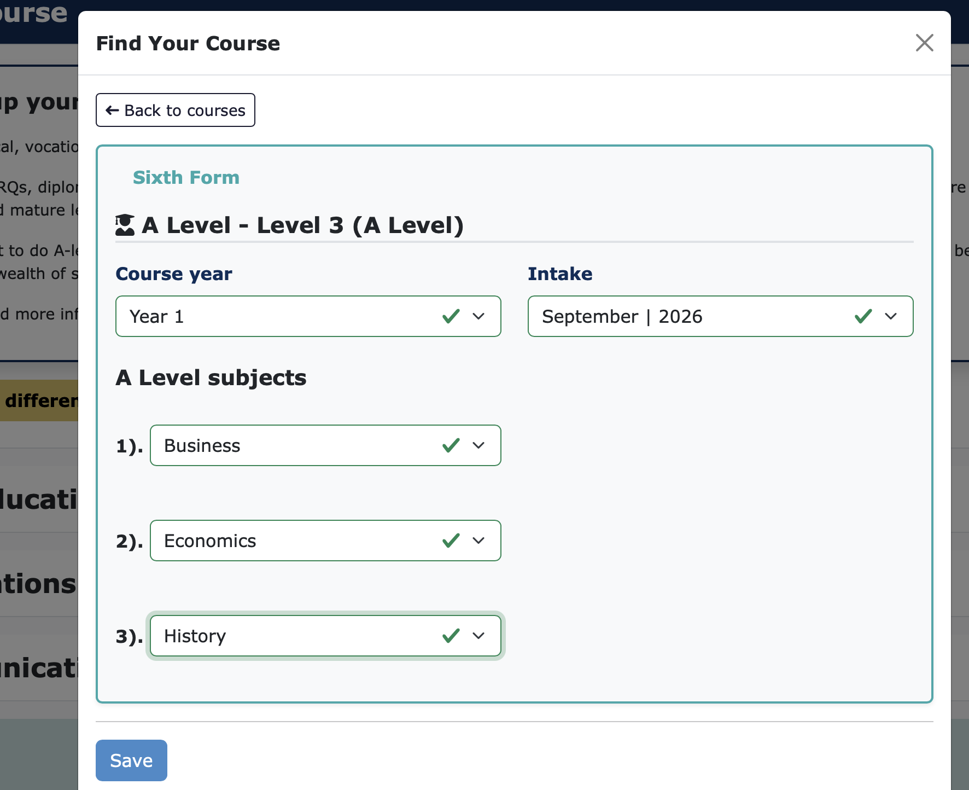
For A Level:
Click Apply for this course. In the next window, pick your 3 subjects from the drop down and press save.

Slide 20
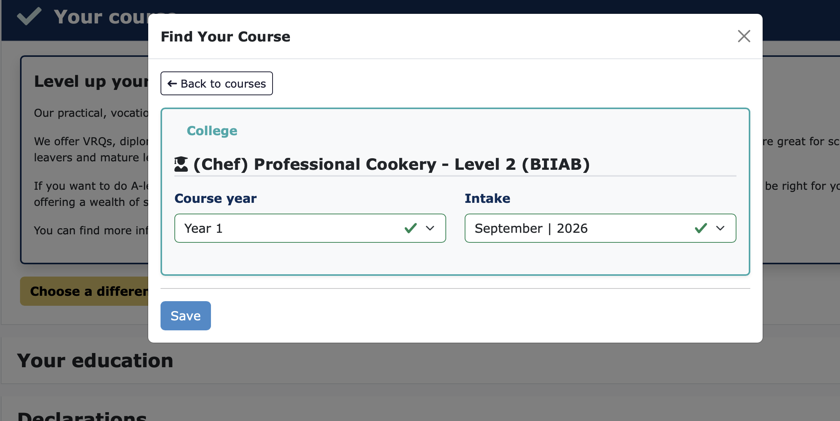
For vocational:
Click on the course you are interested in and press save.

Slide 21
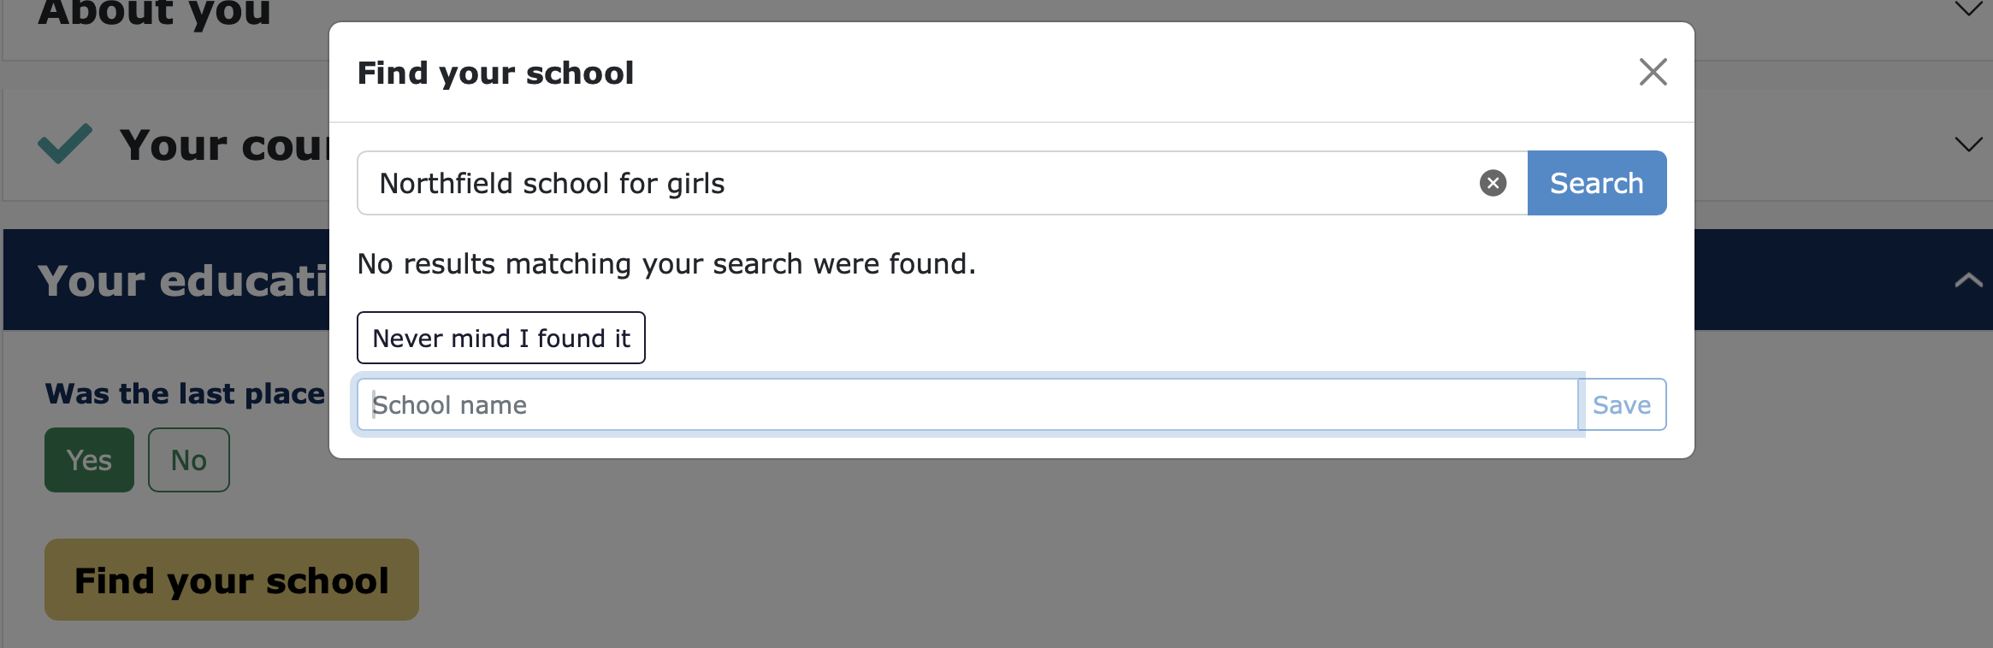
Complete the other headings and press submit.
If it cannot find the school, manually add the school’s name in.

