Slide 1


How to apply

Slide 2
Link: Campuses & Facilities
South and City College have seven campuses.
Some courses are available at only one campus. Some in multiple campuses:
Each course will state which campus it is available at.
Longbridge
Longbridge Construction
Bordesley Green
Digbeth
Fusion Centre
Golden Hillock
Hall Green
Handsworth

Slide 3

Navigate to the website homepage
Home - South and City College Birmingham

Slide 4
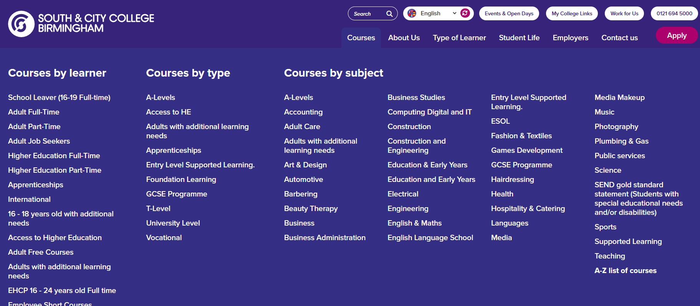
Hover over courses.

Slide 5
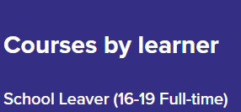
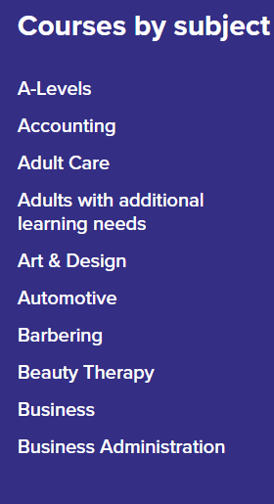
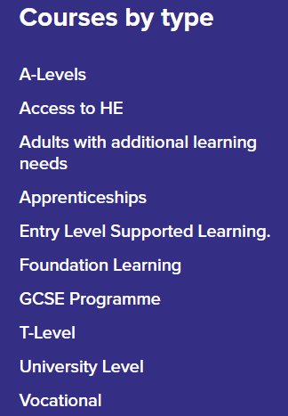
Either:
Or:
Or:

Slide 6
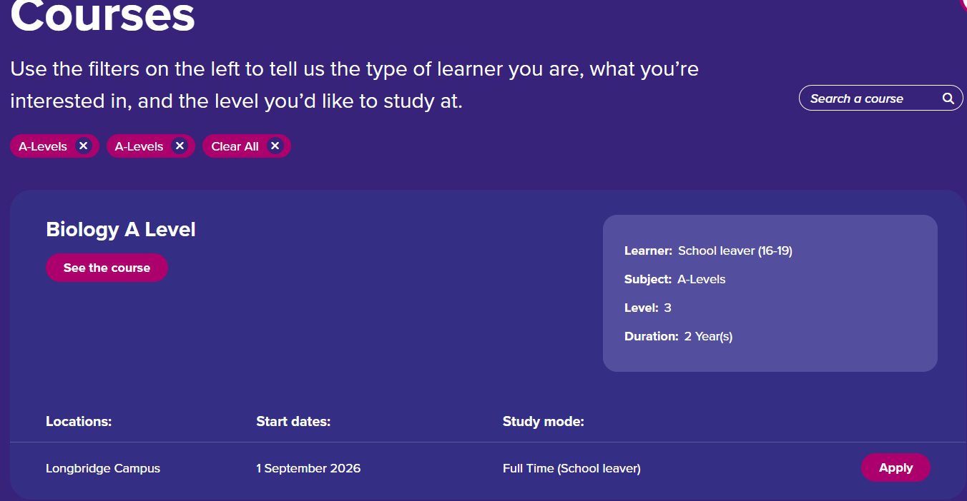
A Levels. Pick 3 or 4. (most people pick 3)
What does the course involve?
Only at Longbridge Campus

Slide 7
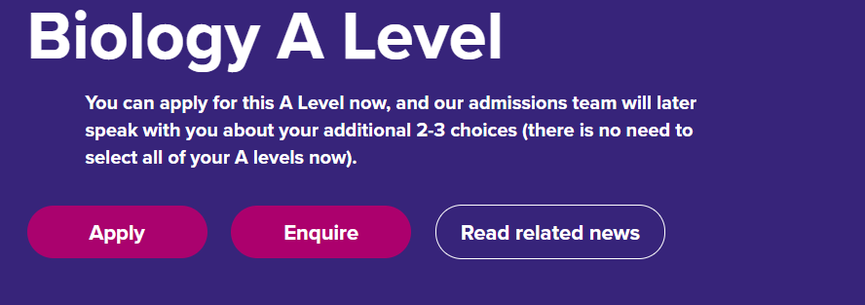
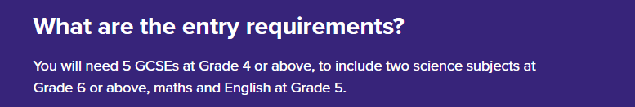
Check you meet the entry requirements. Use your most recent school report to see your grades

Slide 8
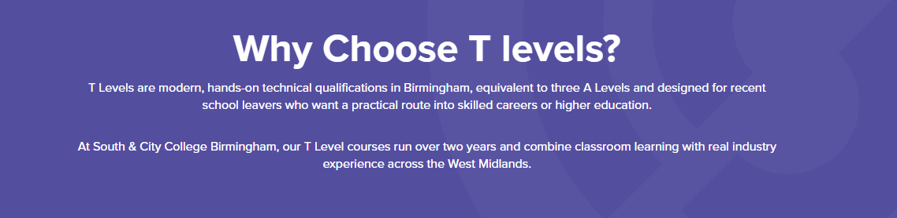
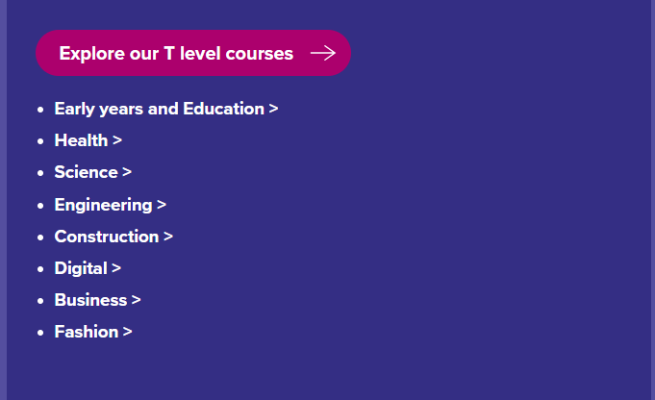
T Levels. You only pick ONE of these.

Slide 9


Slide 10
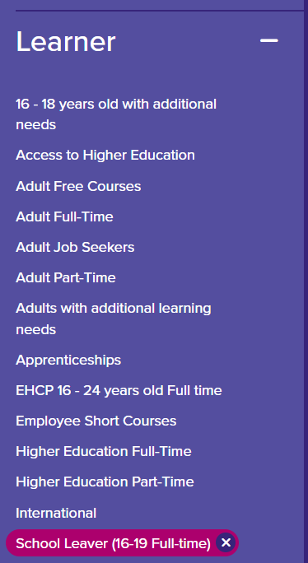
Vocational.
Courses | South and City College Birmingham
There are a lot of courses available for adults. Filter those out by selecting school leaver, from the learner menu on the left of the screen on the website.

Slide 11
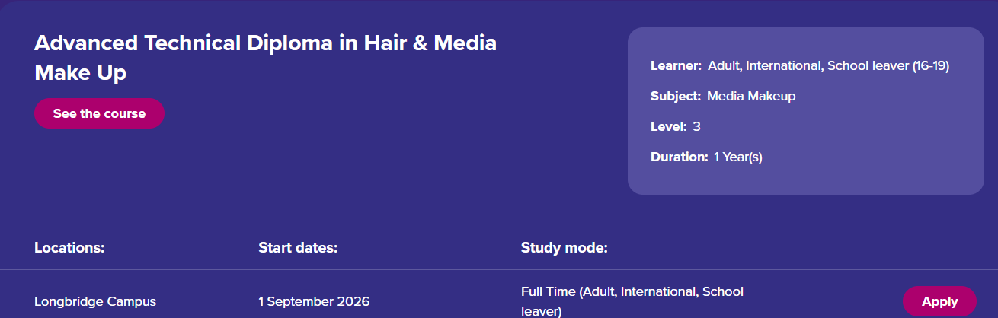
Vocational courses are more practical than A Levels. For example:

Slide 12

Ready to apply?
Apply | South and City College Birmingham

Slide 13
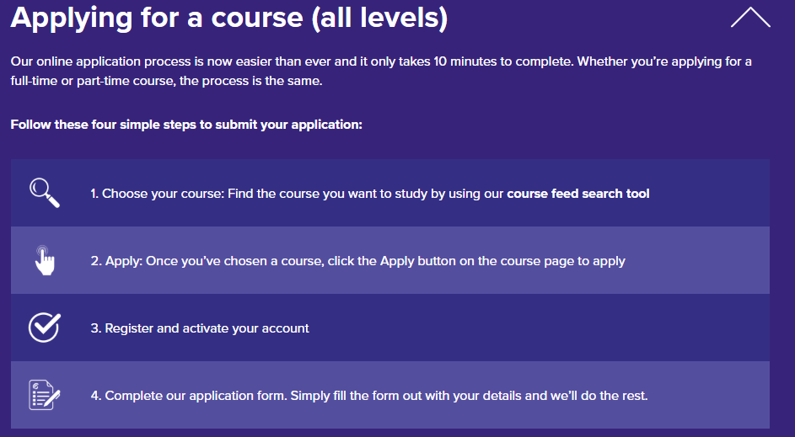

Slide 14

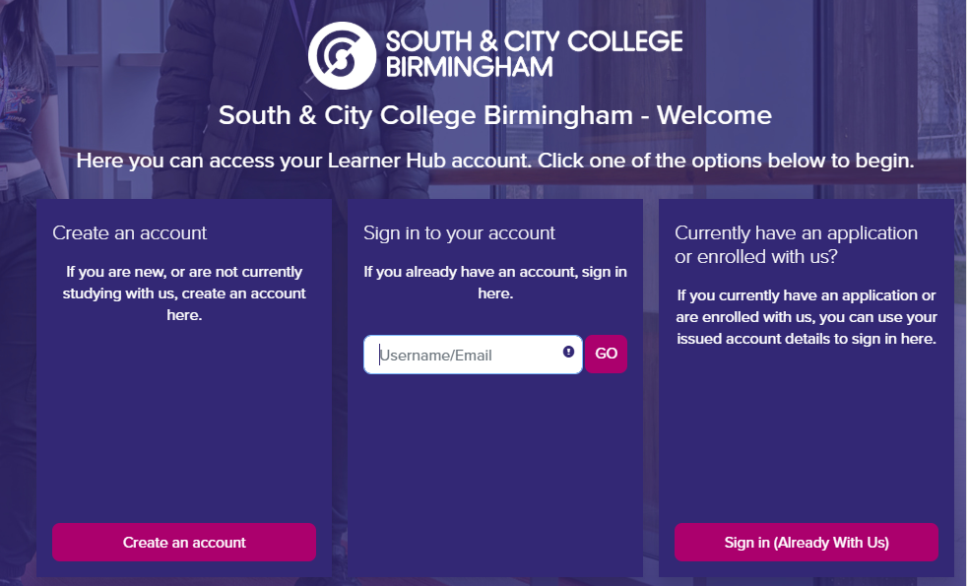
Click in any course you are interested in and create an account.

Slide 15
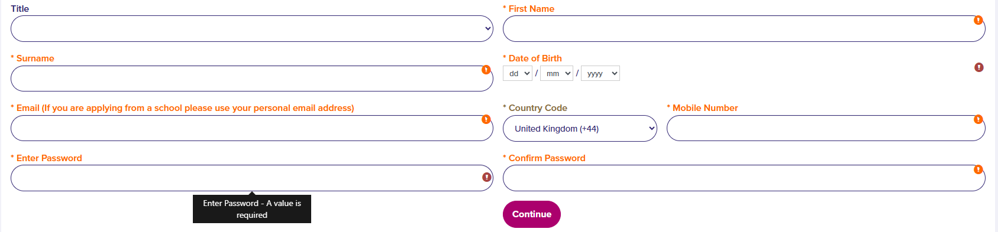
Fill in your details
Do not use school email address, pupils will lose access to emails when they leave in Year 11.

Slide 16
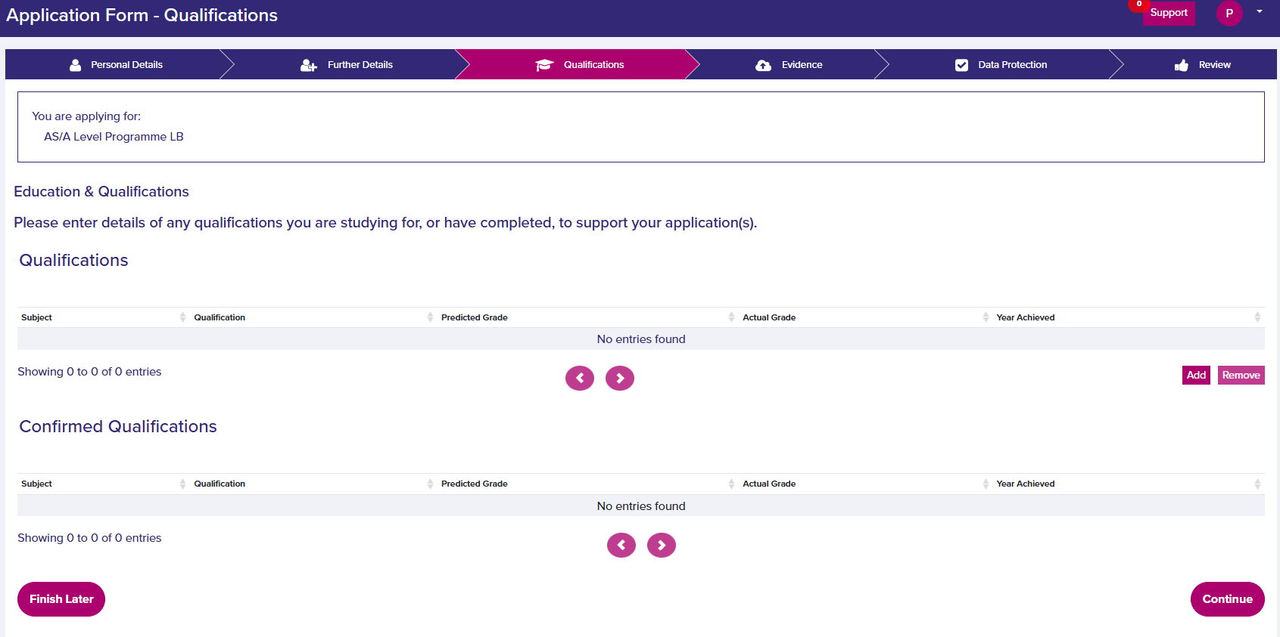
Add in predicted grades – see next slide

Slide 17
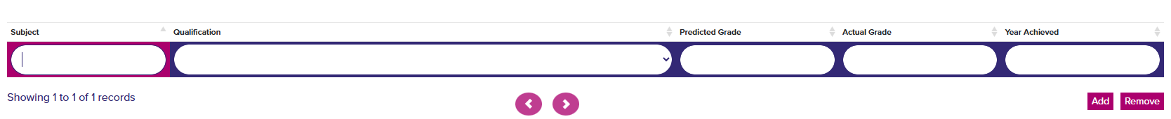
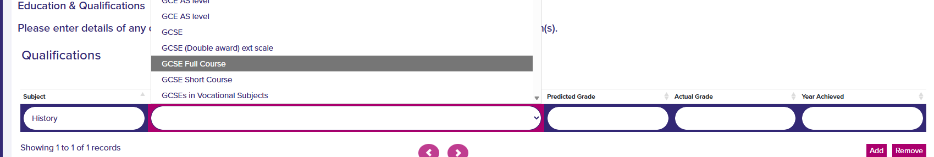
Step 1: Click the add button
Free type the subject name
Click the drop down to choose qualification.
Most subjects we do at school are GCSE.

Slide 18
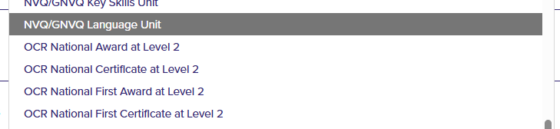
Health and Social Care is OCR National Certificate at Level 2

Slide 19


Step 2
Fill out predicted grade, using your latest school report.
Miss out actual grade, unless you took a GCSE early in Year 10.
Year Achieved is the year your GCSE result came out.
Then click again and do the same for every subject in school.
Click when all grades are entered.

Slide 20
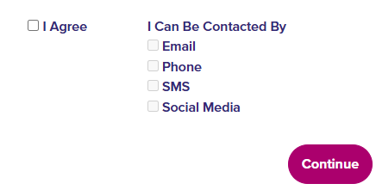
Click I agree and continue.

Slide 21
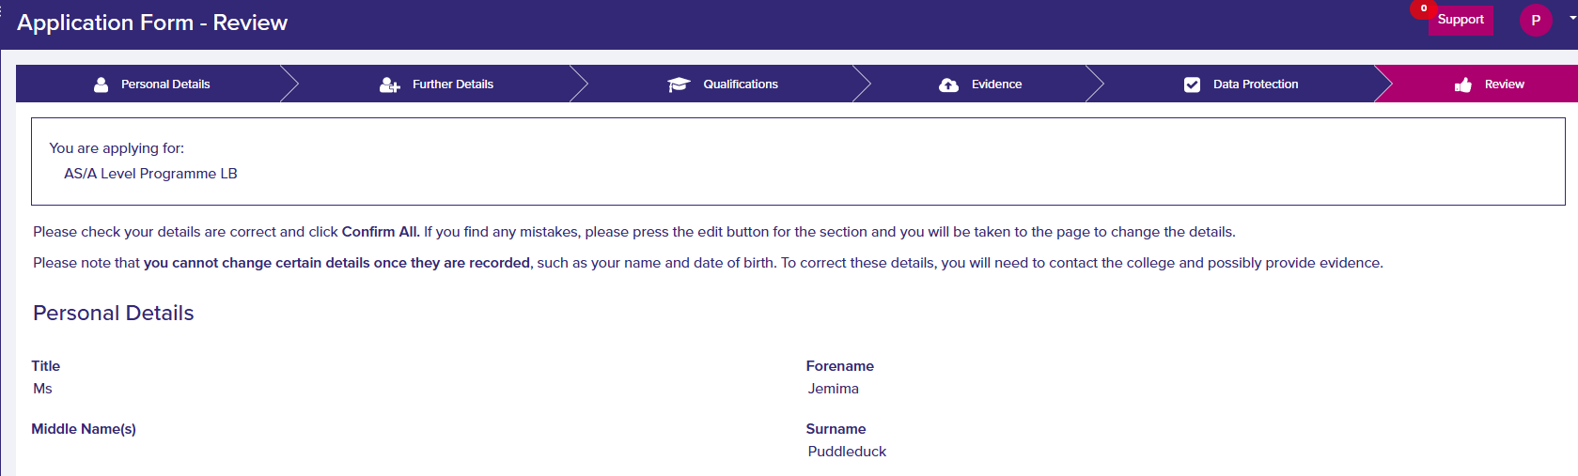

Check your details on the next page
At the bottom of the page click Confirm all.

Slide 22
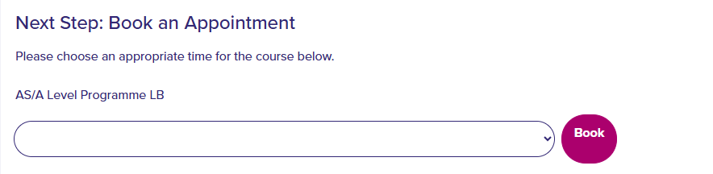
Finally book your interview.

