Slide 1

Parent’s Guide to Careers

Slide 2
What can parents do to support careers?
The best thing parents can do, is talk to their children about their own experiences and their children’s options.
To have this discussion, make sure that you are informed yourself about what is available out there. The next slide talks about where to find research to support this conversation.
Things to consider:
Pupil predicted grades
Labour Market Information
The changing job market – there are careers available now that didn’t exist 5/10 years ago. It is important to keep on top of developments

Slide 3
Where can you find information about careers?
This website has been designed by the Gatsby Trust, who are driving careers improvement in England. It is a great starting point for discussions with your daughter.
Parents Advice for Career Conversations - Talking Futures
This website has been created by the National Careers Service to support conversations with your children:
Help a young person make career choices | National Careers Service
We pay for access to Xello, a careers platform which helps guide students to what careers they may be interested in and what route they need to take to get there.

Slide 4
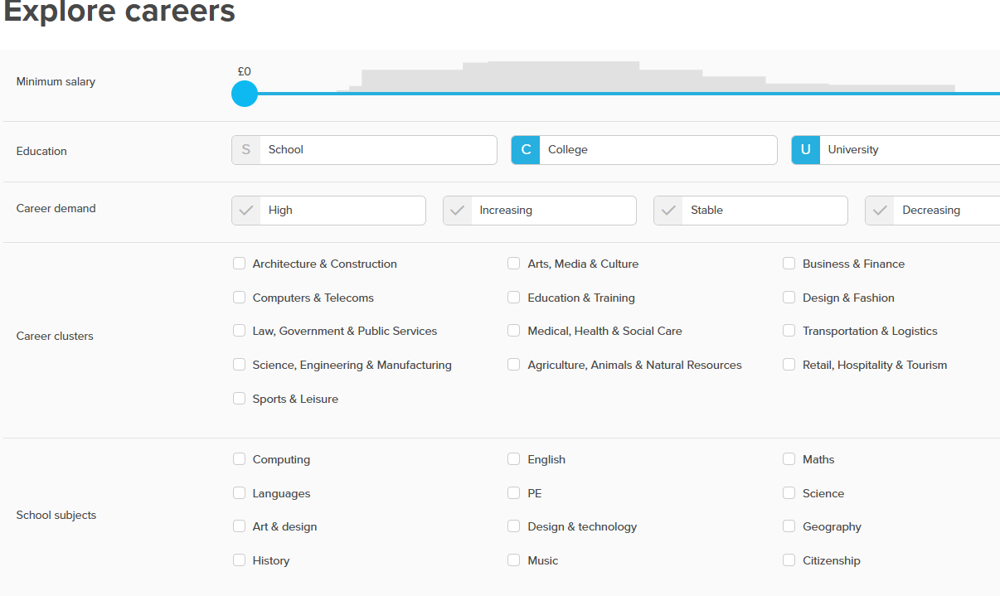
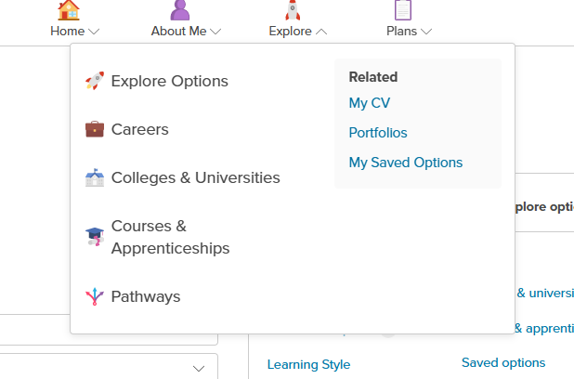
How to explore careers on Xello
On the Xello homepage click on explore at the top of the page
You can then explore careers by clusters: for example, all careers based on working with medicine, or even by subjects they enjoy/are good at in school.
In the drop down, click on careers

Slide 5
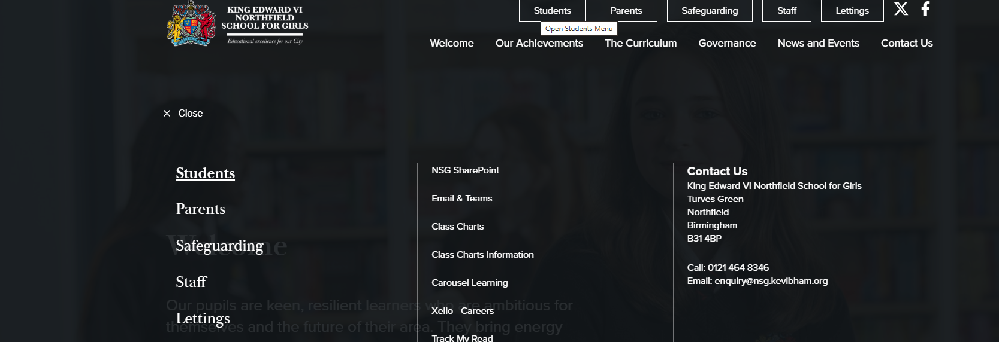
How can pupils use Xello?
There is a link on the school website, under students, for Xello
They sign in using single sign in with Microsoft.
It is their school email and password ( the same as they use to log into computers in school).

Slide 6
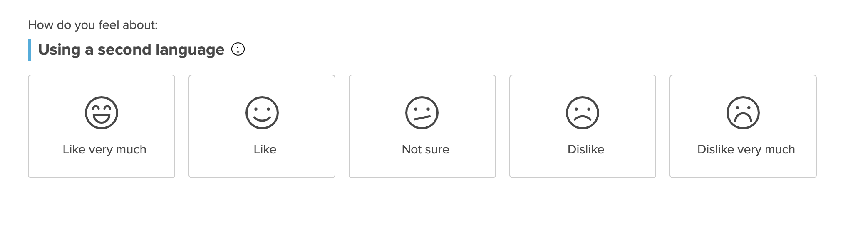
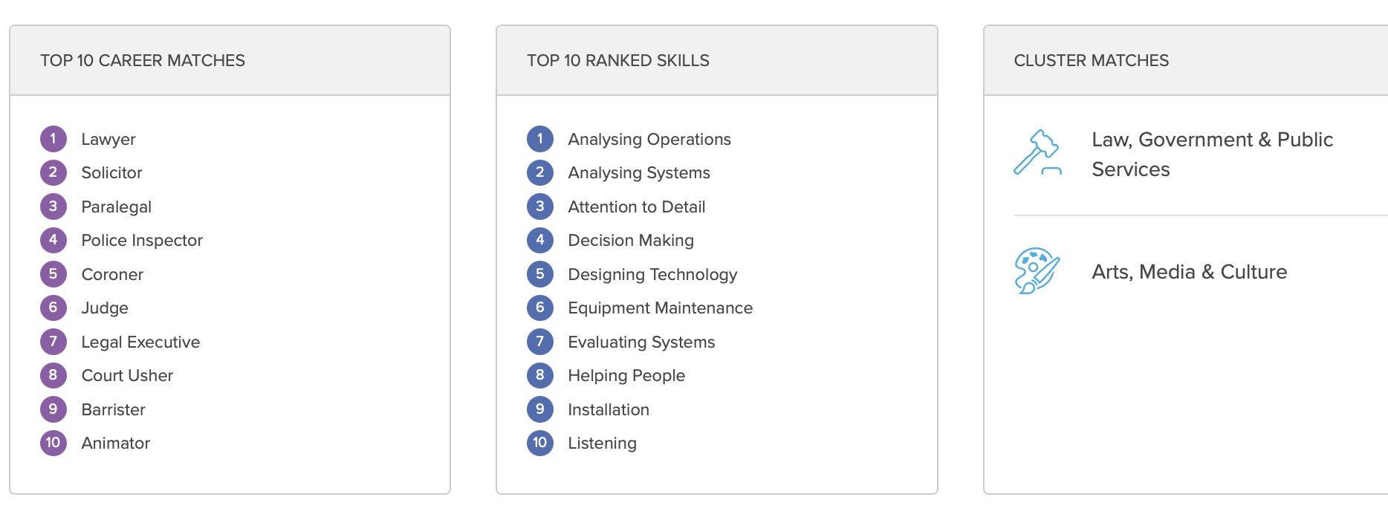
What can it do?
It will ask you simple questions to help predict careers you will like:

Slide 7
What is Labour Market Information (LMI)?
Labour Market Information (LMI) informs you about what job prospects there are now and are predicted in the future for different careers.
The growth of AI is rapidly changing the employment landscape.
It is a powerful way to decide if your chosen career is one which will be looking for employees in the future.
The West Midlands is economically struggling, compared to the rest of the UK, which means doing your LMI research is crucial.

Slide 8
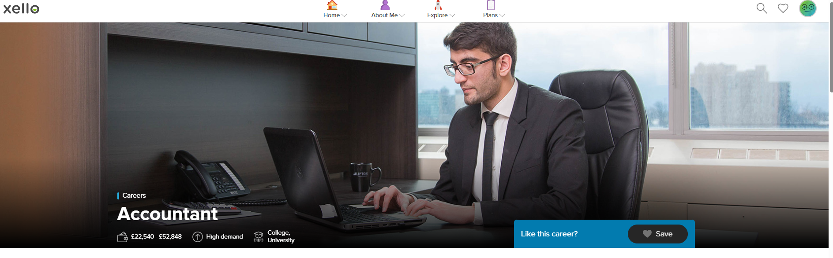
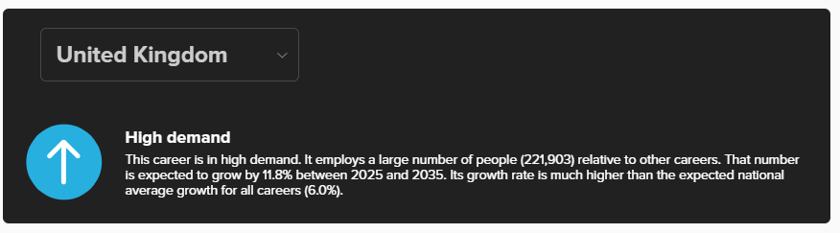
Xello can inform you about LMI (Labour Market Information)

Slide 9
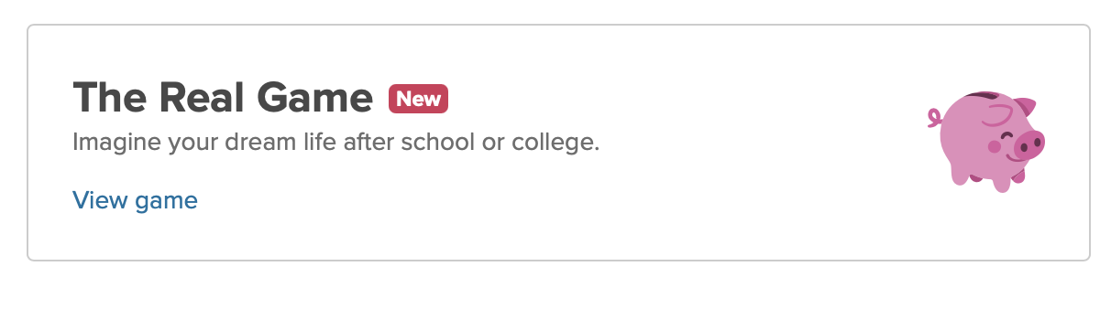
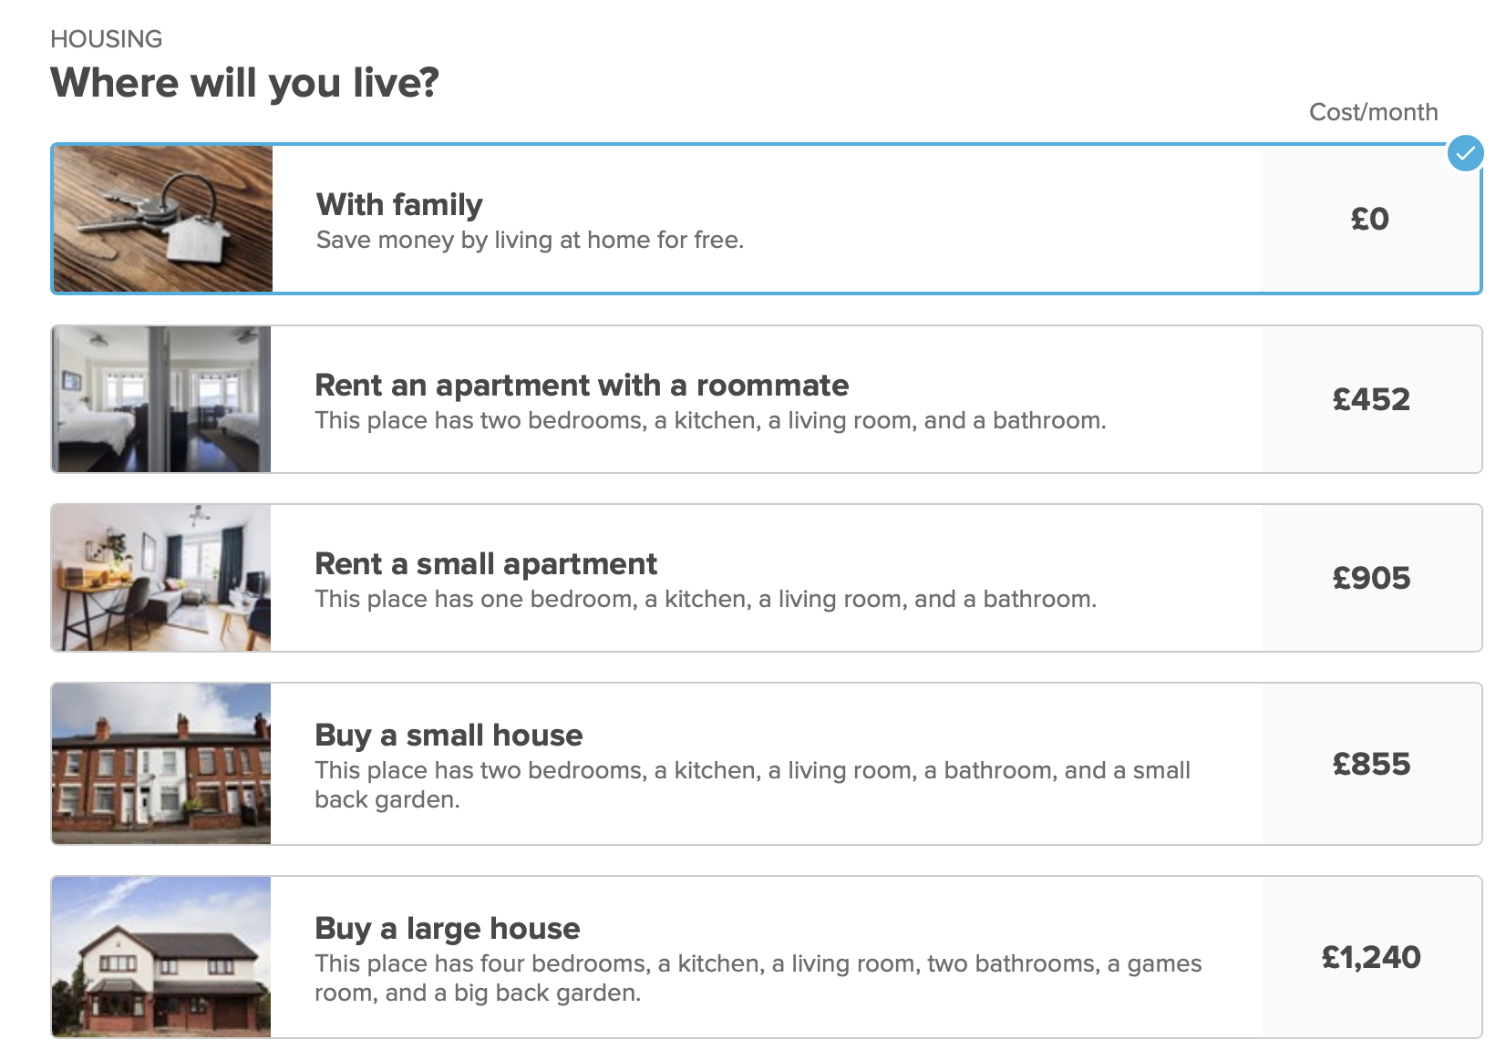
It will help with budgeting and what jobs match up to the lifestyle you want
It will ask you about what kind of house you would like to buy, what kind of transport you will use, what devices and mobile plans you would like to have etc.
Yoi can then try and match that up with jobs

Slide 10
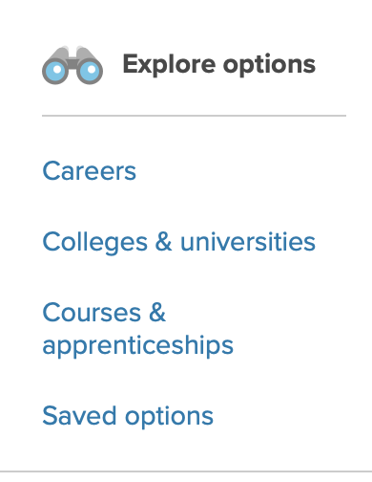
Or you can simply research jobs, what qualifications you need and how much you get paid
It will even show you which colleges, sixth forms and universities run the courses you are interested in, including the grades you need to get into that course

Slide 11
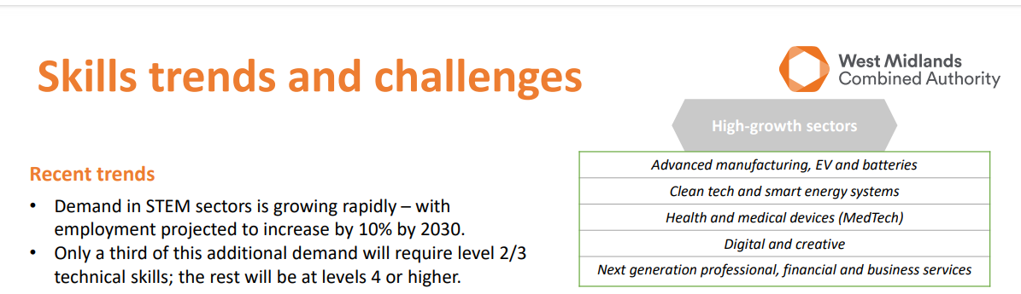
Other helpful websites:
According to the West Midlands Combined Authority, these are the job sectors most in demand:
A good website to research STEM careers is:
STEM Careers - Youth Employment UK
Careers advice - job profiles, information and resources | National Careers Service
Get to where you want to be in careers, learning and life - Career Connect
Careers - BBC Bitesize

Slide 12
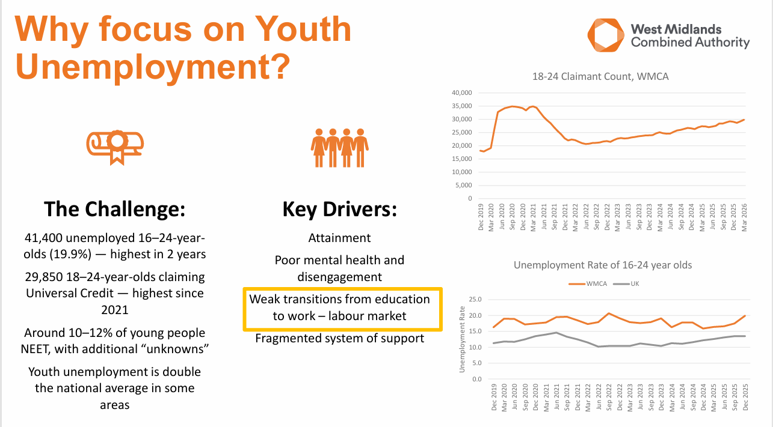
Latest data from the West Midlands Combined Authority from a conference in 2026.

Slide 13
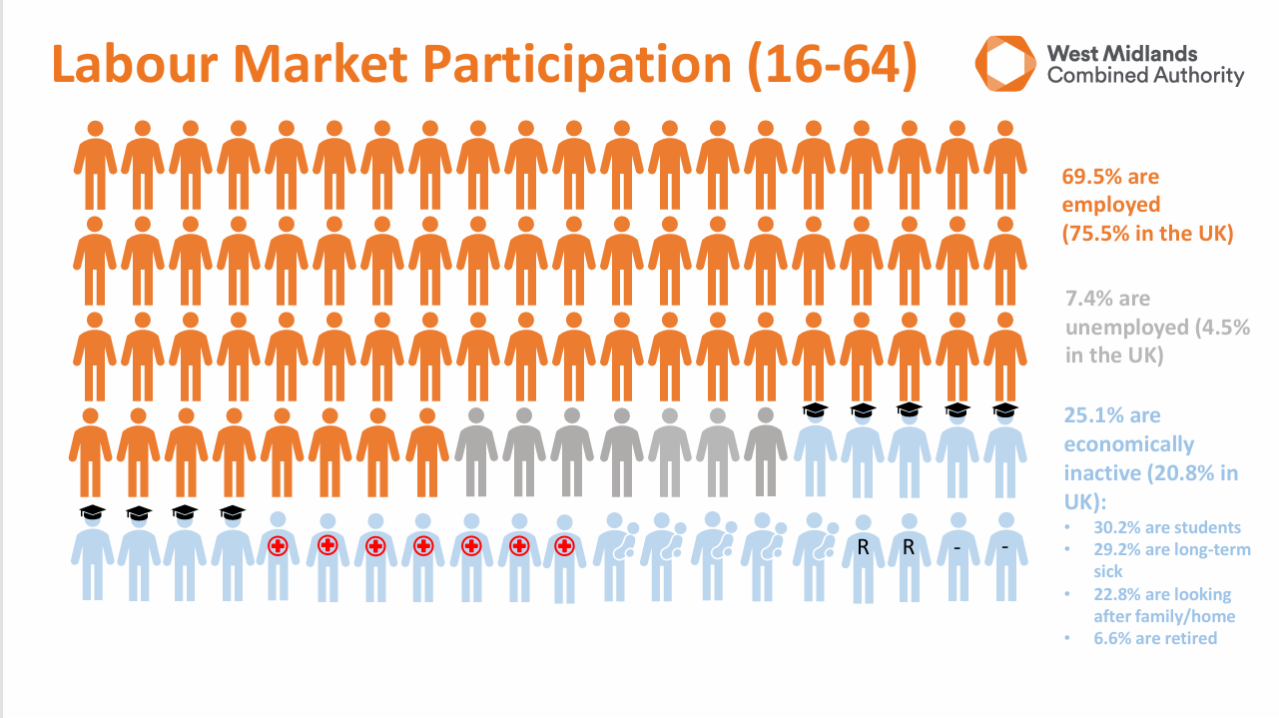

Slide 14
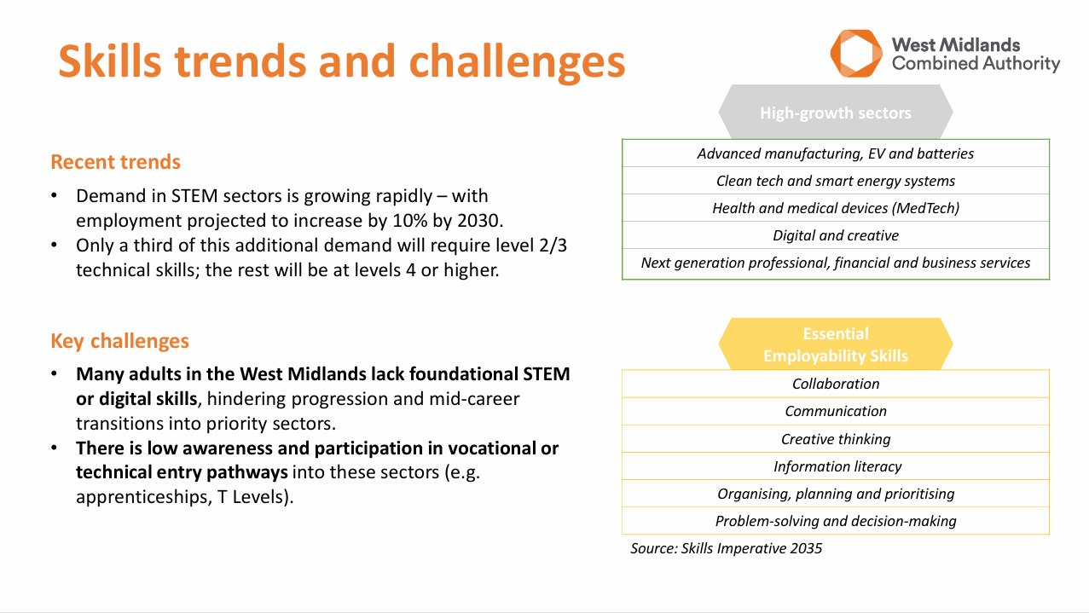

Slide 15
What careers support we offer at school
We deliver careers education in a variety of ways in school
Through PSHE lessons. Every year group has a series of lessons in the PSHE curriculum, ranging from identifying skills, in Year 7, to supporting with options in Year 9 and applying to post 16 education in Year 11
One to One interviews with our careers advisor, Mrs Miles. Every student will get AT LEAST one interview, with follow up information given to the pupil
In lessons. Every subject in the school has a dedicated fortnight, when they deliver careers information to all classes about the relevance of their subject to careers.
Work Experience. Year 10s are all given the opportunity for a week’s work experience at the end of Year 10. We are also starting to expand work experience to 5 days work experience in KS3, where we are taking pupils out to experience the workplace.
Assemblies and visitors. We invite employers and other education providers into school to speak to pupils about opportunities outside of school.
Bespoke opportunities. Mrs Miles, our careers advisor takes pupils out on invitation or self referral to engage with employers and the workplace .
Year 10/11. We hold a Careers Fayre, with local post 16 providers and employers have a stand and it gives the pupils an opportunity to engage with other providers and ask questions.
Year 10/11 we hold CV workshops and a mock interview day, where external people come into school and give every Year 11 an opportunity to have a mock interview, with feedback. This is supported in PSHE lessons.

Slide 16
What do you need to know?
What different qualifications are available?
What do “levels” mean?
What are the most desirable skills for employers?
What do we mean by sectors or industries?
How to apply for post 16 opportunities in education and the workplace

Slide 17
What do “levels” mean?
Entry Level – foundational, pre-GCSE courses designed to help students with special educational needs, those not ready for Level 1, or those who didn't achieve GCSEs. They are divided into three sub-grades (Entry 1, Entry 2, and Entry 3).
Level 1 - Level 1 qualifications are primarily designed for students who are just starting out in formal education, looking to learn a new subject, or need to build core academic and practical skills before advancing. They generally serve as a foundational stepping stone.
1
Level 2 – These are equivalent to GCSE grades 4-9. They designed for school leavers, adult learners, and employees looking to build foundational knowledge.
2
Level 3 - Level 3 qualifications are academic, vocational, or technical courses typically taken by students aged 16 to 18 after completing their GCSEs. They are equivalent to A Levels and are generally required for entry into university or higher education.
3
Level 4+ This is for post 18 education
4

Slide 18
What different qualifications are available?
A Levels
Level 3.
More academic qualifications, with an exam at the end.
Specific subject based:
Eg:
Biology
History
Vocational qualifications
More practical, linked to work.
Eg Health and Social Care, Applied Science.
Levels range from 1-7
Most common are BTEC and T Level (video next slide)

Slide 19

What are T Levels?

Slide 20
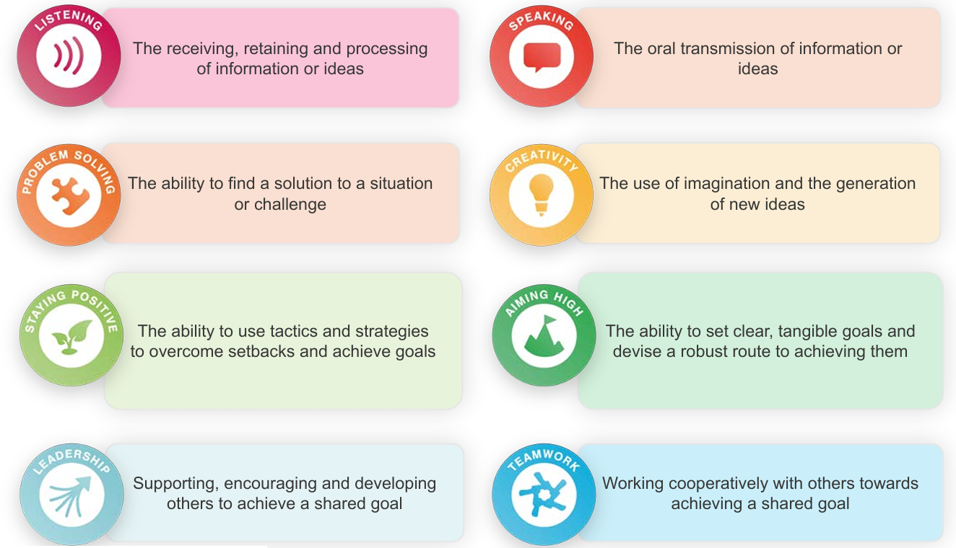
What are the most desirable skills for employers?

Slide 21
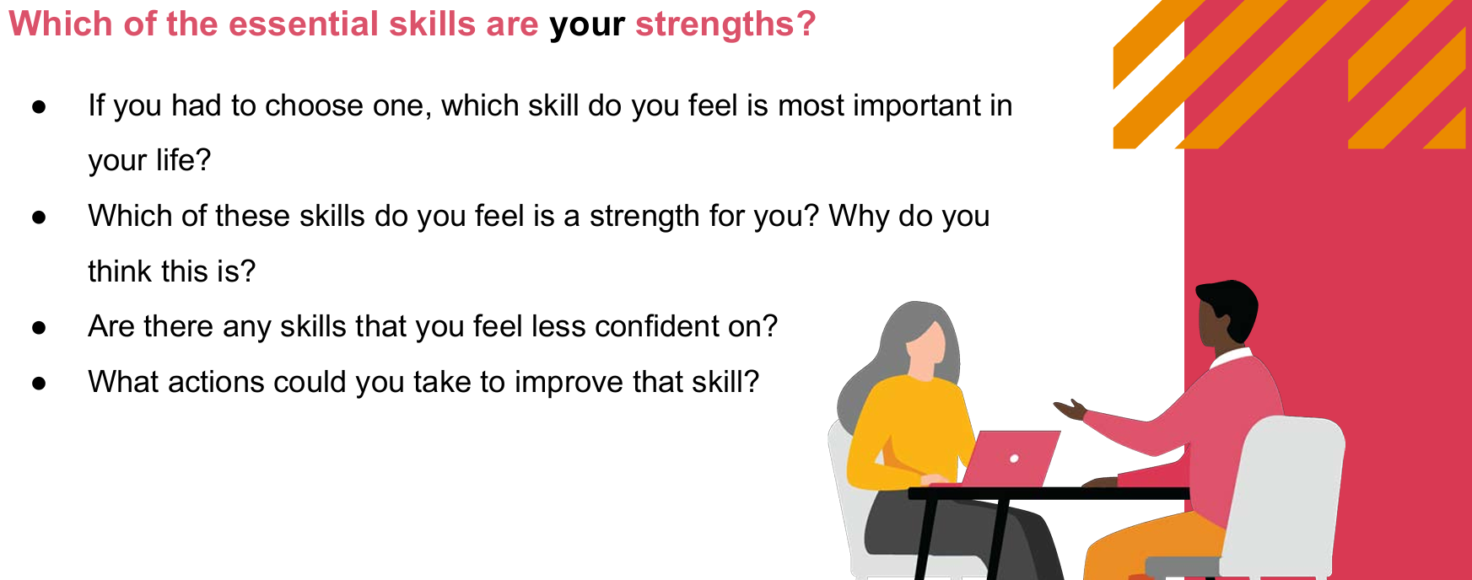
Things to talk to your daughter about:

Slide 22
Extra support for parents
How can I support my daughter in deciding her next steps?
Parent’s resources developed by PWC (PricewaterhouseCoopers)
Link below:
Using the toolkit at home - Employability Skills Toolkit - PwC UK

Slide 23
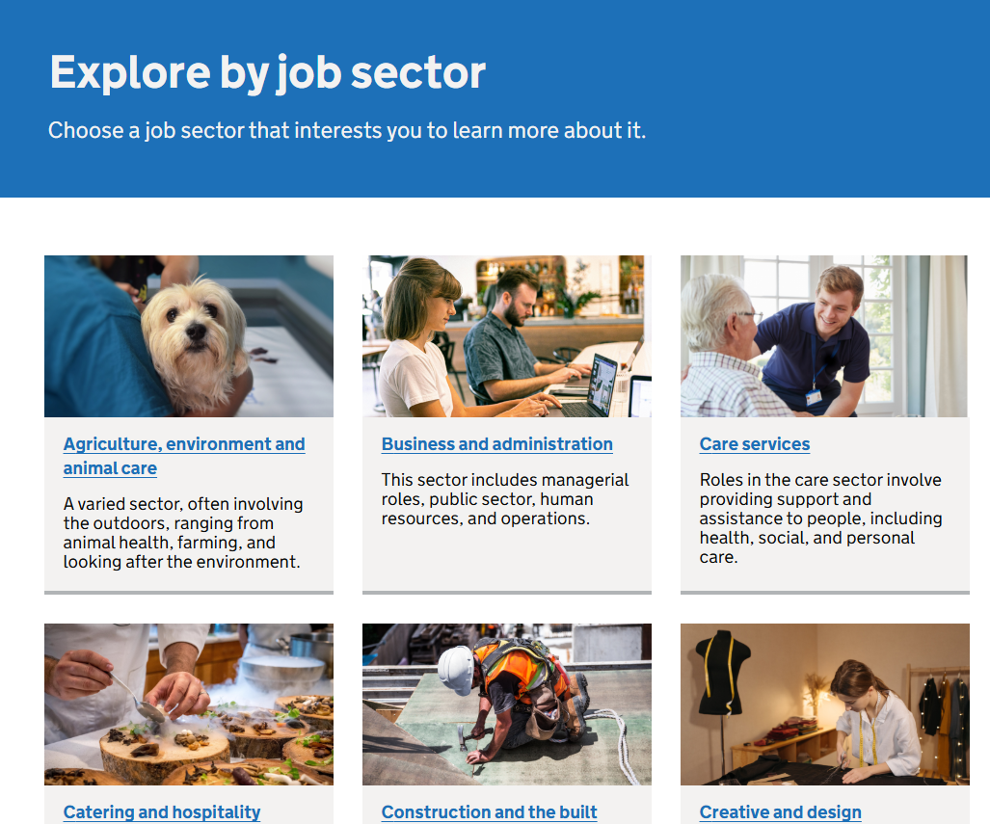
What do we mean by sectors or industries?
One way to think about careers is by looking at sectors rather than specific jobs.
There are multiple jobs available in each sector, to help narrow down what you are interested in doing.
For example, Health and Science. If you click on the link opposite, and navigate to Health and Science, there are 177 different careers profiled

Slide 24
How to apply for post 16 opportunities in education and the workplace
We have made a series of PowerPoints about how to apply for our most popular post 16 providers on the school website. Please look at those for help
For apprenticeships, most apprenticeships are listed on the National Apprenticeship website.
Find an apprenticeship - GOV.UK
You can search by career, sector or distance.
As it is like applying for a job, these are usually ready for application in late Spring/Summer.

Slide 25
What support will pupils will SEND get from the school?
Our Careers Adviser will meet all SEND pupils several times in their time in school.
Pupils will be supported with making their applications.
Learning Support work with pupil destinations to share relevant information.
Bespoke visits arranged to college if needed
Our Careers adviser attends all ECHP reviews

