Slide 1



TITLE: Vocational subjects and
my GCSE Options
Thursday, 25 June 2026
STARTER:
You will be choosing your GCSE options in this half term.

Slide 2
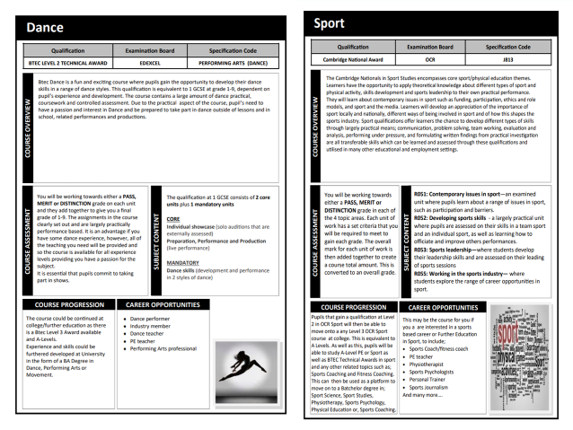
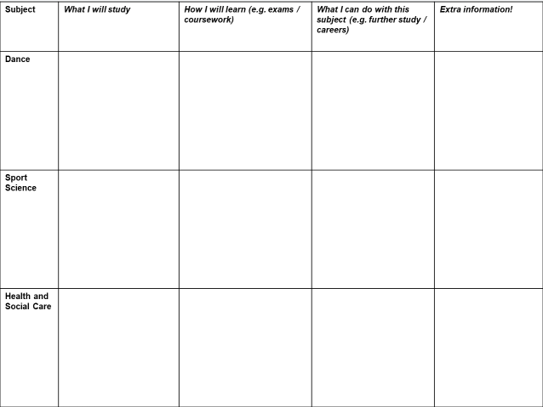
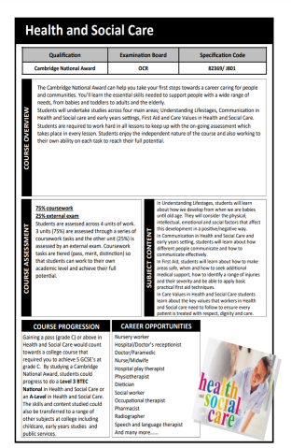
We will now use the vocational subjects pages from the Options Booklet to research how suitable these subjects are for you

Slide 3
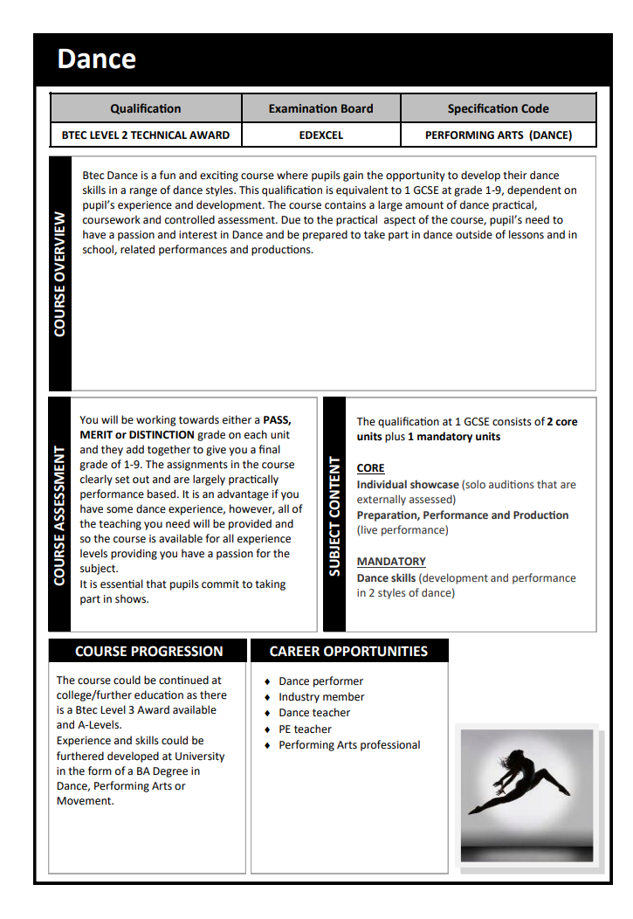
TASK
Use the information from your sheet to fill in the first row of your table: Aim for 2-3 bullet points per box
What I will study | How I will learn (e.g. exams / coursework) | What I can do with this subject (e.g. further study / careers) | Extra information!
e.g. Individual showcase…
e.g. each unit assessed as Pass, Merit or Distinction…
e.g. can lead to BTEC Level 3 or A-level in Dance…
Challenge
Select 1-2 facts for the extra information box

Slide 4

Extra information! Why choose Dance?
https://youtu.be/iOOp3tEEROg

Slide 5

Some of the vocational courses on offer are for qualifications known as the Cambridge National Awards
What are the Cambridge Nationals?
These are courses (equivalent to GCSEs) which are practical, accessible, fun to teach and exciting to learn.
They will inspire students to develop real-world skills to prepare them for their future and allow access to Level 3 qualifications (college) and apprenticeships

Slide 6

Video: Student and teacher overview of Cambridge Nationals
https://youtu.be/arGzDKbtYOU

Slide 7
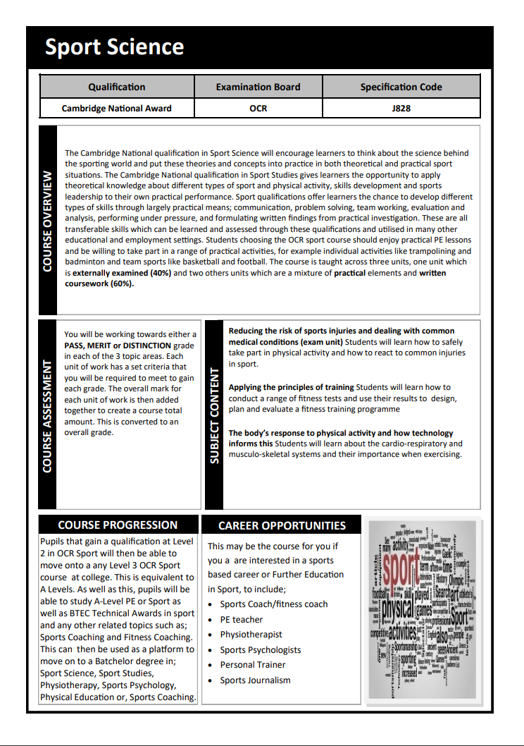
TASK
Use the information from your sheet to fill in the Sport Science row of your table: Aim for 2-3 bullet points per box
What I will study | How I will learn (e.g. exams / coursework) | What I can do with this subject (e.g. further study / careers) | Extra information!
e.g. Reducing risk of sports injuries…
e.g. each topic area assessed as Pass, Merit or Distinction…
e.g. can lead to a Level 3 OCR Sport course at college…
Challenge
Select 1-2 facts for the extra information box

Slide 8

Extra information! Why choose Sport?
https://youtu.be/SnqwK9GDa7s

Slide 9
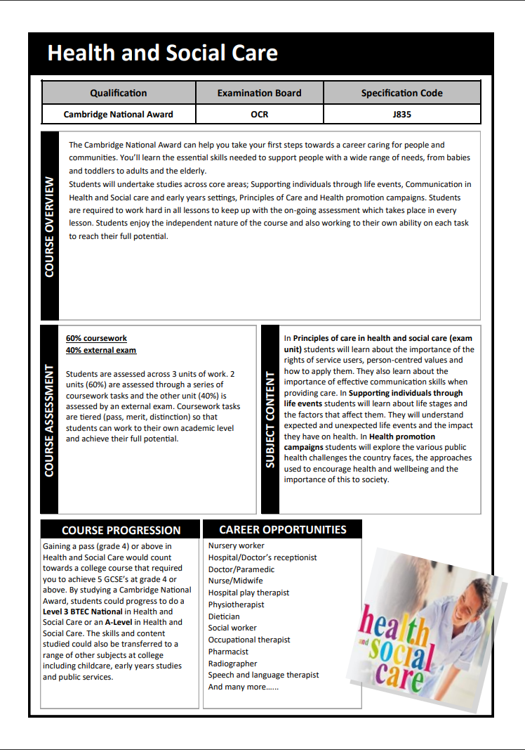
TASK
Use the information from your sheet to fill in the Health and Social Care row of your table: Aim for 2-3 bullet points per box
What I will study | How I will learn (e.g. exams / coursework) | What I can do with this subject (e.g. further study / careers) | Extra information!
e.g. Principles of care in health and social care (exam
unit)….
e.g. 60% coursework
40% external exam…
Challenge
Select 1-2 facts for the extra information box

Slide 10
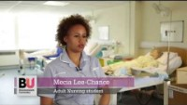
Extra information! Why choose Health and Social Care?
https://youtu.be/yRk8QXEtFbQ

Slide 11

Extension task: On a full page in your book, design a poster to advertise at least one of these vocational subjects

Slide 12
