Slide 1


TITLE: My options for GCSEs in the creative arts and performing arts

Slide 2


TASK: Discuss in pairs
You will be choosing your GCSE options after half term.
BRONZE: Look at the pictures. Which subjects do you think they represent?
SILVER: Look at the pictures. What do you think is the difference between the creative and performing arts?
Creative artists use their creativity to convey an idea or emotion through a medium such as drawing or painting. Performing artists do this through a performance such as drama.

Slide 3

Recap and develop: Before you choose any of your GCSE Options – key dos and don’ts
For pupils in England: careers advice available at https://nationalcareers.service.gov.uk
Or call 0800 100 900
https://youtu.be/Lowf-d62bEw

Slide 4
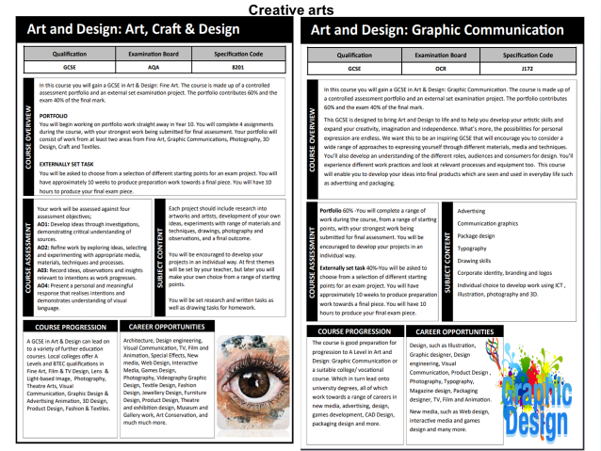
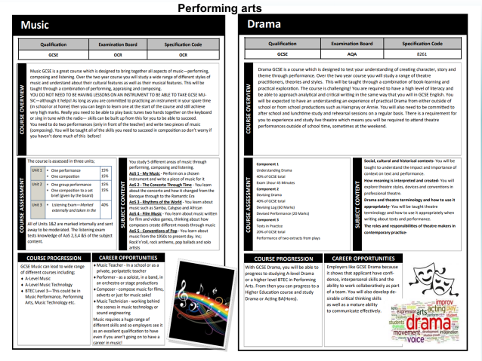
TASK: Read through the pages from the Options booklet on the GCSEs available in creative and performing arts.
Highlight or circle all the information in each GCSE that you find interesting

Slide 5

Extra information! Why choose Art and Design?
https://youtu.be/o5JcQiQDmq0

Slide 6

Extra information! Why choose Music?
https://youtu.be/MvYbJL7slnc

Slide 7

Extra information! Why choose Drama?
https://youtu.be/25FOqNTmsaE

Slide 8
Evaluation: How suitable are these subjects for me?
Remember: You must choose one from French, Geography and History.
You can also select Religious Studies as one of your other three Options
Bronze Challenge: How likely are you to select each subject? Give each one a score out of 5 on your sheet (the higher the score, the more likely you are to choose)
Silver Challenge: As Bronze, but give a reason for the subject you have given the highest score to.
Gold Challenge: Write down at least one question you could ask a teacher to find out more about the subject you are most interested in.

Slide 9


Creative arts

Slide 10
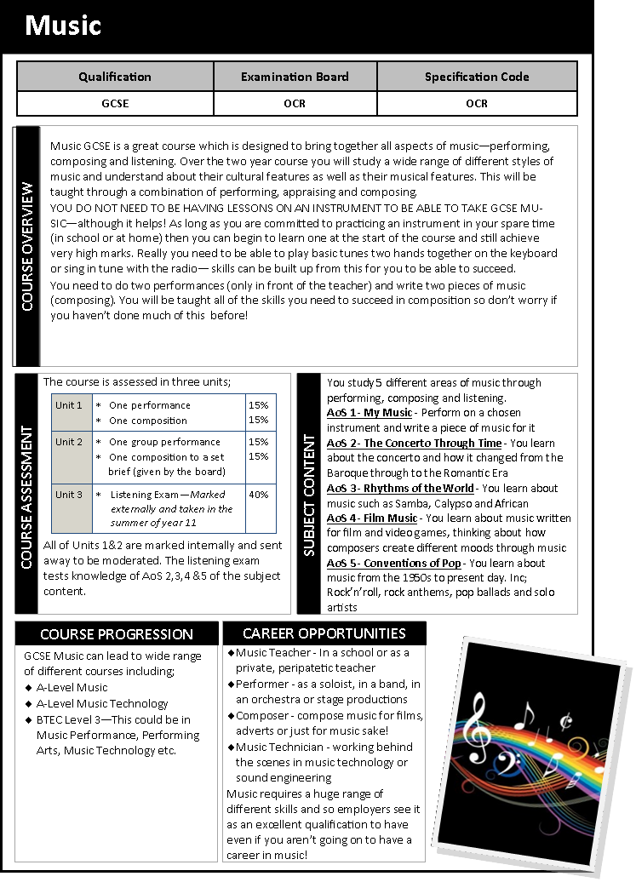
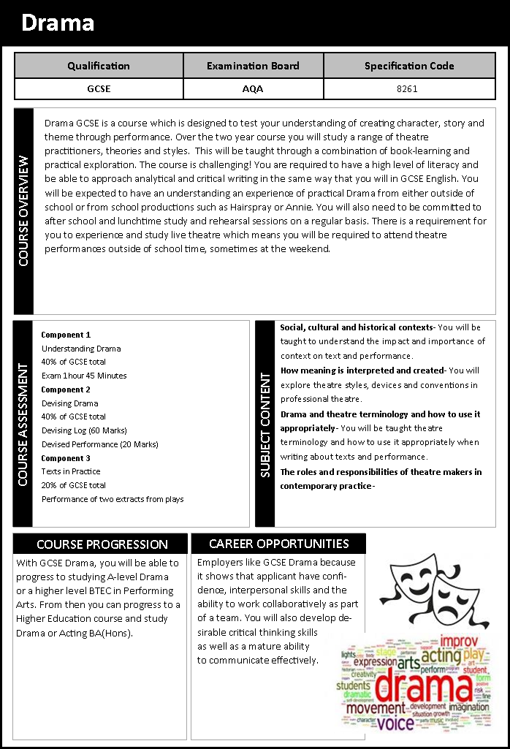
Performing arts

