Slide 1

Before you choose any of your GCSE Options – key dos and don’ts
For pupils in England: careers advice available at https://nationalcareers.service.gov.uk
Or call 0800 100 900
https://www.youtube.com/watch?v=d_ssJV_XfjQ&ab_channel=DepartmentfortheEconomy

Slide 2
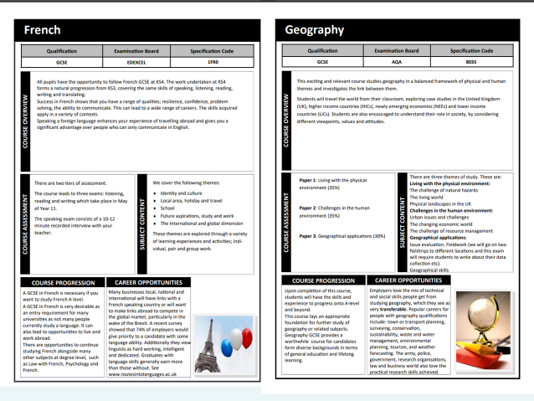
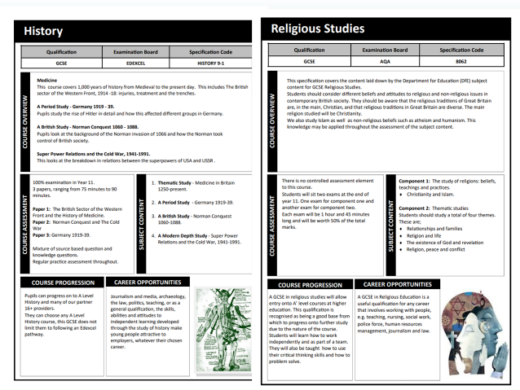
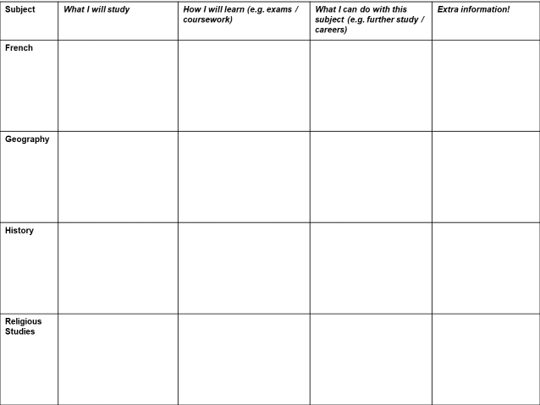
We will now use the Humanities pages from the Options Booklet to research how suitable these subjects are for you
Important Options information!
Most pupils will carry on with French as a GCSE (first 4 groups)
All pupils have to do either Geography or History (but you choose which one)
You can also choose to do GCSE Religious Studies (RE)

Slide 3
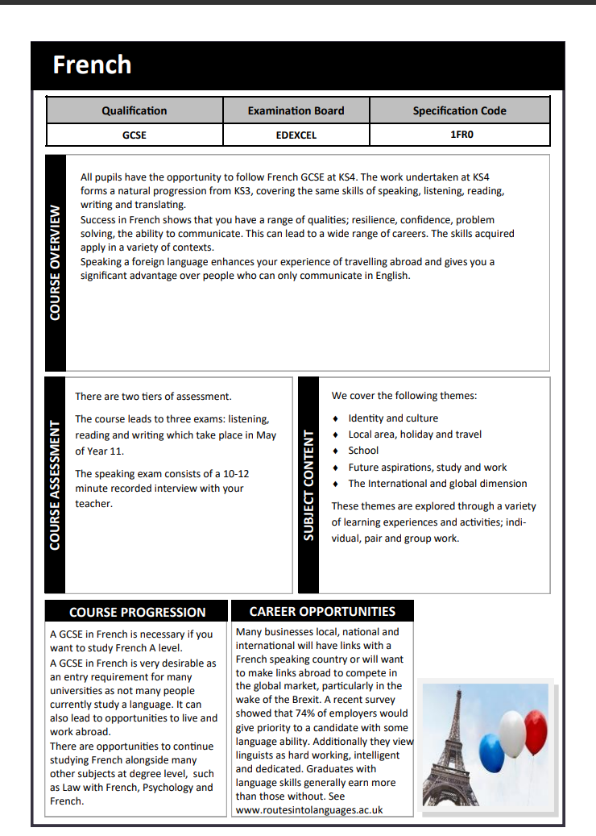
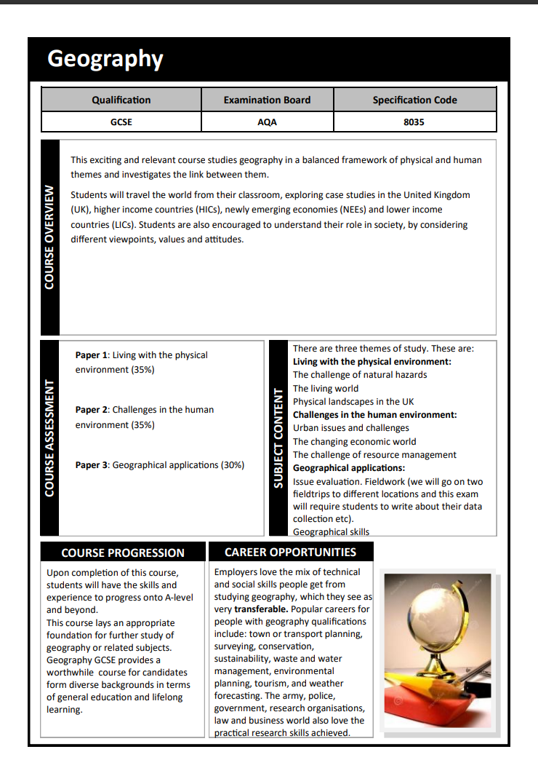

Slide 4
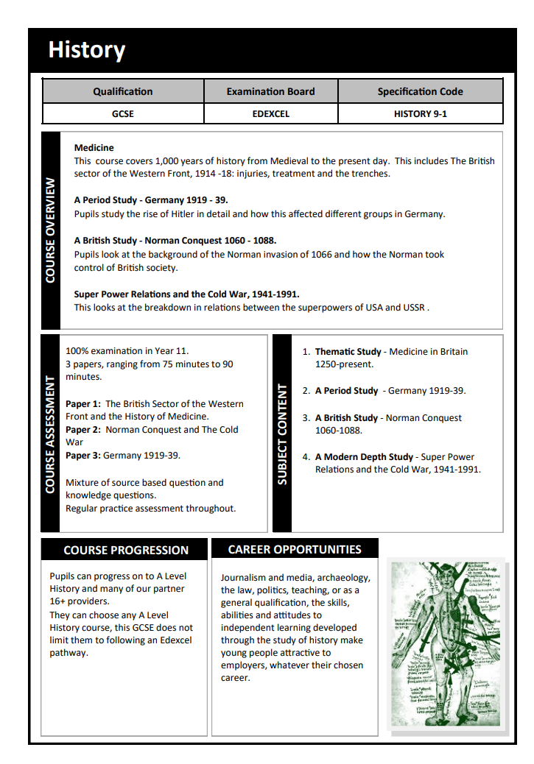
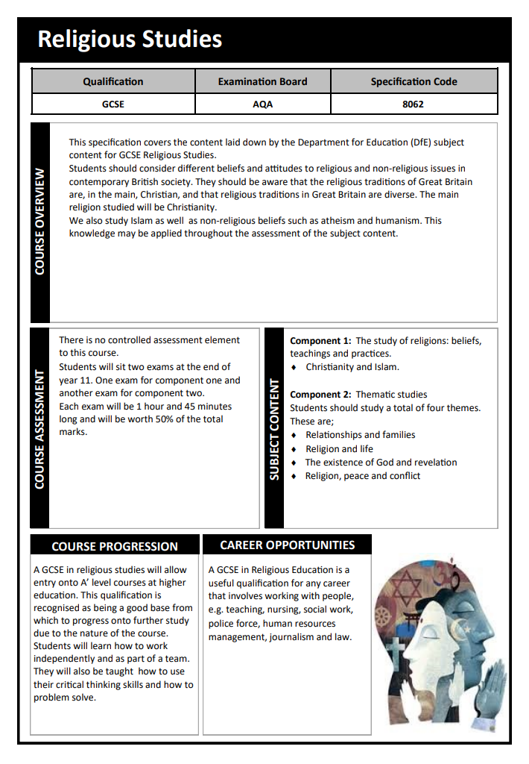

Slide 5

TASK
Use the information from your sheet to fill in the first row of your table: Aim for 2-3 bullet points per box
e.g. three exams…
e.g. can lead to A-level French…
e.g. Identity and culture
Challenge
Select 1-2 facts for the extra information box

Slide 6

Extra information! Why study French?
https://www.youtube.com/watch?v=V7_Z48d4XQI&ab_channel=EFInternationalLanguageCampuses

Slide 7
TASK
Use the information from your sheet to fill in the Geography row of your table: Aim for 2-3 bullet points per box
e.g. Living with the physical environment
e.g. can lead to A-level Geography…
e.g. three exams…
Challenge
Select 1-2 facts for the extra information box

Slide 8





Extra information! Why choose Geography?
Play video
2 Minutes
Notes:
TEACHER NOTES & IDEAS
Play the YouTube video by enabling Content
You can also click the link on Play video
All videos can be found on the Cre8tive Resources YouTube Channel here: https://www.youtube.com/watch?v=o5JcQiQDmq0&list=PL-wgVjjWM93K4MqcECxX5eYEqndP79yK0

Slide 9
TASK
Use the information from your sheet to fill in the History row of your table: Aim for 2-3 bullet points per box
e.g. Medicine in Britain 1250-present
e.g. three exams…
Challenge
Select 1-2 facts for the extra information box

Slide 10

Extra information! Why choose History?
Play video
2 Minutes
Notes:
TEACHER NOTES & IDEAS
Play the YouTube video by enabling Content
You can also click the link on Play video
All videos can be found on the Cre8tive Resources YouTube Channel here: https://www.youtube.com/watch?v=o5JcQiQDmq0&list=PL-wgVjjWM93K4MqcECxX5eYEqndP79yK0

Slide 11
TASK
Use the information from your sheet to fill in the Religious Studies row of your table: Aim for 2-3 bullet points per box
e.g. The study of religions: beliefs,
teachings and practices.
Christianity and Islam.
Challenge
Select 1-2 facts for the extra information box

Slide 12

Extra information! Why choose Religious Studies?
https://www.youtube.com/watch?v=jQTMETwqcKs&ab_channel=KimStephen%28KnownasMrsPope%29

