Slide 1

How can English and STEM subjects help your future?
Thursday, 25 June 2026

Slide 2
You will be choosing your GCSE options after half term.
But there are some subjects you will have to do…
BRONZE: Why do you think that a good grade in GCSE English is so important to getting on a course after GCSEs (A-level / BTEC / apprenticeship) or just starting a job?
SILVER: Why do you think you will also need a good grade in GCSE Maths ?
GOLD: What do the letters STEM stand for? Why are these subjects associated more with boys than girls?

Slide 3



Key terms
Core Subjects – English, Maths and Science.
STEM – Science, Technology, Engineering and Maths.
Engineering - the branch of science and technology concerned with the design, building, and use of engines, machines, and structures.

Slide 4
Key stage 4
During key stage 4 (Y10 and 11) most pupils work towards national qualifications - usually GCSEs.
The government sets compulsory national curriculum subjects are the ‘core’ subjects (which must be taken as full subjects) and ‘foundation’ subjects which must be covered in some form.
Core subjects are:
English
maths
Science
Foundation subjects are:
computing
physical education
PSHRE / citizenship (PSHE combined with elements of RE)
What do you think these are?

Slide 5
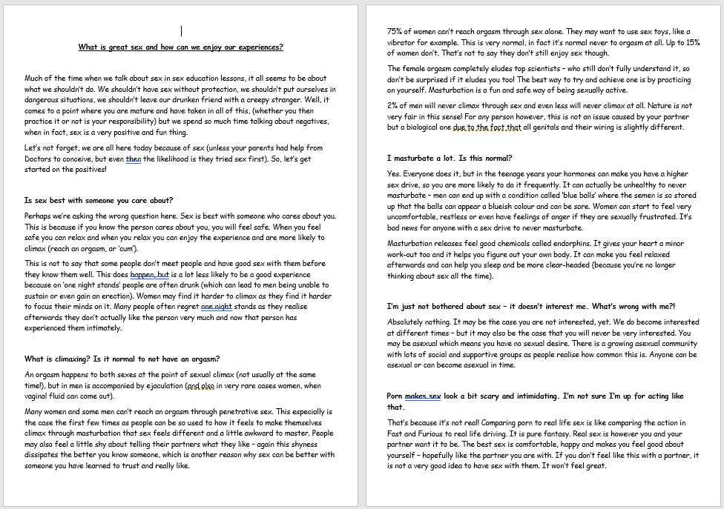
Research:
We will now find out more
about why we place such an
emphasis on English, Maths and
Science at school as a core
for entering the work
environment and the kind
of career opportunities offered by
studying STEM subjects further.
TARGETED READING!
As you read through the sheet, highlight
or underline three key facts in each section

Slide 6

Top 10 Stem Careers: make a list
https://www.youtube.com/watch?v=-sKFHQjZg0s&t=159s&ab_channel=10JawDroppingFacts

Slide 7
Women in STEM
Why careers in STEM are open to everybody
https://www.youtube.com/watch?v=K_jwslpAZhI&ab_channel=bournemouthuni

