Slide 1


How to apply

Slide 2

Navigate to the Halesowen website
Home - Halesowen College

Slide 3
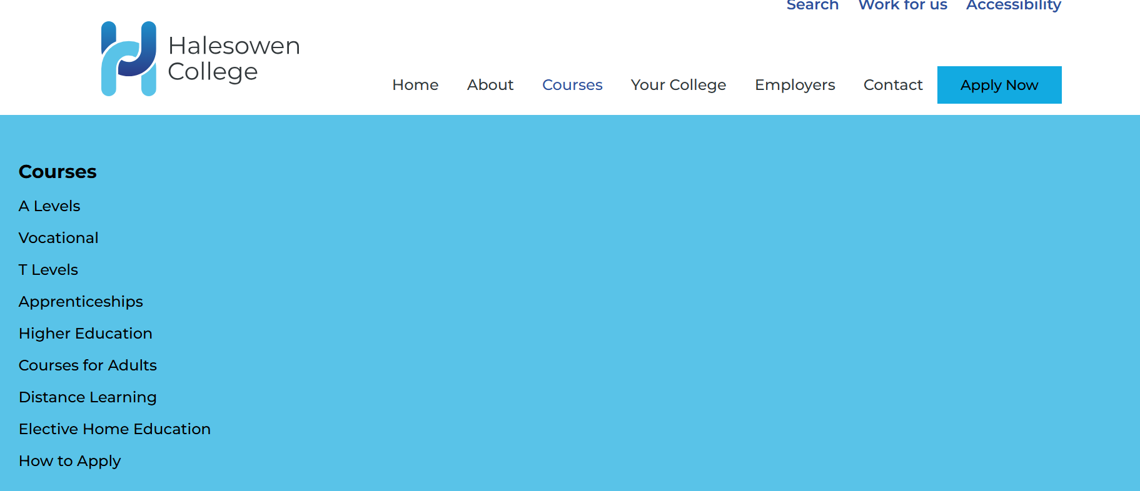
Go to courses:
A Levels are more academic subjects, like History or Physics
Vocational are more practical subjects, like Health and Social Care, construction or Hair and Beauty
T Levels are Vocational qualifications with a work placement included
Apprenticeships are work based, with some training in college
HIGHER Education is for 18+

Slide 4
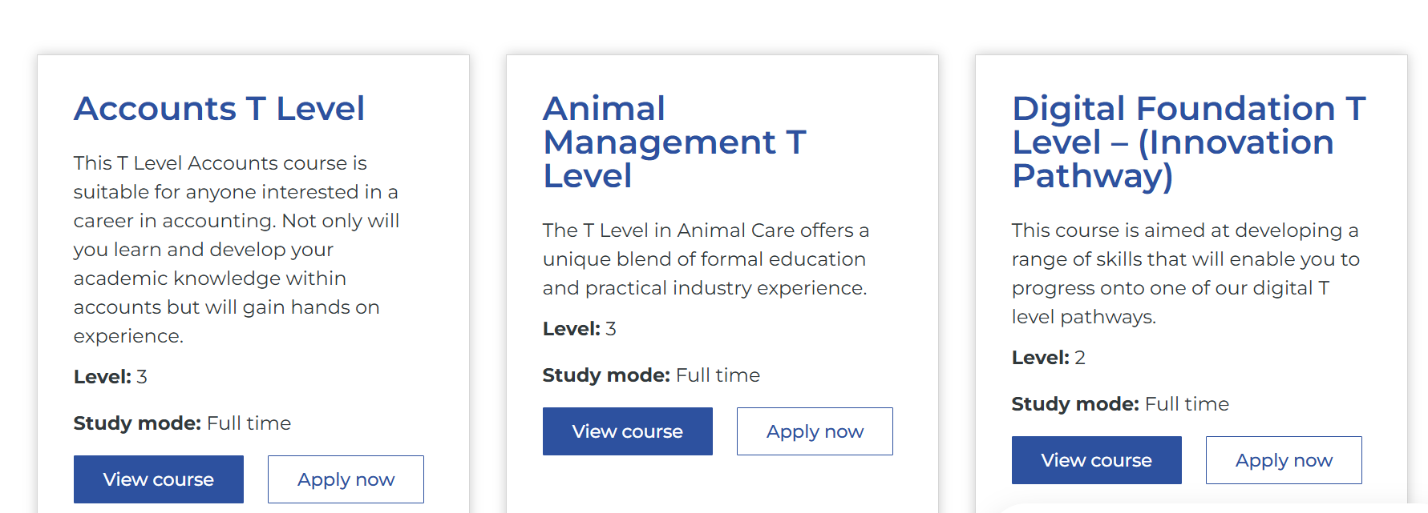
Choose a course option: (1)T Levels.
You will only pick one of the options available for T Levels

Slide 5
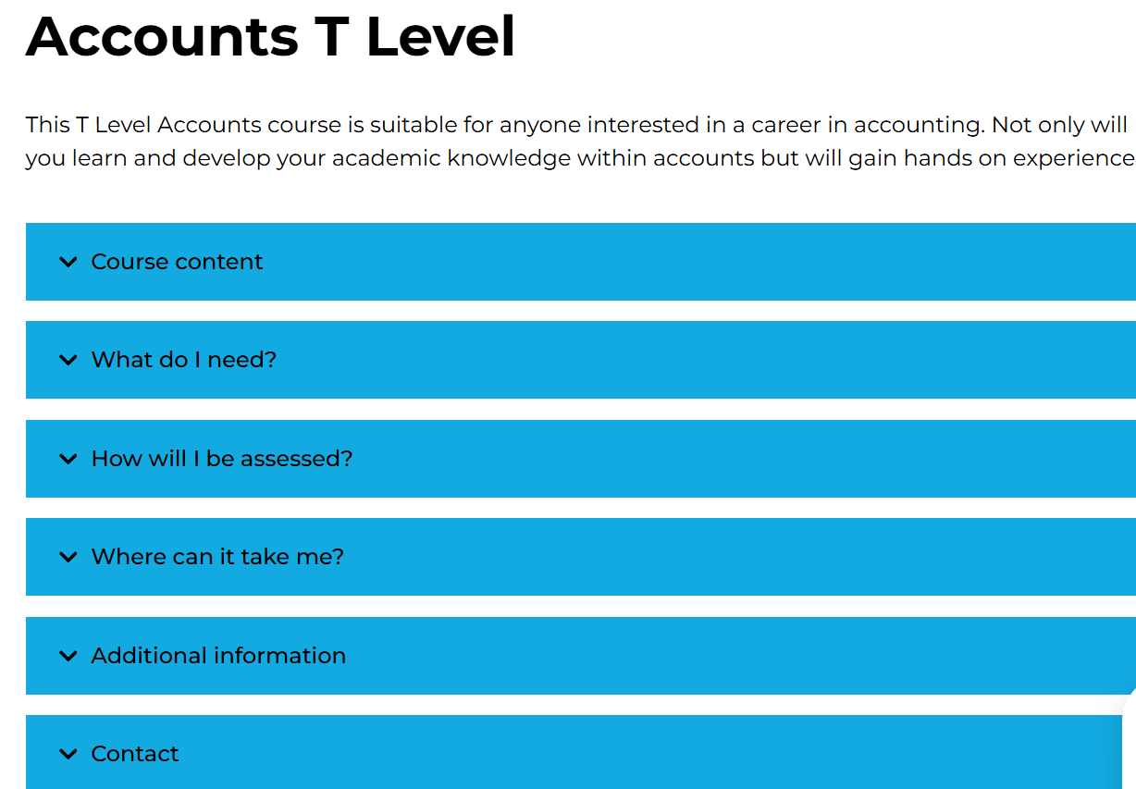
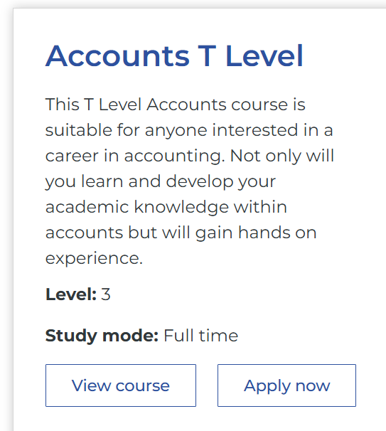

Slide 6
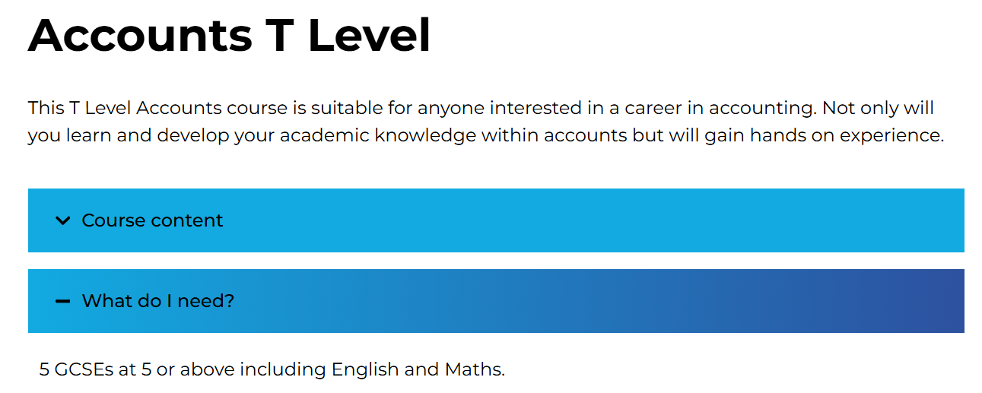
Look at the content and the entry requirements (What do I need)

Slide 7


Slide 8
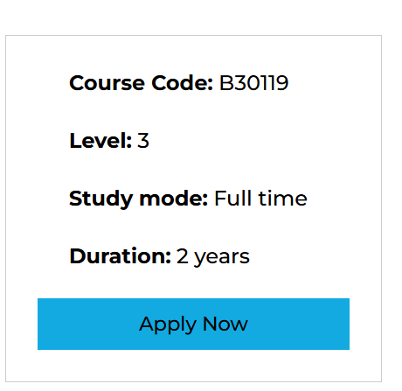
If you are interested, click Apply Now
I will go through how to fill out the form in slide 15.

Slide 9
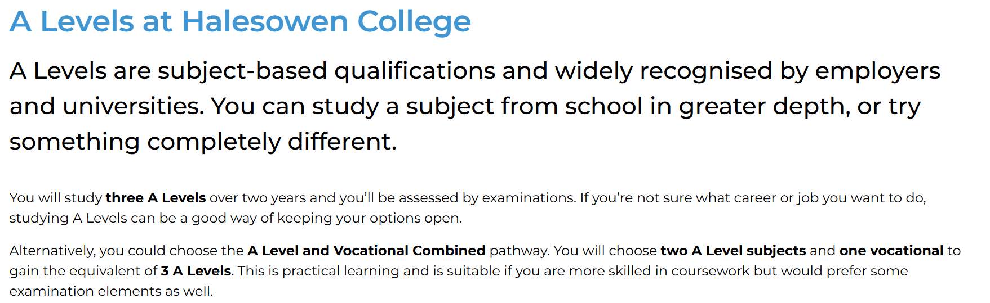
Choose a course option: (2) A Levels

Slide 10
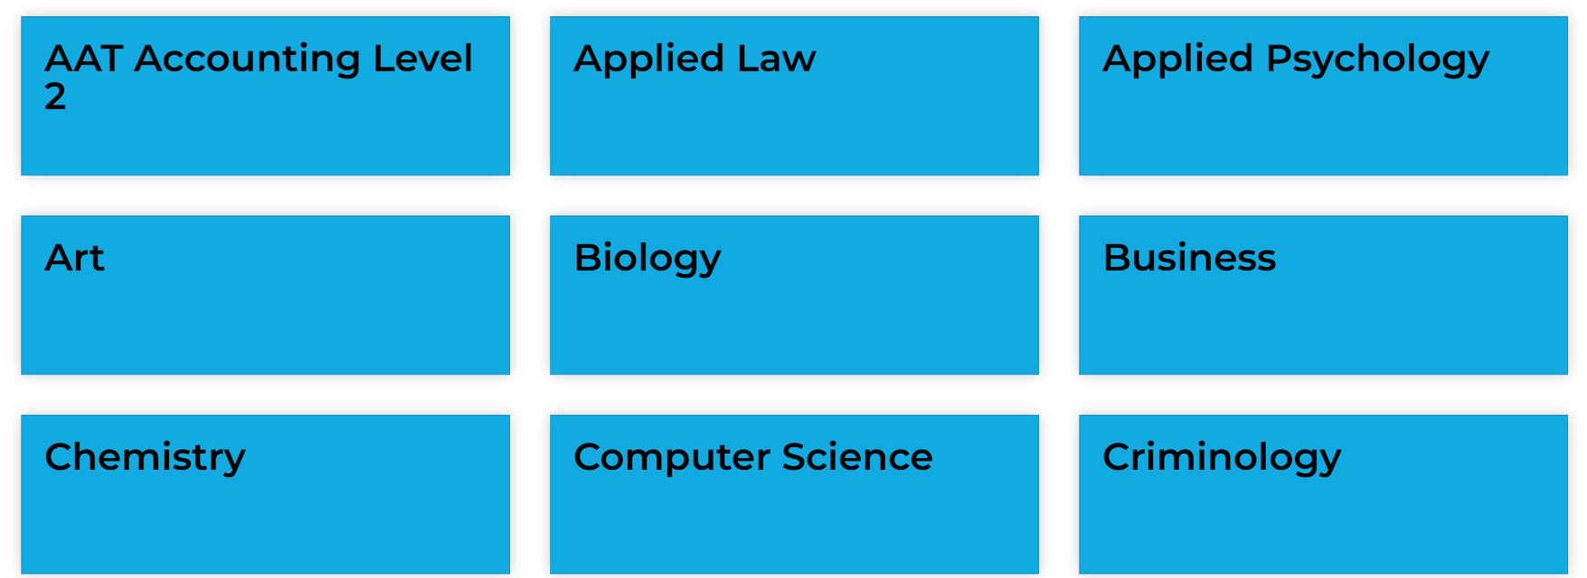
There are a HUGE range of A Levels at Halesowen. Here are just some of them:

Slide 11
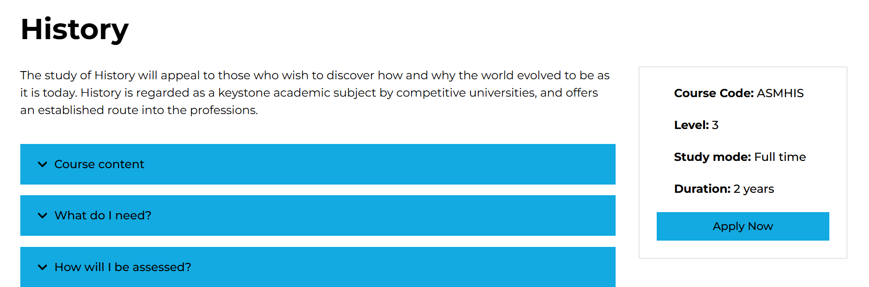
Check the course content. Is it something that sounds interesting?

Slide 12
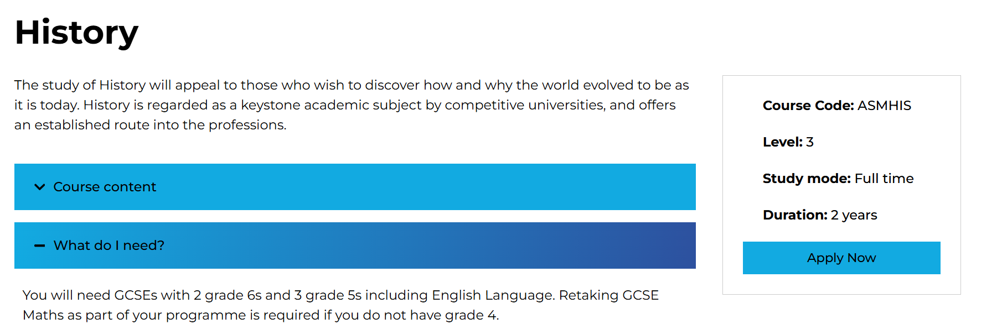
Entry Requirements. Do they match with predicted grades? Each subject will have its own requirements.

Slide 13
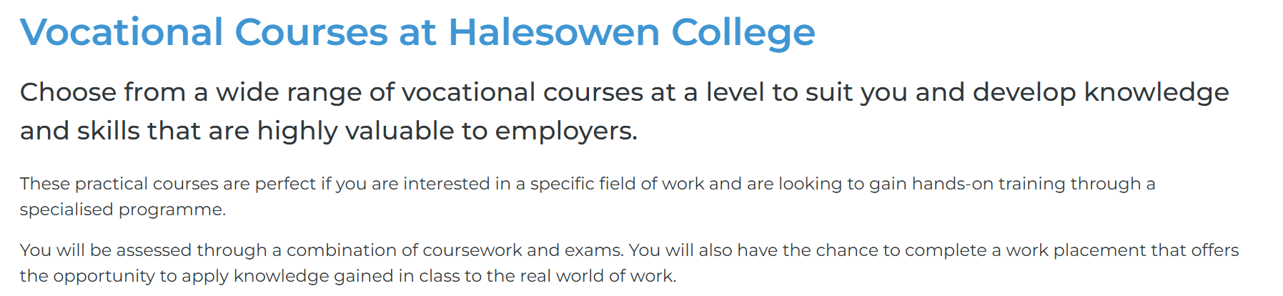
Choose a course option: (3) Vocational

Slide 14
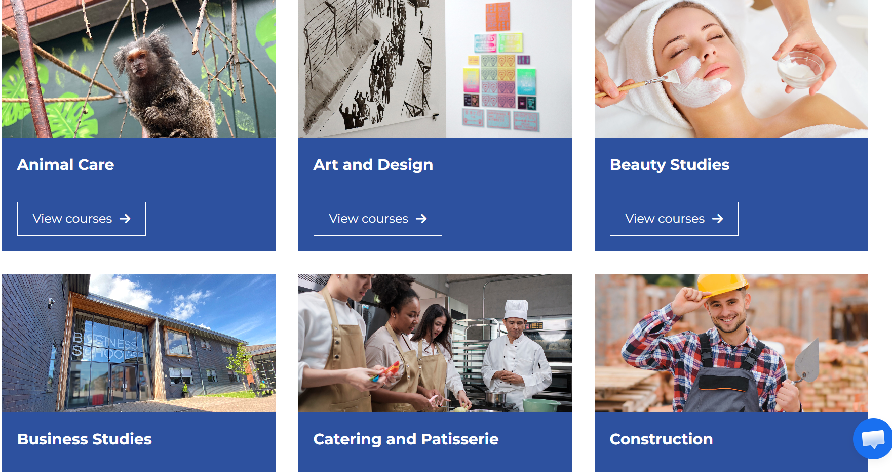
There are a lot of vocational choices. Here are just some of them:

Slide 15

How to apply:

Slide 16
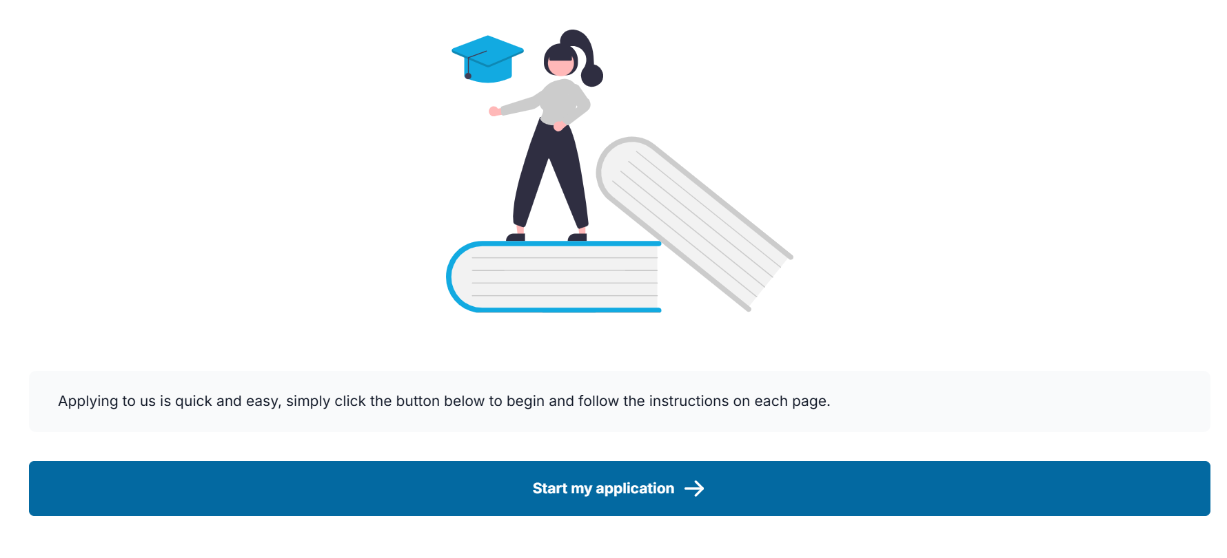

Slide 17
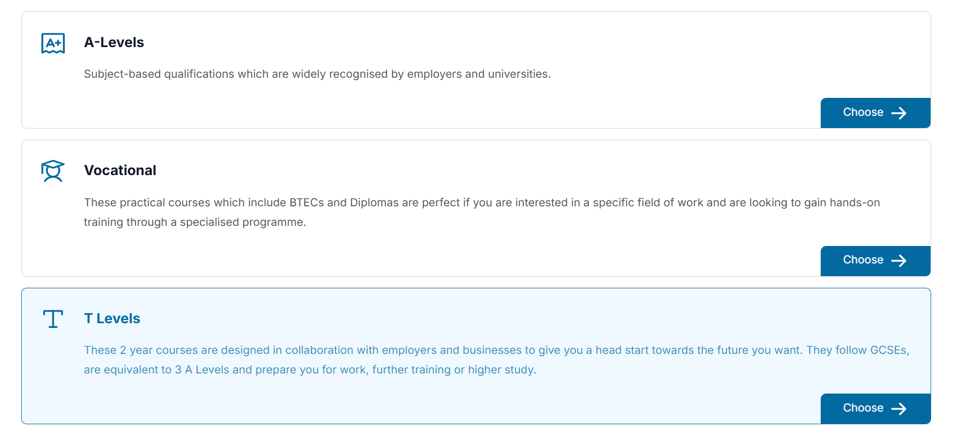
Pick your option:

Slide 18
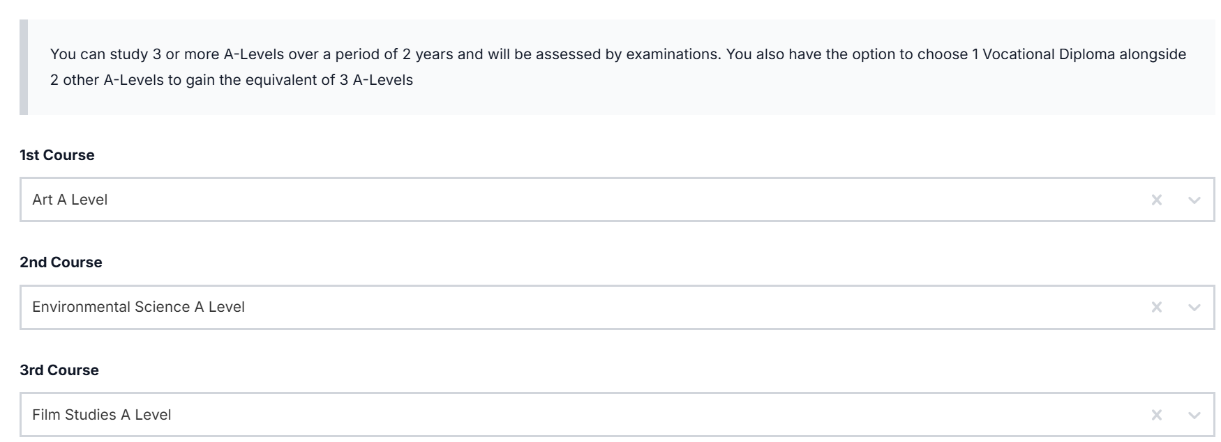
Example: A Levels

Slide 19
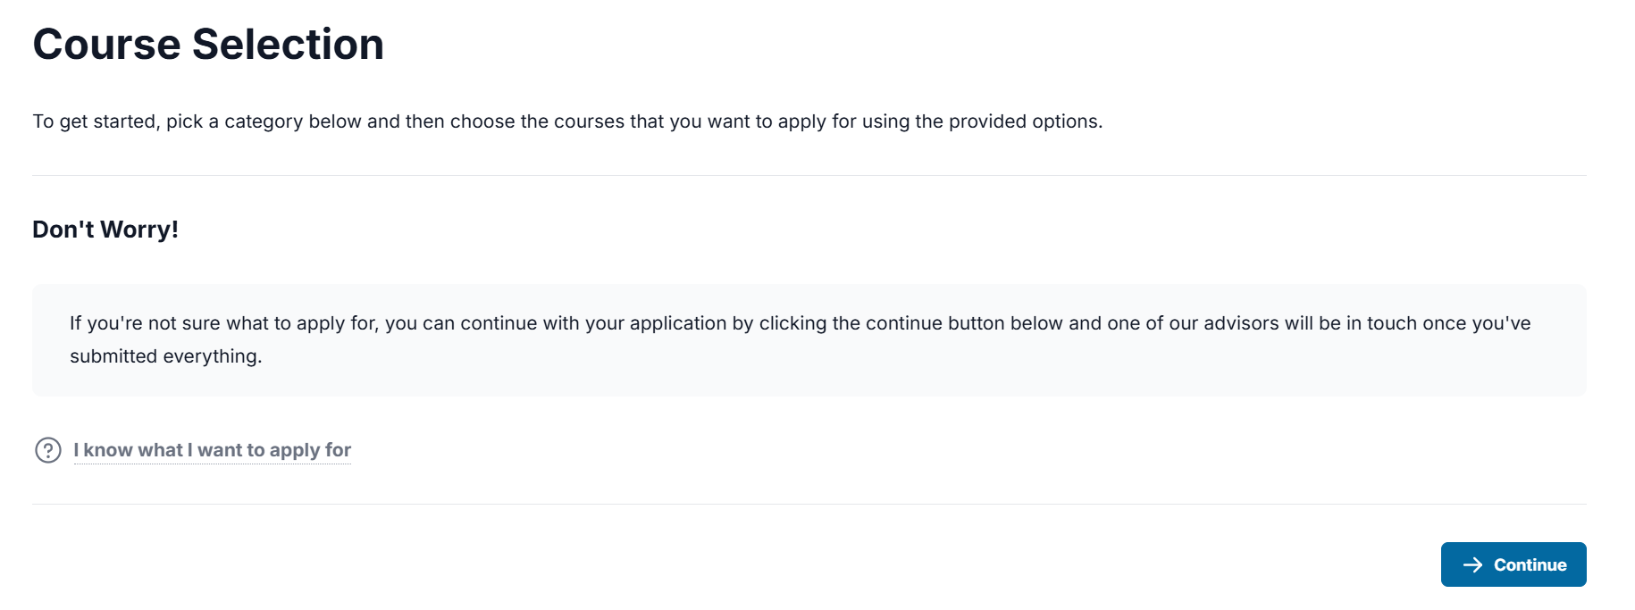
If pupils can’t decide what to pick?

Slide 20
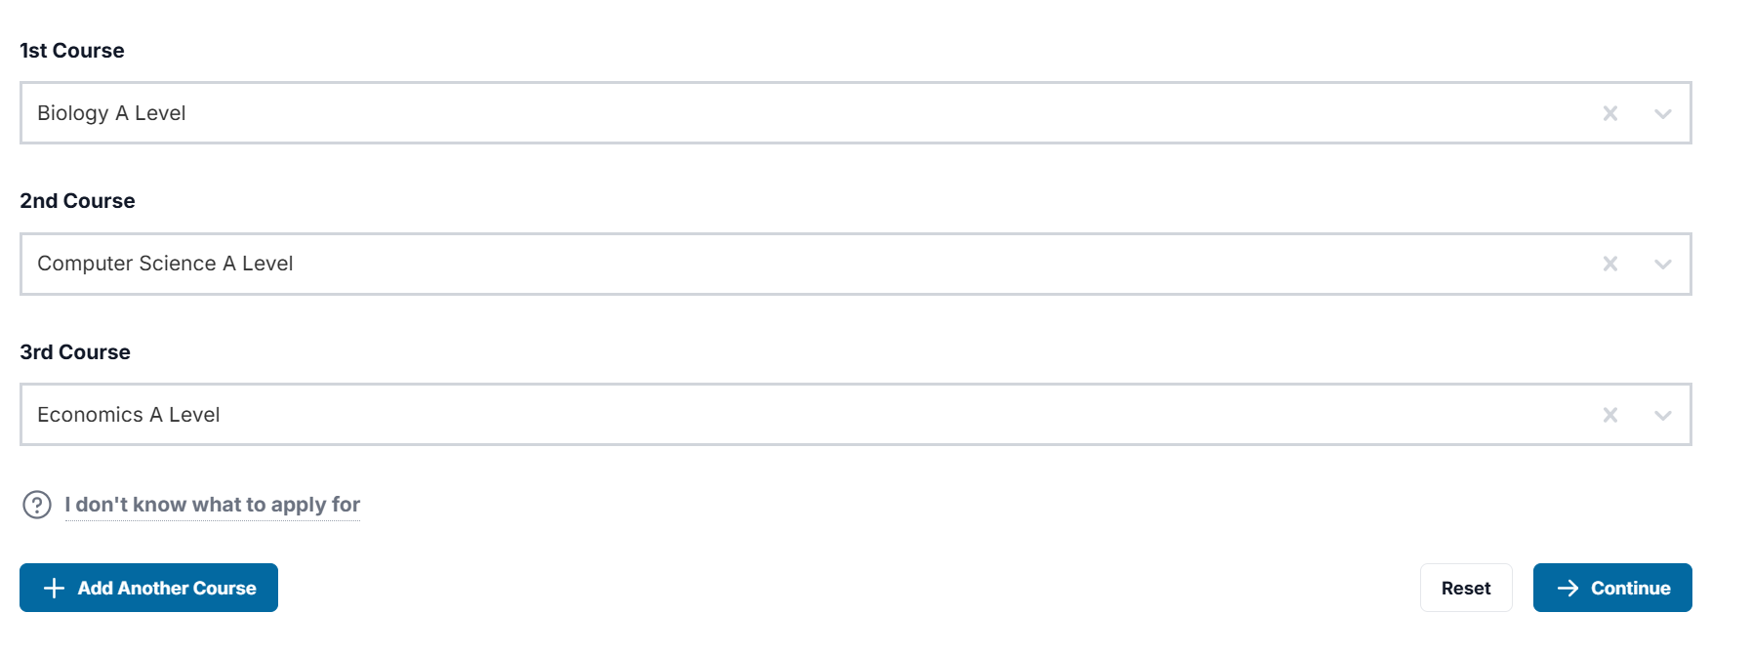
Click continue

Slide 21
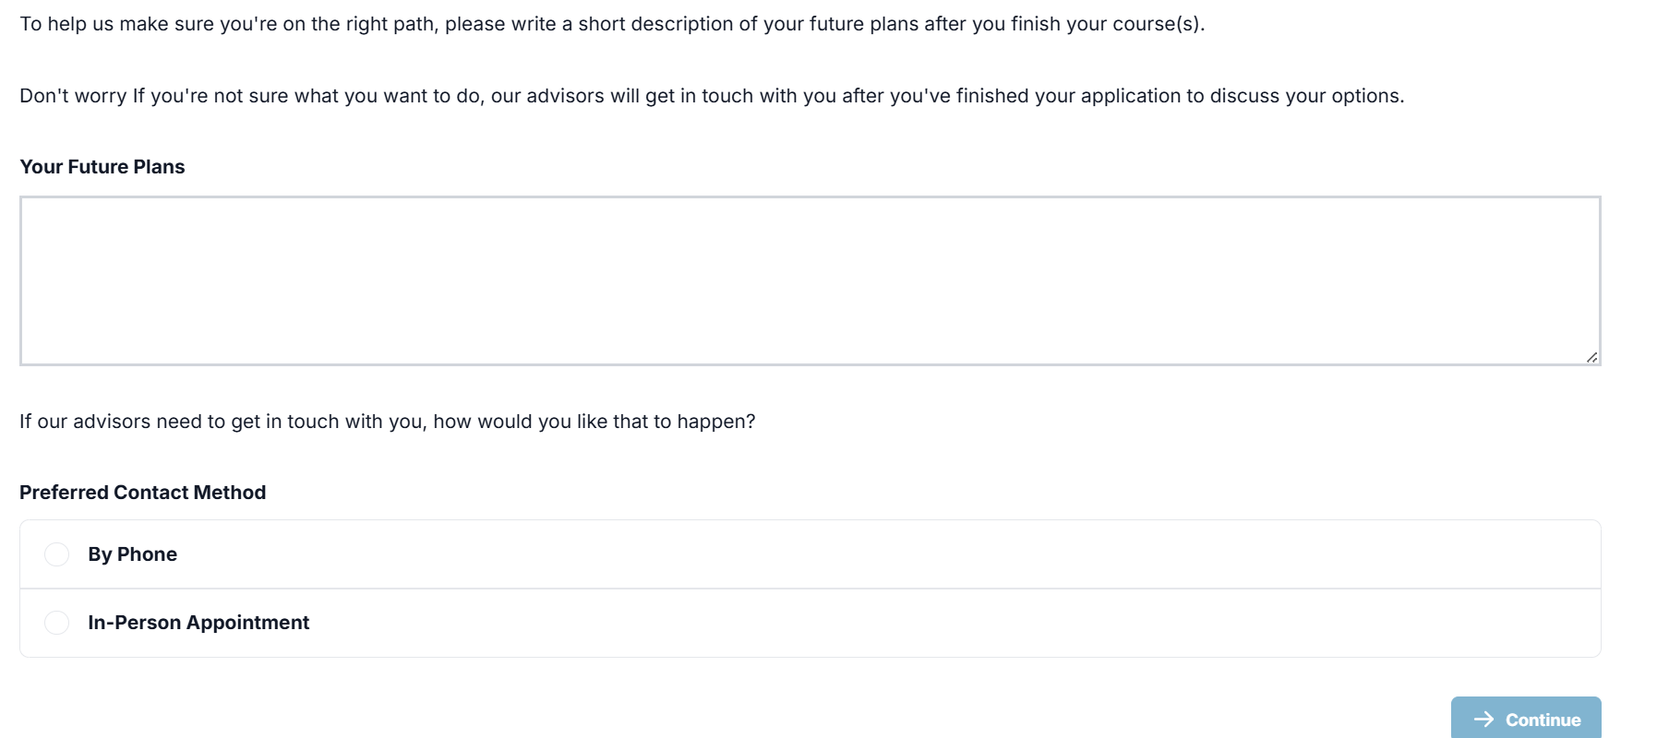
There is a page on pupil’s future plans (if they know what they want to do)
There is also an option of how they can contact pupils to call them for interview.

Slide 22
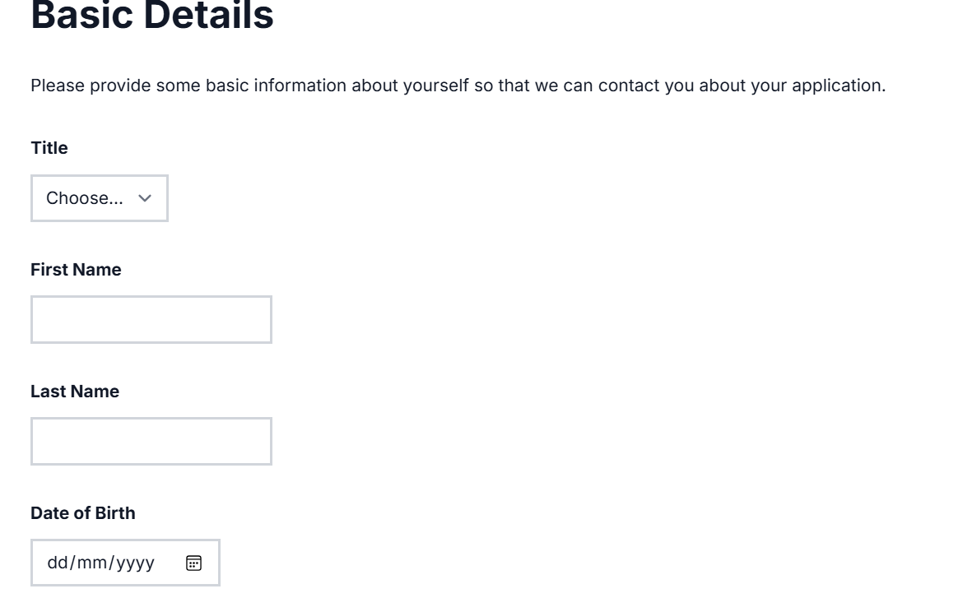
Then fill in your personal details

Slide 23
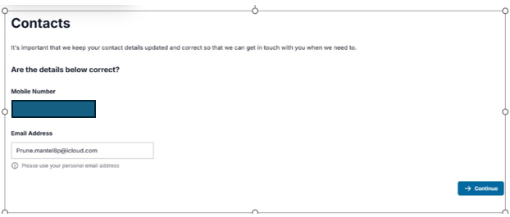
Do not use school email address. Pupils will lose access to this when they leave.

Slide 24
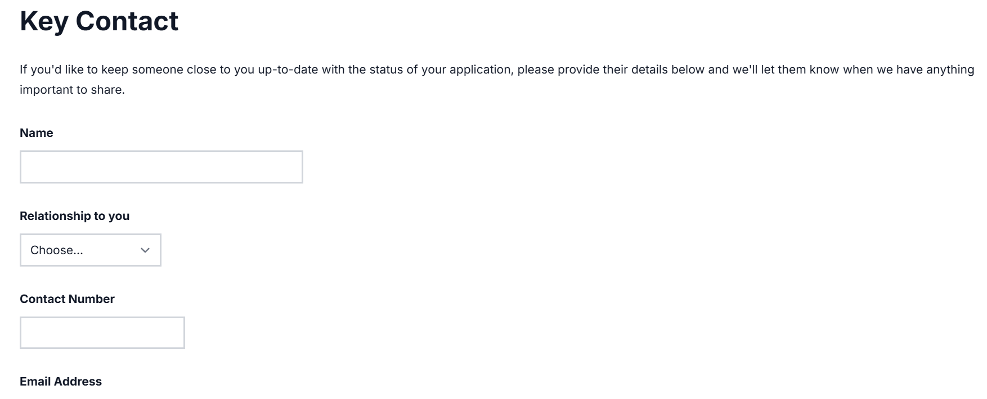
You could put a parent in this section.

Slide 25
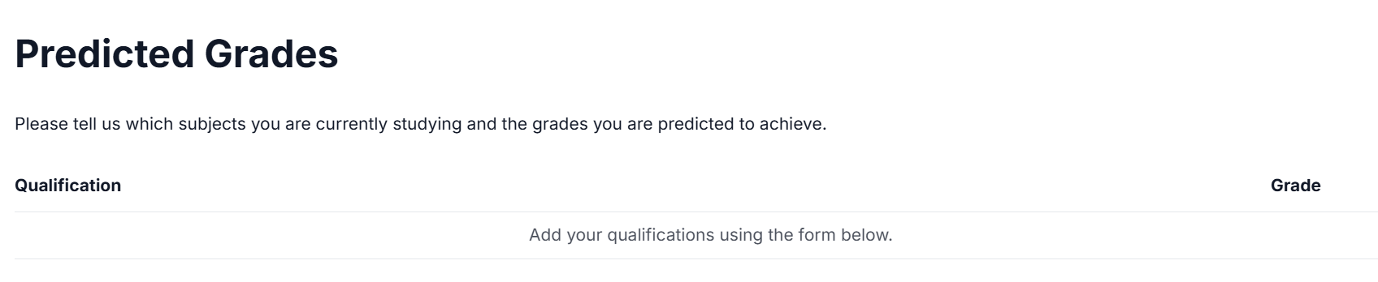
Add in predicted grades here. Use your most recent school report.

Slide 26
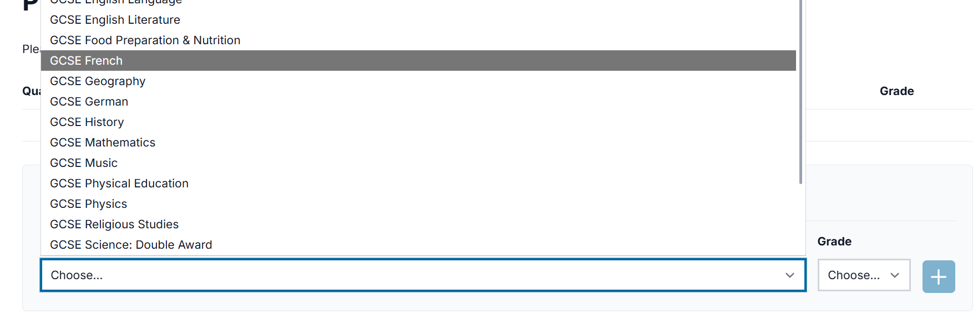
Pick each GCSE subject you are taking from the list

Slide 27
Keep adding current GCSE subjects with:

Slide 28
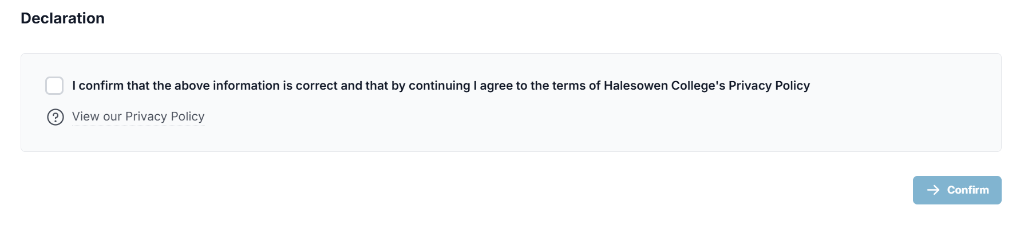
At the end. Confirm and submit.

