Slide 1


How to apply for college:

Slide 2
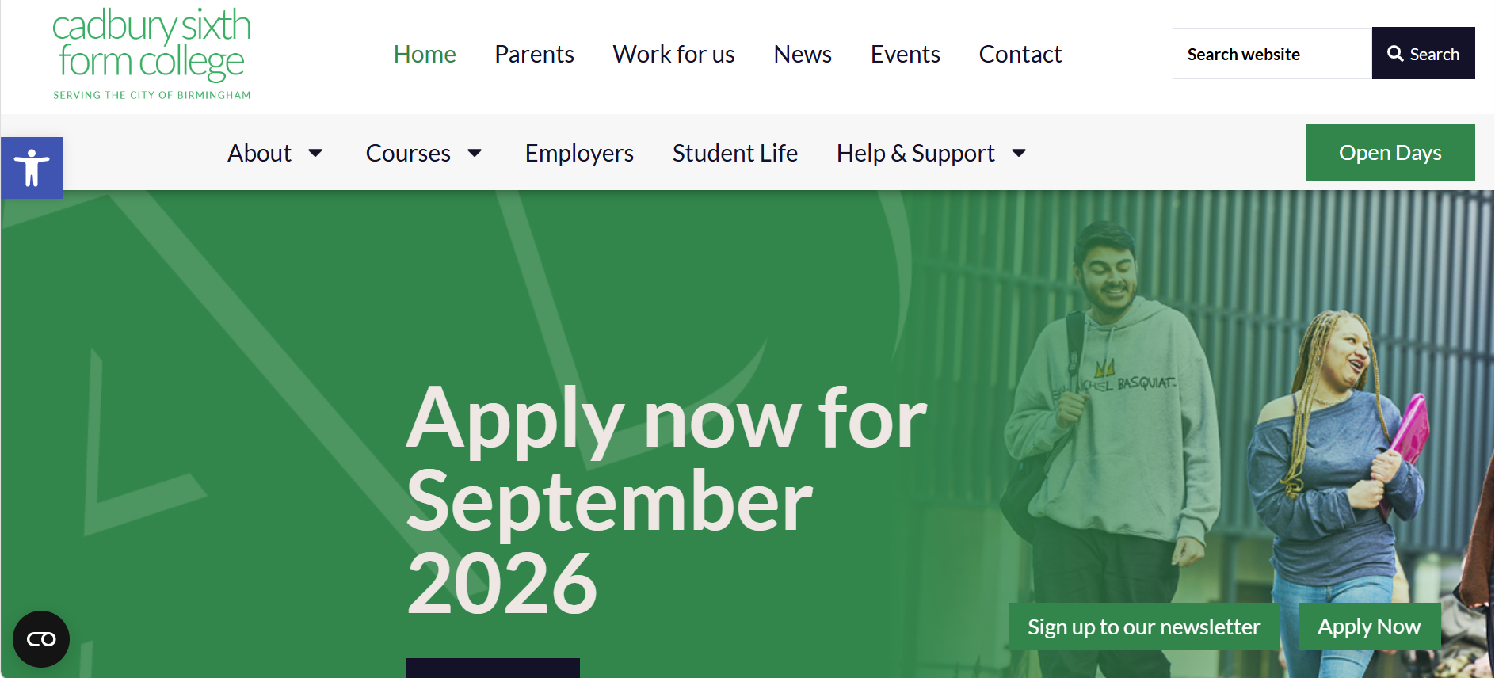
Go to the Cadbury College website:
Cadbury Sixth Form College Birmingham | CadCol

Slide 3
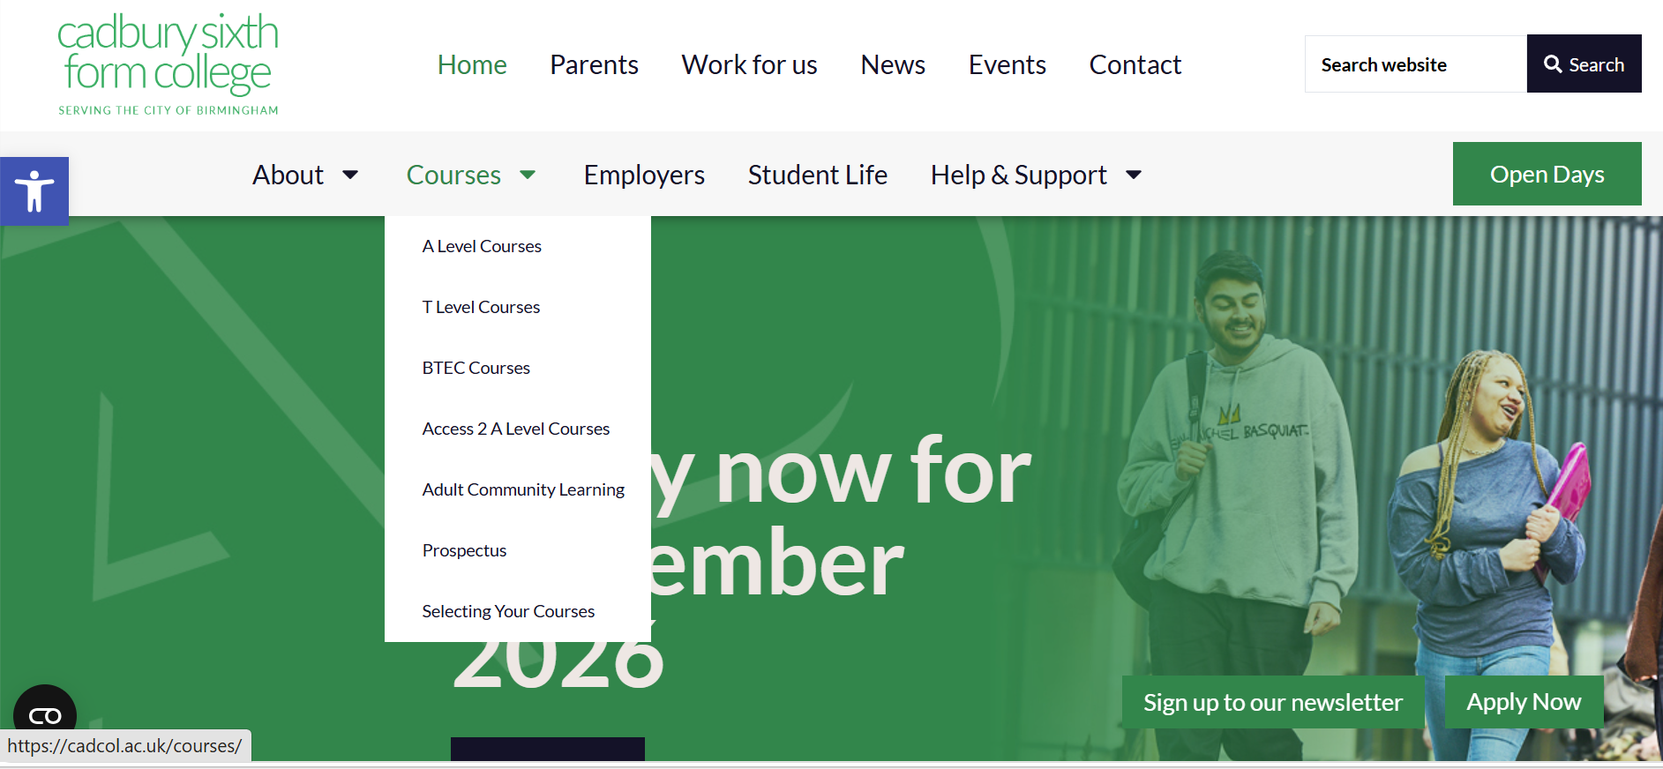
Navigate to courses.

Slide 4
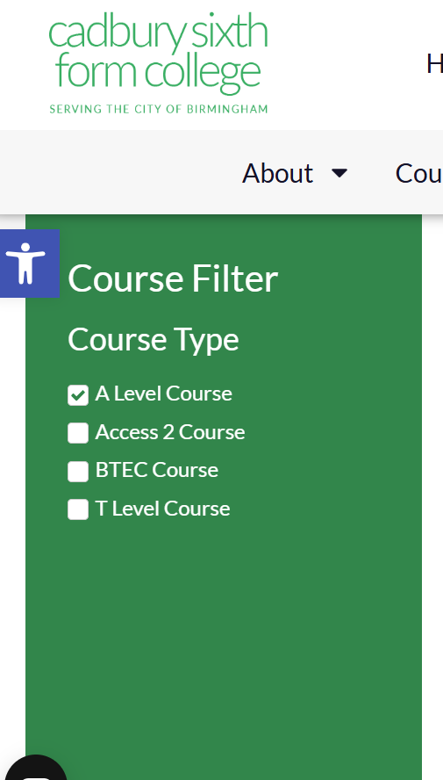
On the left, pick what you want to apply for.
Access2course is a 1-year course between GCSE and A Level, if your GCSE grades are not quite high enough to meet the entry requirements

Slide 5
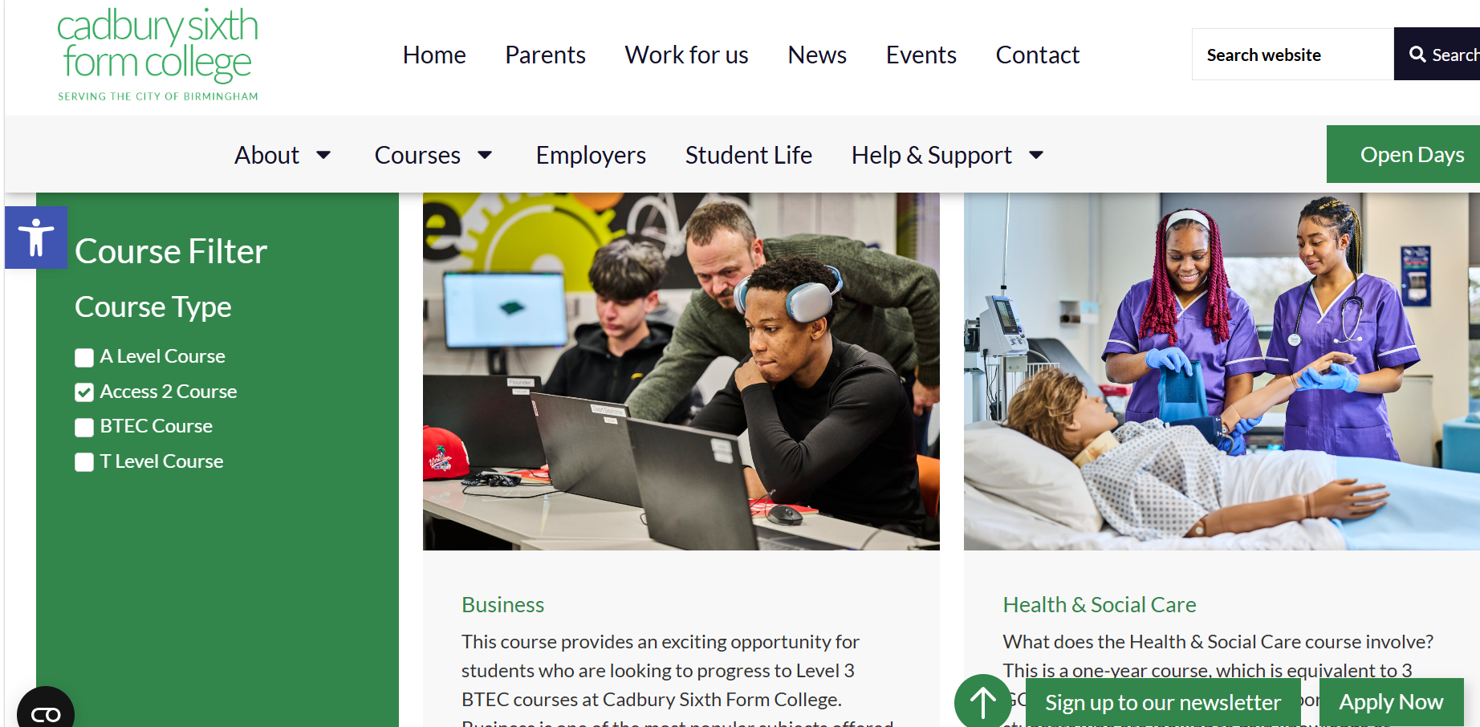
Some examples of the Access2Courses available. There are lots more on the site.

Slide 6
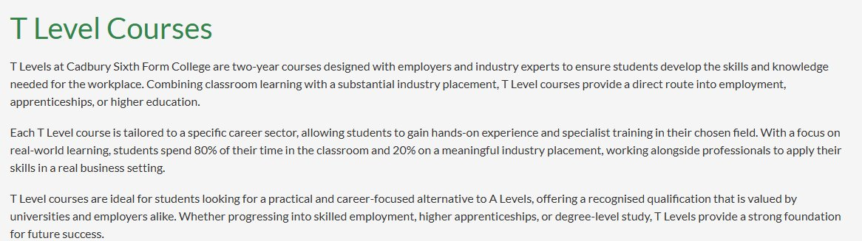
T Levels
T Level Courses - Cadbury Sixth Form College Birmingham

Slide 7


Slide 8
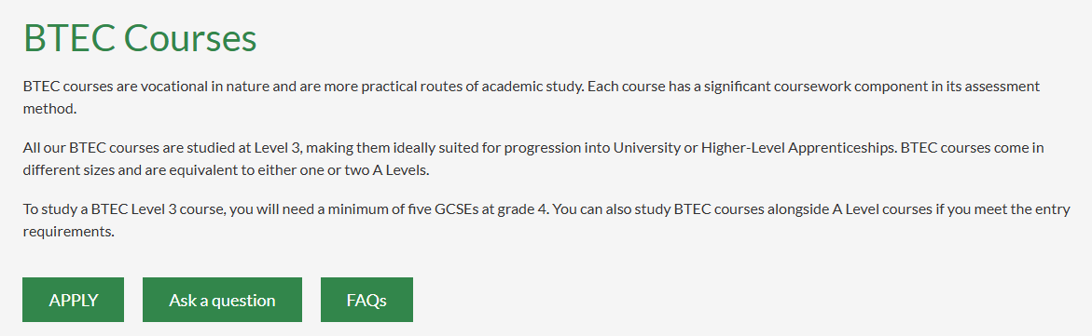
Vocational:

Slide 9
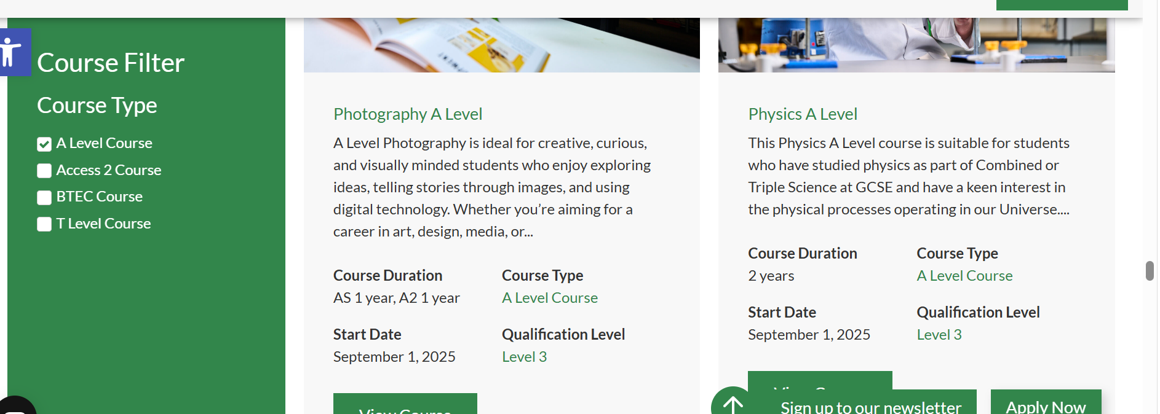
A Levels
Cadbury have a wide variety available. You can pick 3 or 4. The most common number is 3.

Slide 10
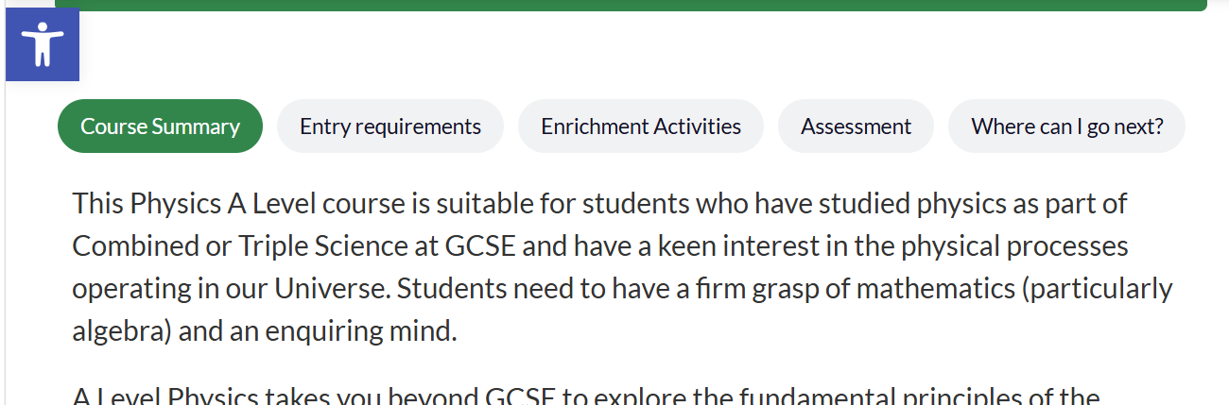
There is a course summary for each subject. Does it sound interesting? On open days you can meet the teachers and ask them more.

Slide 11
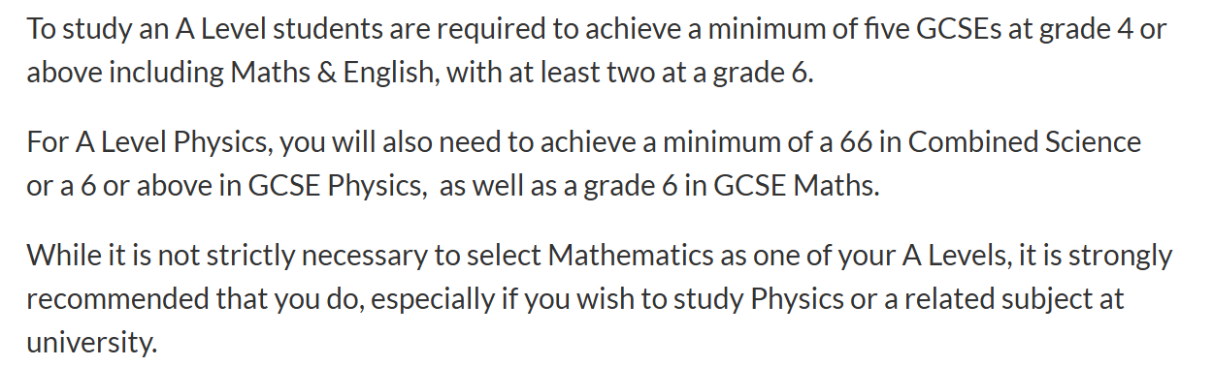
Entry Requirements
Each subject will have specific exam grade requirements or subjects that need to have been taken at GCSE to get onto the course.

Slide 12
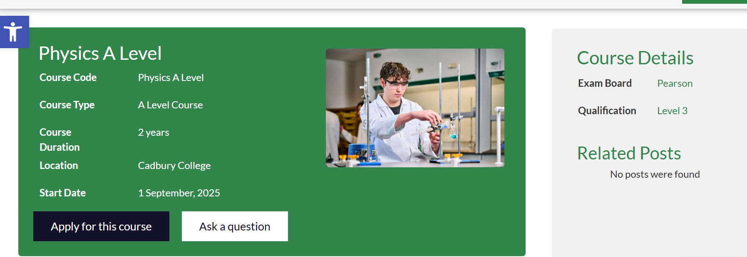
How to apply

Slide 13
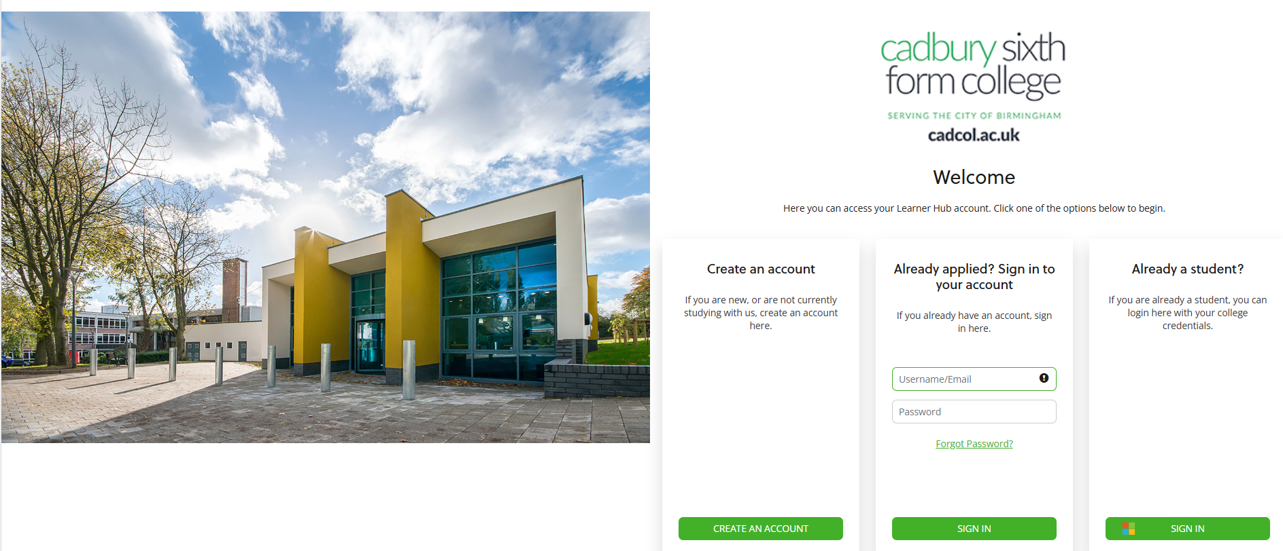
Create an account.

Slide 14
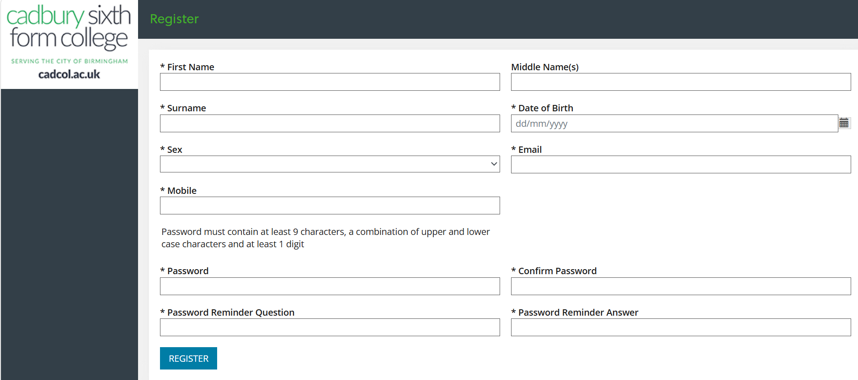
Fill out all the fields with a * next to it. Do not use school email addresses – pupils will lose access to these when they leave.

Slide 15
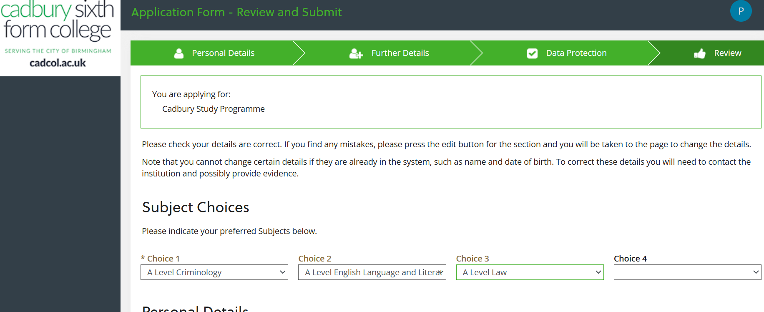
When you have entered all personal details it will ask you to chose your subjects.

Slide 16
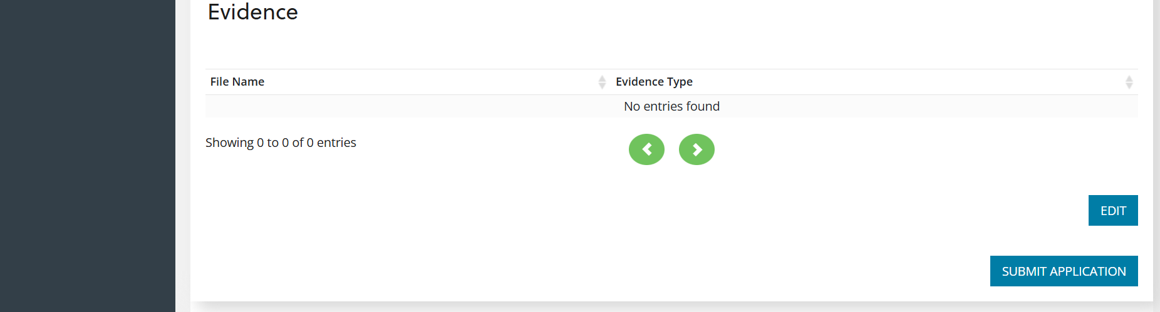
Click submit at the bottom.

Slide 17
What happens next?
Pupils will be contacted to say their application has been received-either a text message or an email.
Pupils will later be invited in for an interview.
We are having interview practice in Year 11 in November, in school to support with this.
If a place is offered, it will be conditional, depending on GCSE grades in August.
In September, pupils will be invited to enrol. If they do not have the right grades, Cadbury may offer an alternative course.

