Slide 1


National Apprenticeship Week 2026
The Apprenticeship Assembly Film - Amazing Apprenticeships

Slide 2
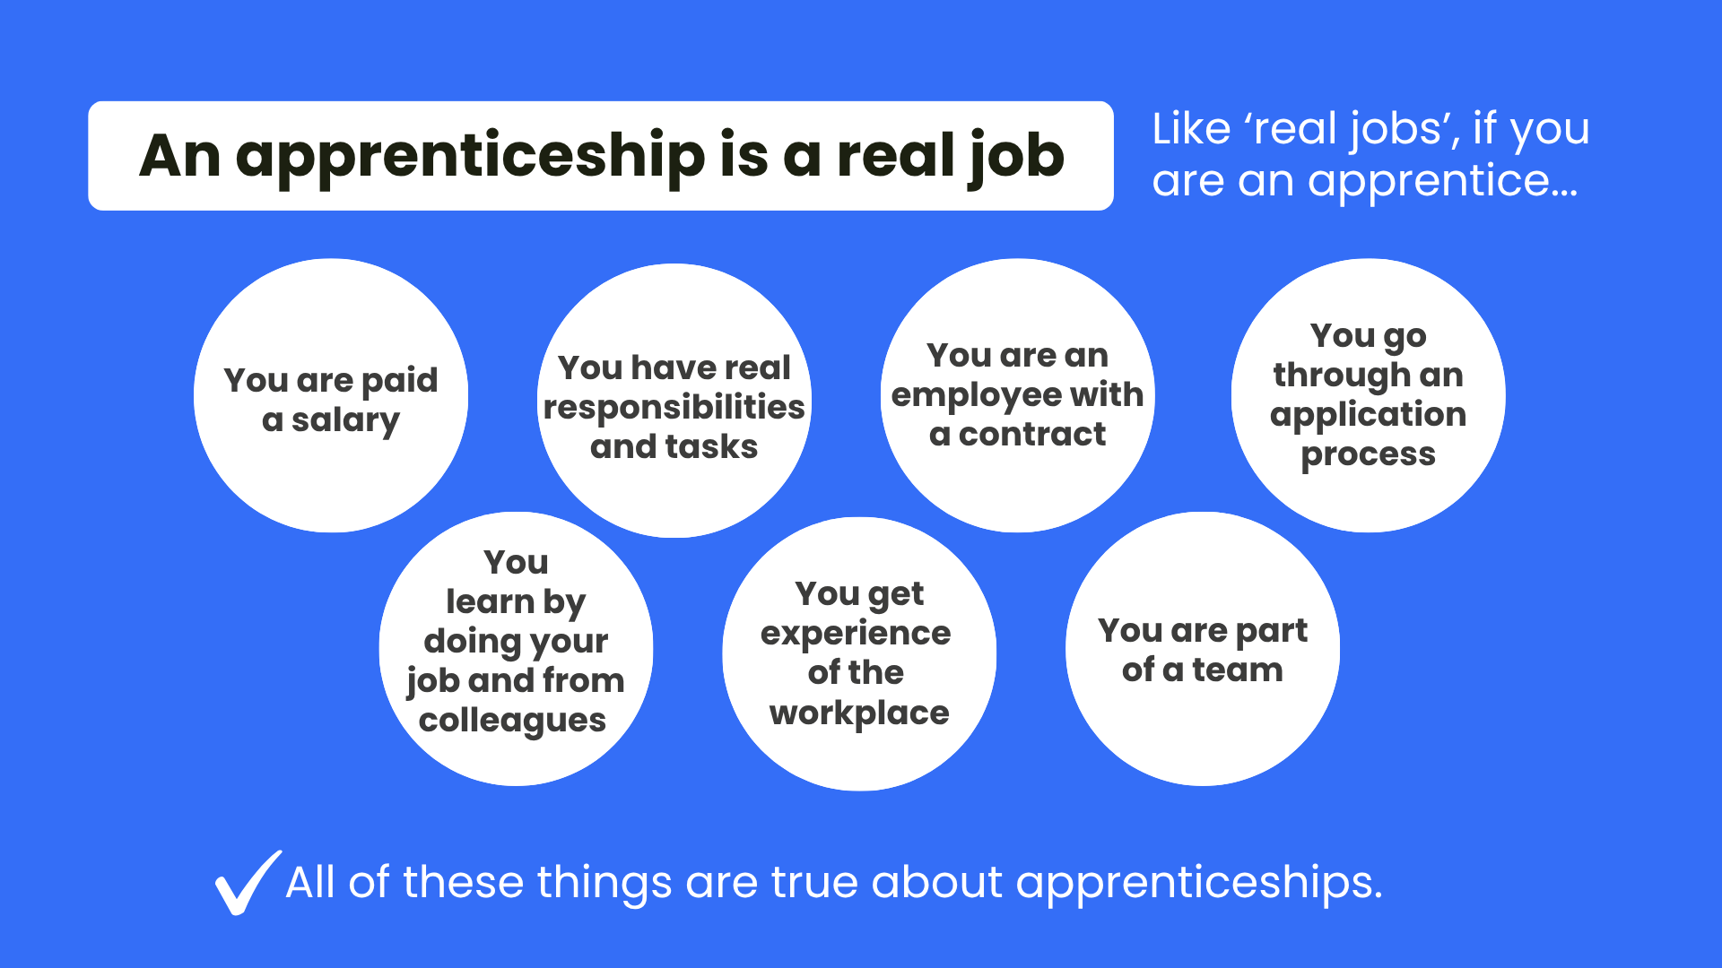
Notes:
You can see on the screen the statement ‘An apprenticeship is a real job’.
On the screen you can see some of the things a ‘real job’ involves
- You’re paid a salary
- You have real responsibilities and tasks to do
- You have a contract of employment and are an employee just like anyone else
- There are application processes that vary from employer to employer
- You learn by doing your job and from your colleagues
- You get valuable experience of the workplace
- You are part of a team
All of these things are also true about apprenticeships!
But does anyone know how an apprenticeship is DIFFERENT to a real job?

Slide 3
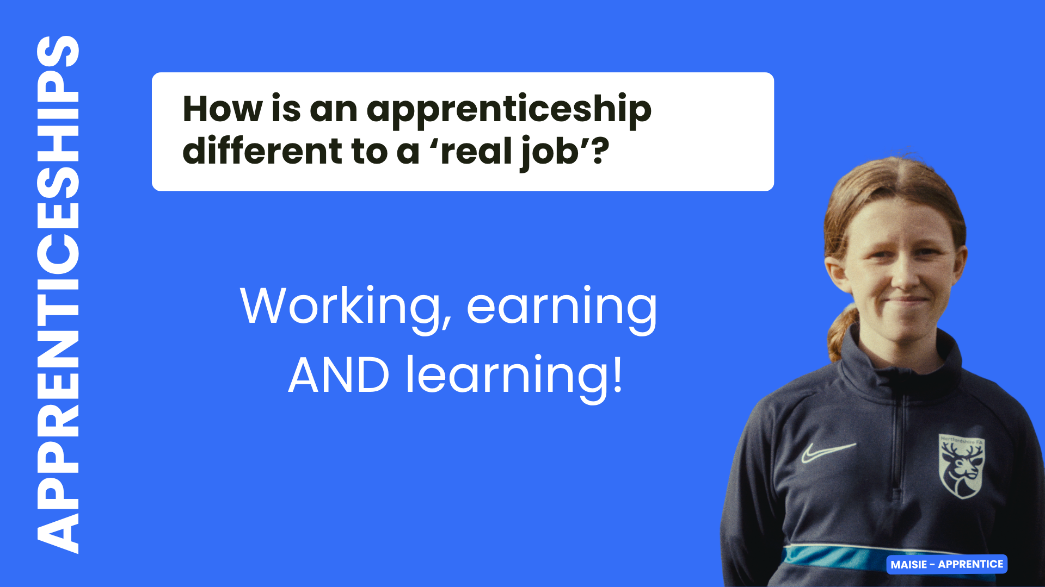
Notes:
If you’re doing an apprenticeship, as well as all the ‘real job’ things we’ve just covered, you also LEARN and gain new skills at the same time.
But how does this work and what else is important to know about apprenticeships?

Slide 4
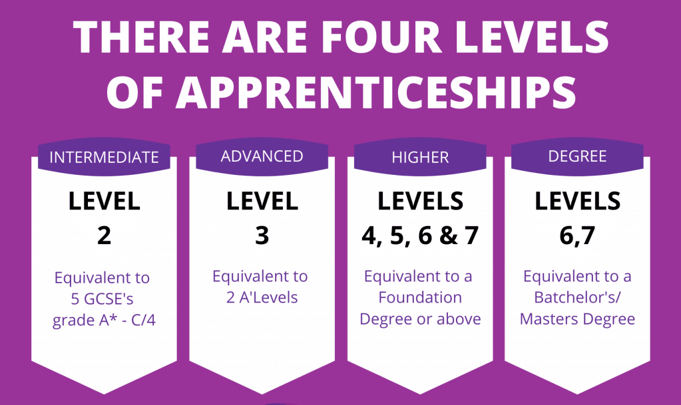
Notes:
If you’re doing an apprenticeship, as well as all the ‘real job’ things we’ve just covered, you also LEARN and gain new skills at the same time.
But how does this work and what else is important to know about apprenticeships?

Slide 5
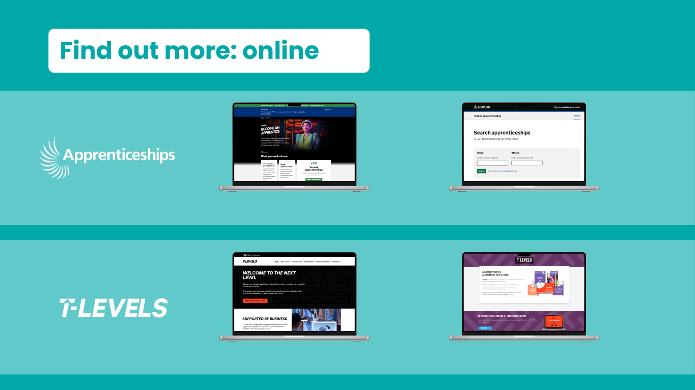
Where to look for Apprenticeship Job Vacancies?
Where to look for apprenticeship vacancies?
Find an Apprenticeship Gov UK
www.gov.uk/apply-apprenticeship
  https://www.gov.uk/apply-apprenticeship

Slide 6

Notes:
The next option we are going to discuss today is T Levels.
You will have almost certainly heard of A-levels, but there is a brilliant technical option you can take after your GCSEs called T Levels.

Slide 7
Key facts about T Levels
Two year
course
Alternative
to
A-levels
80%
study /
20% work
45-day
industry placement
T LEVELS
1 T Level
=
3 A-levels
Designed
by
employers
Get
work
ready
21 subjects
Notes:
(Speaker note: Please click for animation – circles will appear individually)
T Levels are a two-year course for people aged 16-19, designed as a technical alternative to A-levels.
T Levels are really unique compared to other post-16 options, because you spend 80% of your time in the classroom, but 20% of your course is spent on an industry work placement – around 45 days.
You take one T Level, but it’s equivalent in size to 3 A-levels and when you complete it, you get allocated UCAS points in the same way.
T Levels have the real career focus and industry alignment we spoke about earlier because they have been designed with employers from all the relevant industries to ensure they teach students exactly the right skills they need to be work ready. And the industry placement means T Level students gain valuable workplace experience, adding to their employability.
There are currently 21 different T level subjects you can take, and you can see these on the next slide.
After finishing your T Level, you could go straight into a job, start an apprenticeship, go onto an HTQ, or apply to university.

Slide 8
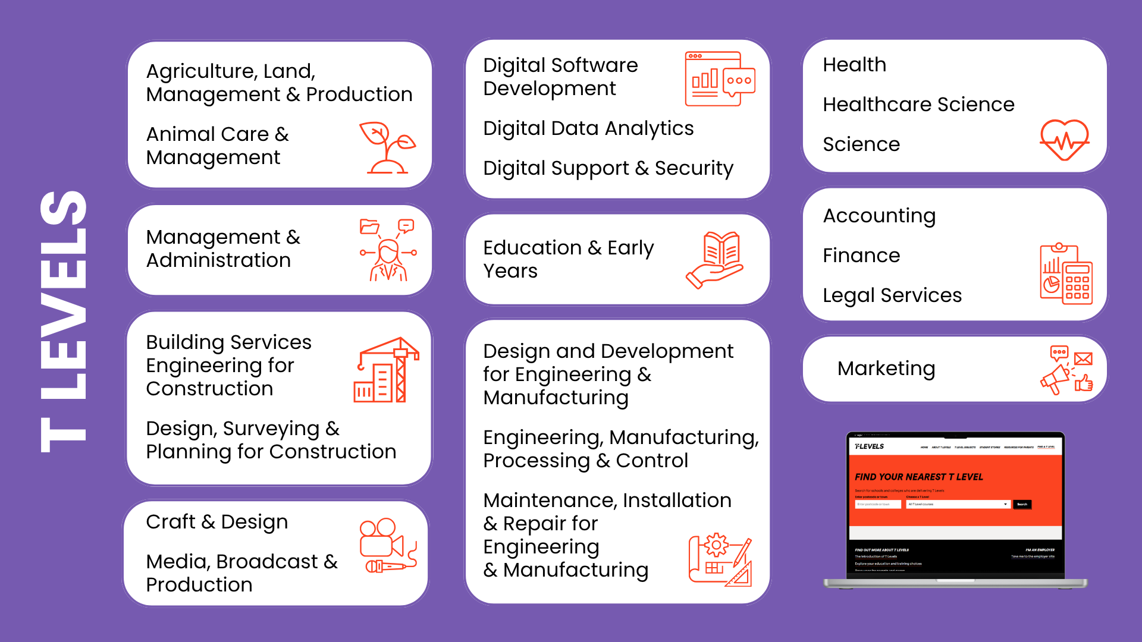
Notes:
There are 21 different T Level subjects you can take and you can see them on the screen.
You can also hopefully see that they span a wide range of subjects and sectors – from animal care and agriculture, through to accounting and marketing.
It is really important to check which are available at providers local to you. T Levels were launched in 2020 so are still rolling out in schools and colleges across the country. You can check by looking on the Find a T Level page on the T Levels website by putting in your postcode.
We’re going to watch a short film(s) now, so you can hear directly from T Level students about their experience.

Slide 9


Notes:
(Speaker note: There are five T Level student films on these slides - select one or more options that best suit your students and learning environment.
These slides could also be left out and the links shared with students to explore independently.
Please note that Joseph’s film also includes an HTQ student, Harrison.)
Sydney (Construction, Design, Planning and Surveying T Level): https://vimeo.com/1123908385
Dawn (Design and Development for Engineering and Manufacturing T Level): https://vimeo.com/1123911126
Katy (Education and Early Years T Level) & Dina (Health T Level): https://vimeo.com/1124852290
Joseph (Digital T Level): https://vimeo.com/1124852577
Fernanda (Digital T Level): https://vimeo.com/1129099098/ee0c031ae6?fl=pl&fe=sh

Slide 10
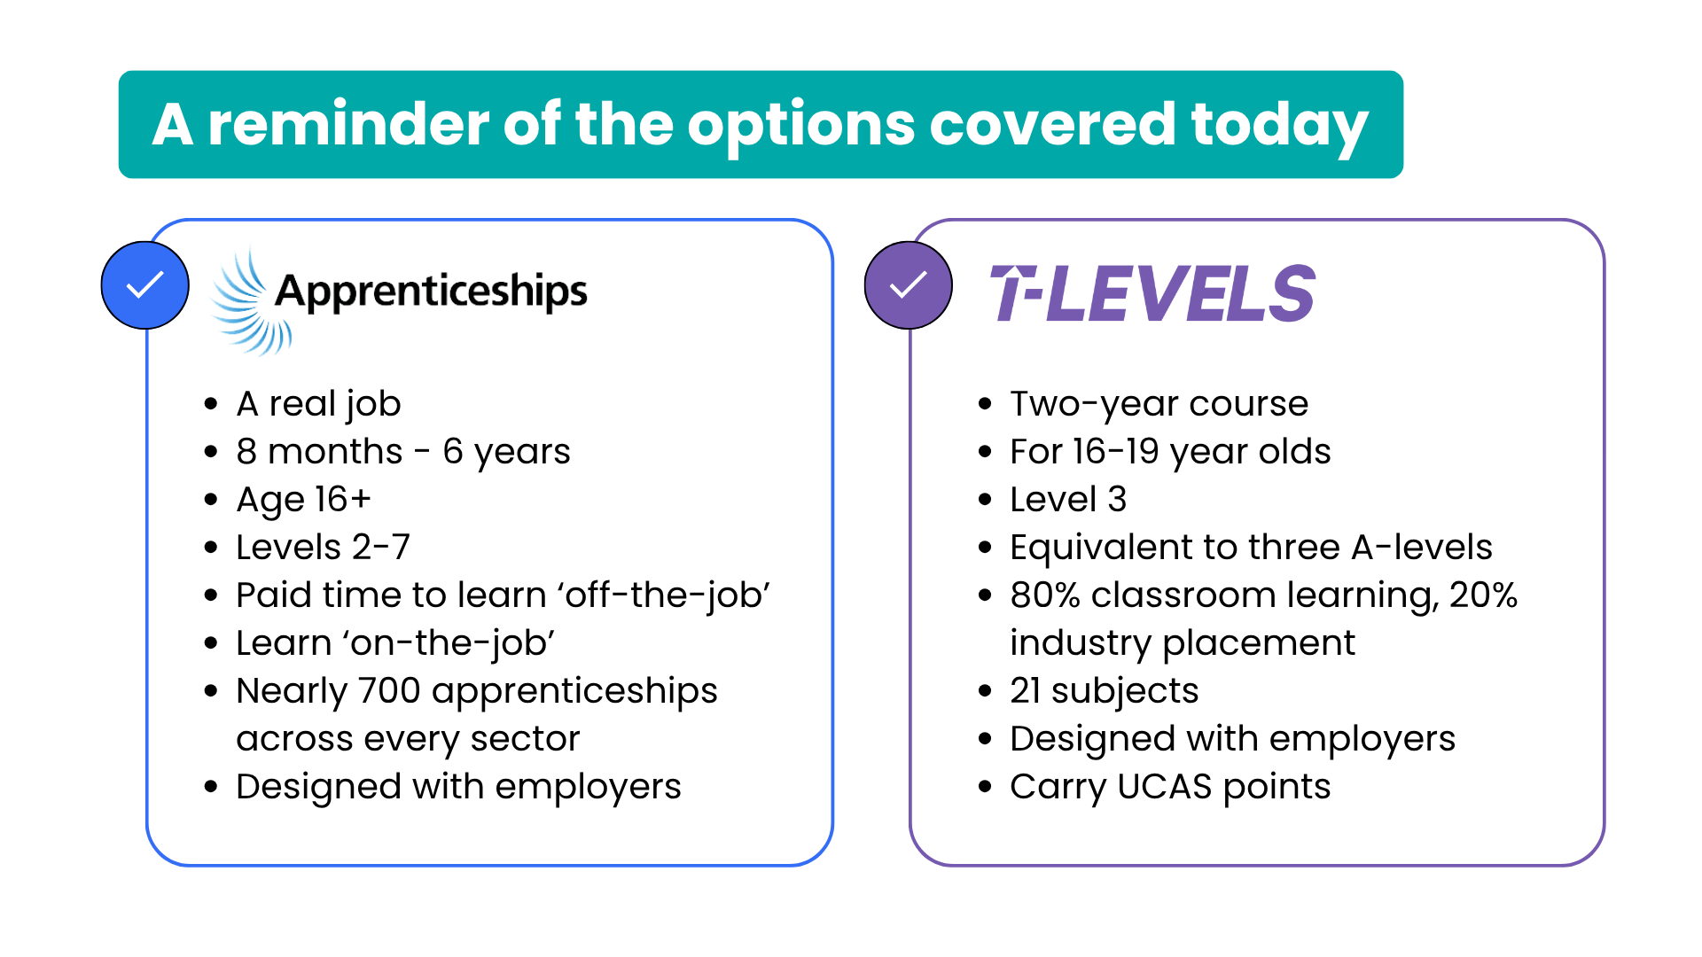
Notes:
(Speaker note: This slide has been included so you can summarise the two technical education options we have discussed today. This slide could also be shared with students, colleagues or parents after the session to summarise what has been discussed.)

Slide 11
Notes:
(Speaker note: This slide has been included so you can summarise the two technical education options we have discussed today. This slide could also be shared with students, colleagues or parents after the session to summarise what has been discussed.)

