Slide 1
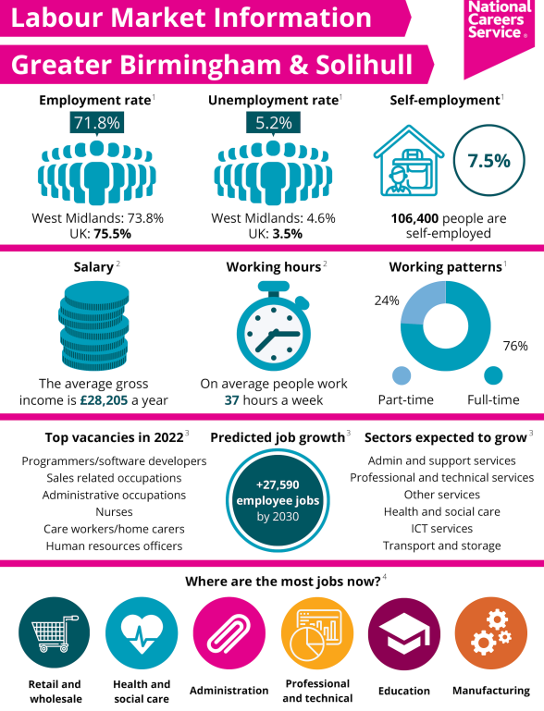

Introducing Labour Market Information (LMI)

Slide 2
What is Labour Market Information? (LMI)
LMI is information about the world of work
It tells us about current job availability, future growth areas, skills needed, typical salaries, and qualifications for different roles, helping people to plan for their future

Slide 3


Slide 4
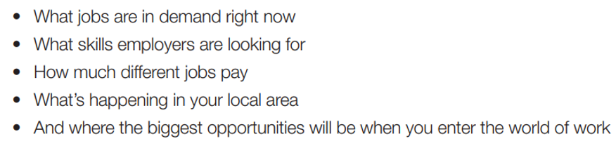
Why is LMI important for YOU?
It tells you
You can then use this information in future career planning and making options choices in school and post 16 education.

Slide 5


Slide 6


Slide 7
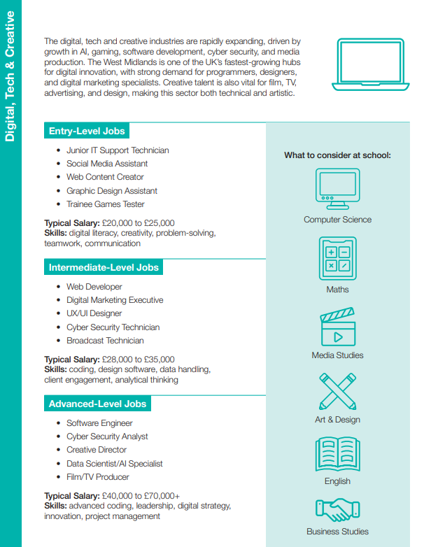
The Digital, Tech and Creative Industry is rapidly expanding in the West Midlands, driven by growth in AI, gaming, software development and cyber security
The West Midlands region is the UK's fastest growth in digital tech jobs, creating thousands of new roles

Slide 8
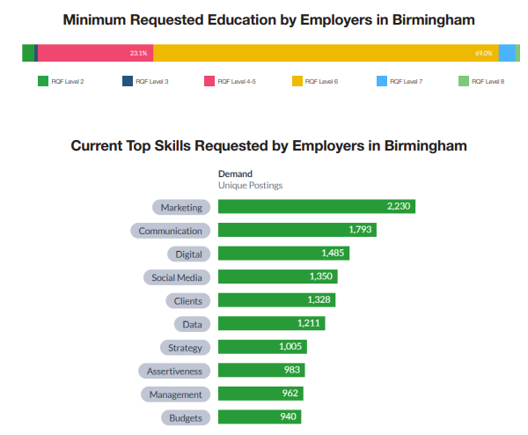
This tells us that employers are looking for people with Level 6 (degree level) qualifications to work in digital tech and creative jobs in Birmingham
These are the most common digital tech and creative jobs in Birmingham

Slide 9


Slide 10
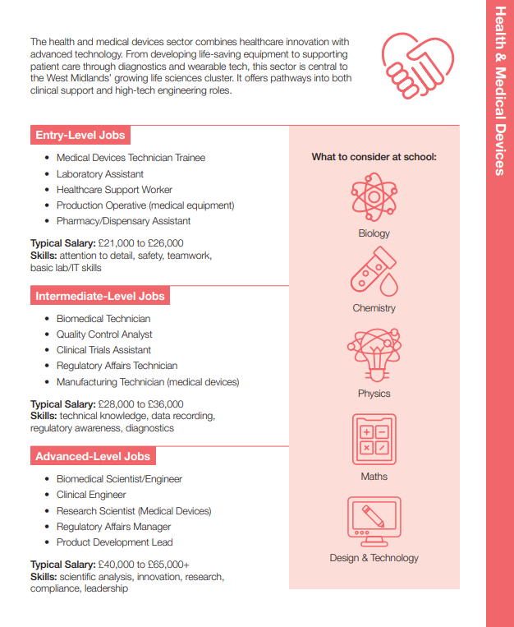
The Health & Medical Devices Creative Industry is growing in Birmingham due to the cities ageing and large population
The health sector faces national shortages

Slide 11


Slide 12
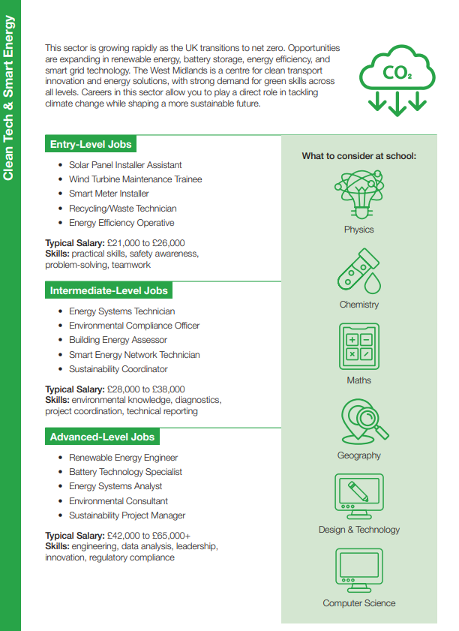
The Green Jobs Industry is rapidly expanding in Birmingham due to investment in clean tech, renewable energy and clean transport solutions

Slide 13

To learn more about careers & opportunities in Birmingham
Access the Step into your future guide in Class Charts

Slide 14

Introducing the Xello careers platform

Slide 15
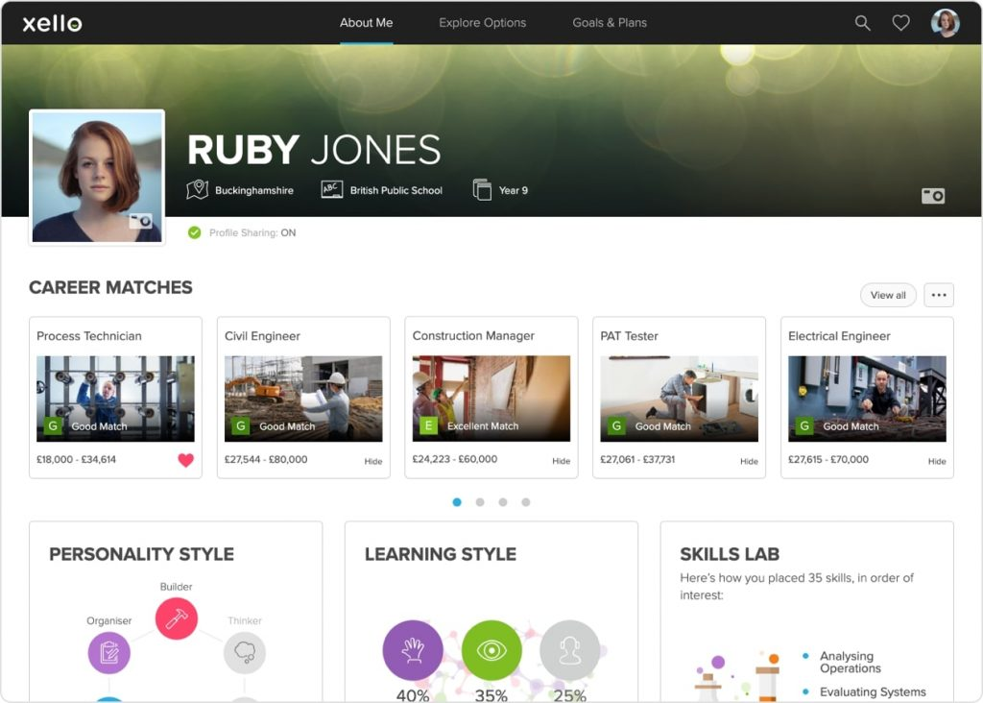
You can access LMI and careers information on your Xello careers platform
Xello is available on your school homepage.
You access the platform using your school login details

Slide 16
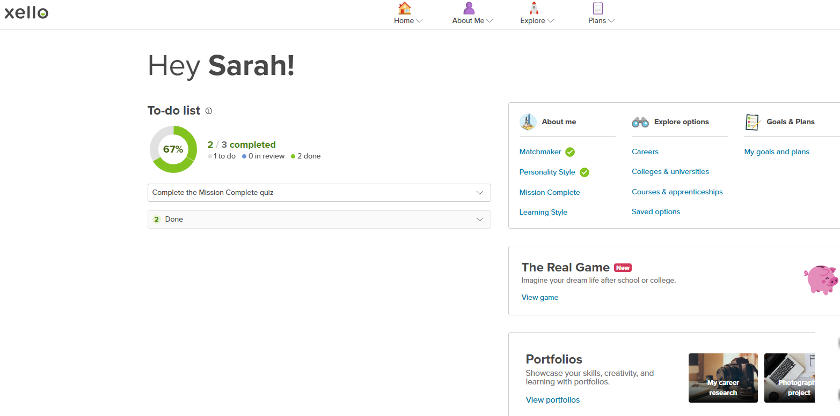
This is the Xello homepage which will give you suggested tasks to complete to help you understand careers information
You can explore the about me section which has different career quizzes
You can explore options such as careers, college, universities and apprenticeships as well as adding your goals and plans

Slide 17
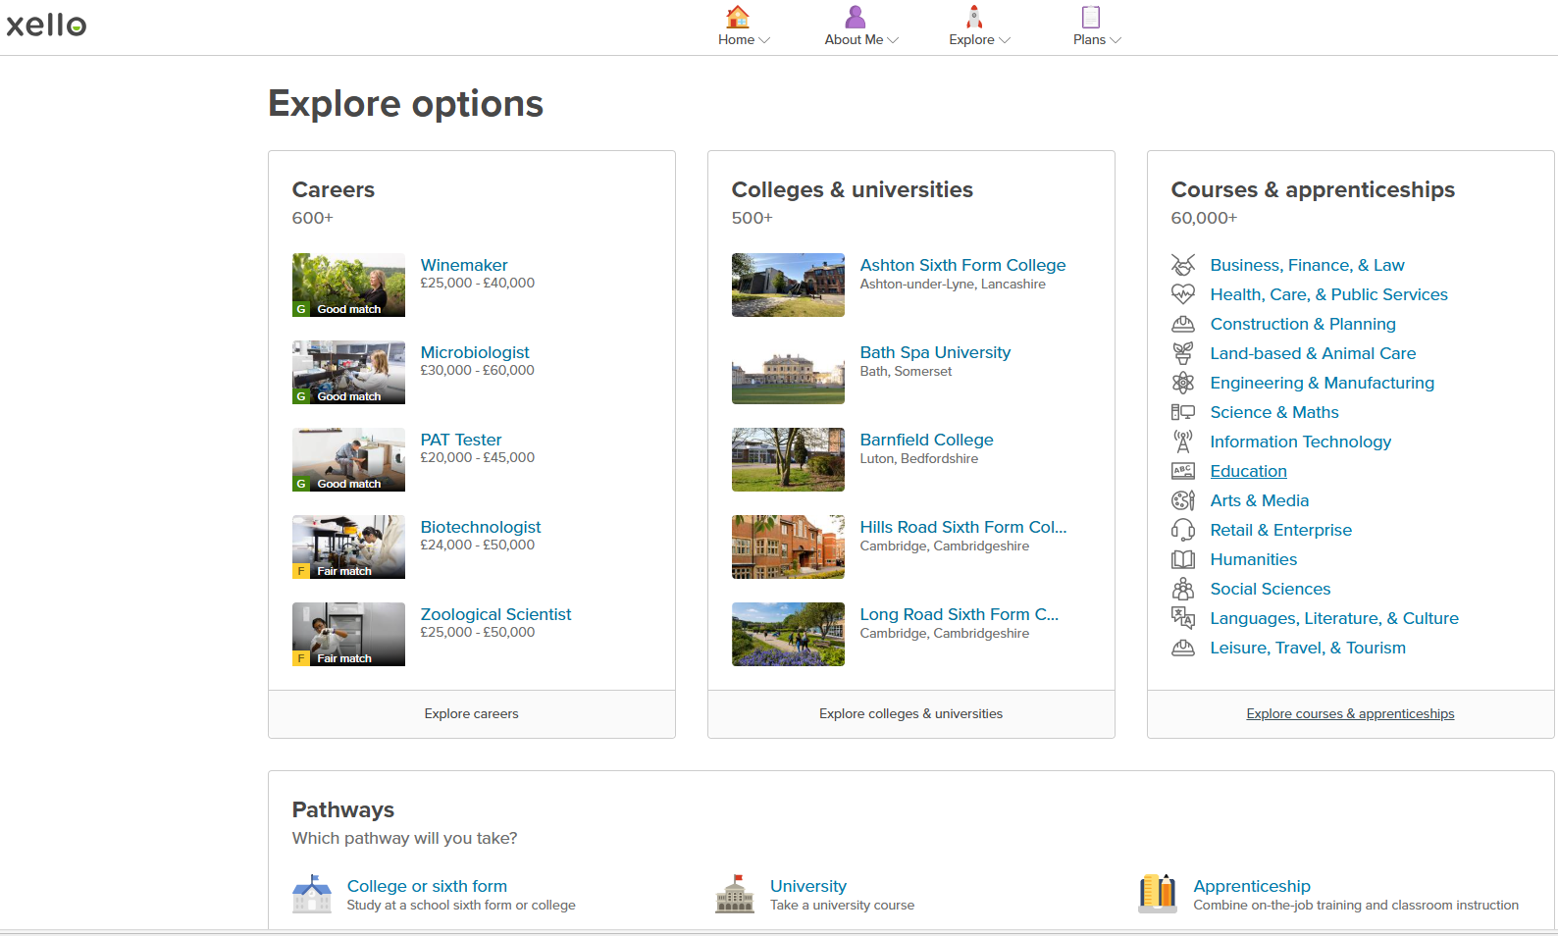
This is the explore options section where you can look for different job roles which will include LMI such as salary, qualification, and whether jobs are in demand or decline

Slide 18
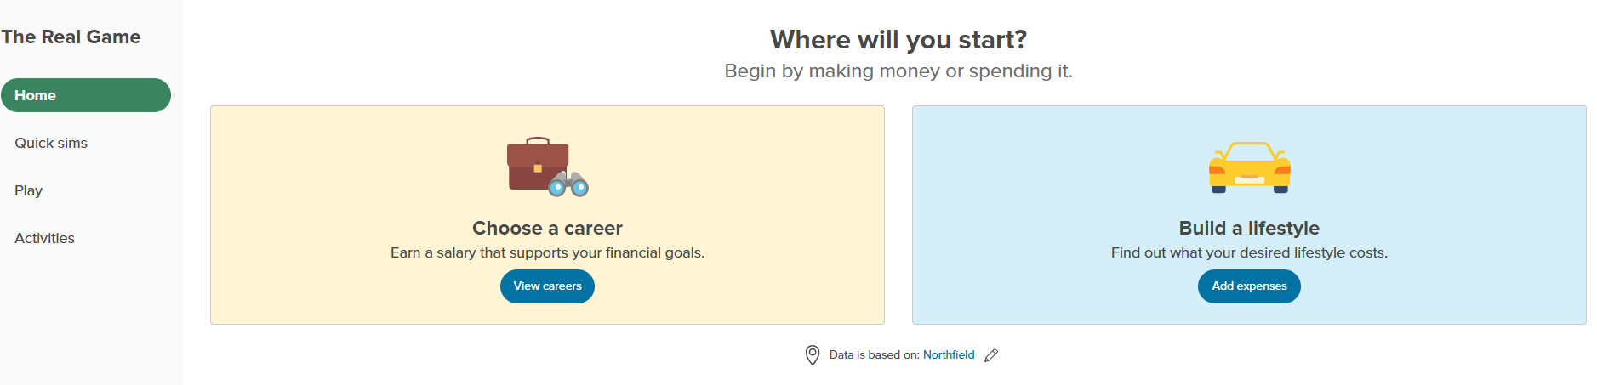
Xello – The Real Game
You can play the real game, which helps you to make decisions about your monthly spending plans as well as giving suggestions on jobs and salaries which will help you maintain your lifestyle!

Slide 19
Understanding your core Employability Skills
Skills Builder defines eight core employability skills which are essential for most jobs:
Listening: The ability to receive, process, and understand information and ideas.
Speaking: Effectively communicating information and ideas verbally.
Problem Solving: Finding solutions to challenges and difficult situations.
Creativity: Using imagination to generate new ideas and approaches.
Staying Positive: Developing strategies to overcome setbacks and stay motivated.
Aiming High: Setting clear goals and creating plans to achieve them.
Leadership: Supporting, encouraging, and developing others towards a shared goal.
Teamwork: Working cooperatively with others for a common objectives

Slide 20
Why are Employability Skills important?
Work Readiness & Career Progression: These skills are essential for getting jobs, succeeding in recruitment, and advancing in careers, providing a strong starting point for early talent.
Academic & Life Success: They improve perseverance, self-belief, and academic outcomes, helping with university entrance and overall life satisfaction.
Adaptability & Innovation: They equip young people to handle new technologies (AI) and challenges, making you more resilient to change.
Increased Earning Potential: Evidence shows people with stronger employability skills earn significantly more and have higher job satisfaction.

Slide 21
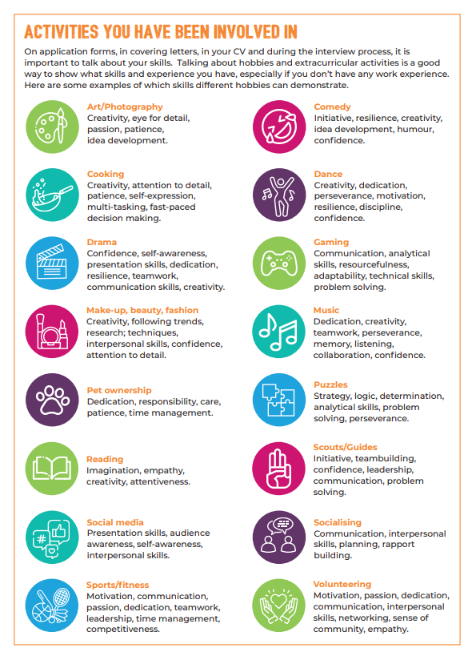
Think about the types of activities you carry out in school / lessons, extra-curricular activities and hobbies and interests outside of school.
Talking about hobbies, interest and extra-curricular activities is a good way to show what skills you have

Slide 22

Example of how to highlight your Employability Skills in applications or at interview
Always include examples which show how you have developed your skills

Slide 23
Careers Support in school
Q. How do I book a career meeting in school?
Visit the career office in the pastoral corridor
Email Mrs Miles s.miles@nsg.kevibham.org
Ask your form tutor / teacher to email Mrs Miles with a referral for a meeting
Q. What can I get support with?
You can get support with exploring post-16 and post-18 options, writing a CV, completing job applications, preparing for interviews, identifying your employability skills, completing a career assessment and learning about the range of careers available.

