Slide 1
Tuesday, 07 June 2022
Science Fair Lesson 9: Write-up
Expected learning outcome for today:
To complete a write-up of Science Fair investigations.
Today’s key vocabulary:
Target audience – people you are appealing to
Peer review - when other scientists check investigations to see if claims are valid
Starter:
Why do you think it is important for scientists to share their work with each other?

Slide 2
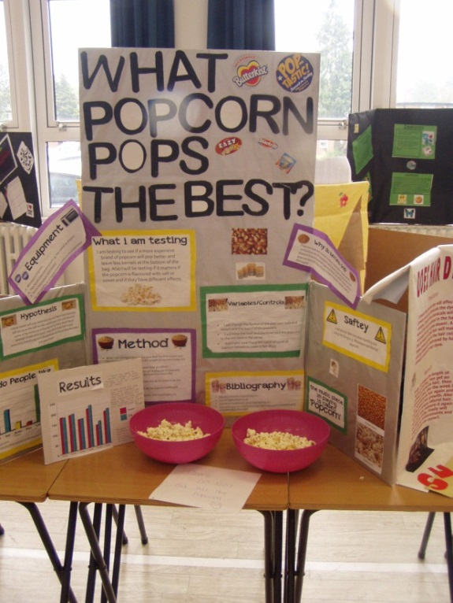
Starter
How many can you think of to share findings of an investigation?
What are the pros and cons of each of these?
Why is it important that findings are checked and shared?

Slide 3
Main Task 1
You are now going to complete your write-up and presentation work.
Remember to include:
The testable question
Your original prediction
Equipment
Method
Risk assessment
Table of results
Graph or chart
Conclusion (and possibly some evaluation work)
Your name!

Slide 4
Plenary
Let’s share some work that we have completed.

Slide 5
Homework
Talk to your family about what you have learned from Science Fair – both from your own project and from those of your classmates!

