Slide 1
Thursday, 05 May 2022
Science Fair Lesson x: x
Expected learning outcome for today:
To understand how to choose a question to investigate for Science Fair
Today’s key vocabulary:
Testable – can be tested
Starter:
“If I could investigate one question about the world it would be…”
Discuss how you would finish this sentence.

Slide 2
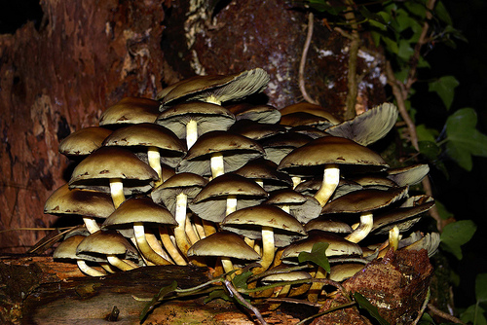
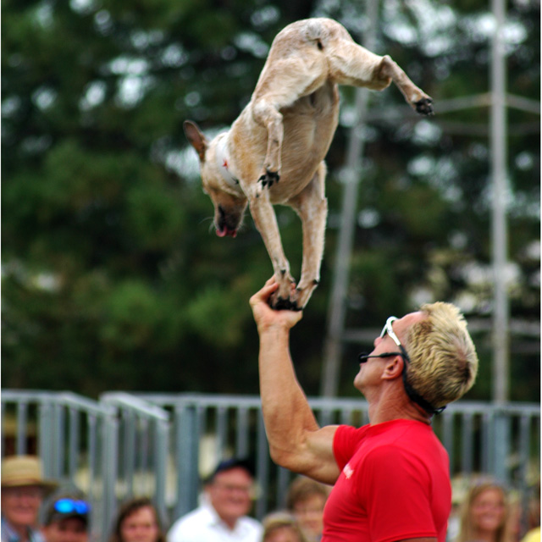
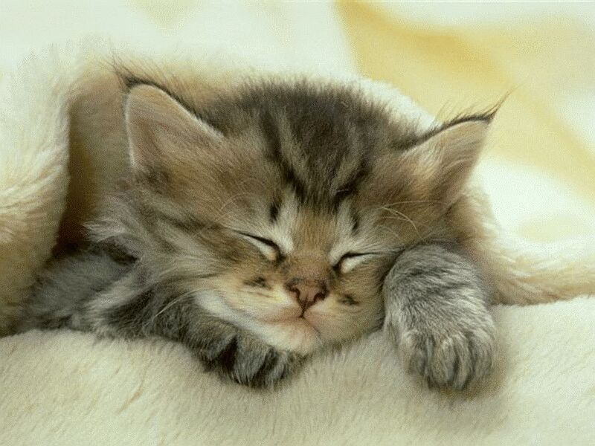
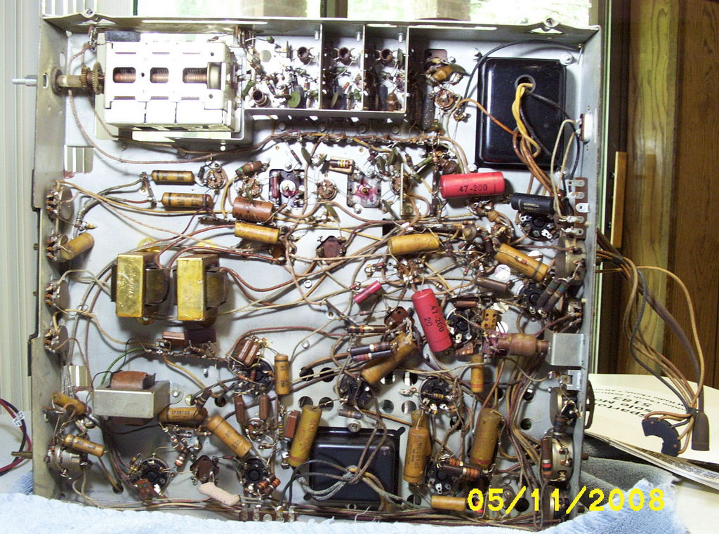
Starter
Discuss these possible questions together.
Is it possible to investigate the questions?
Is it safe to investigate the question?
Can the question be tested (can we answer it scientifically)?
What fungi grow in the local woods?
Can I train my dog?
How long does my cat nap for?
How long are adverts?
What components are inside a TV?

Slide 3
Question | Is it possible? | Is it safe? | Is it testable? | Comments
What fungi grow in the local woods? | ✓ |  | ✓
Can I train my dog? | ✓ | ? | ?
How long does my cat nap for? | ✓ | ✓? | ?
How long are adverts? | ✓ | ✓ | ✓?
What components are inside a TV? | ✓ |  | ✓
Summary:
The question needs to be specific so that you can answer it in a reasonable amount of time.
You can’t carry out unsafe investigations.
Lots of questions can be adjusted to be safe and testable.
Some things might be possible if teachers and parents agree the supervision needed.

Slide 4
Topics that are allowed and not allowed
Animals and plants:
Vertebrates may not be studied. Insects may be permitted but only if your teacher agrees to your proposal in writing.
Behavioural experiments may be allowed as long as no harm (physical or psychological) comes to the animal but your teacher must agree to the proposal in writing.
If your teacher agrees in writing you may be allowed to do observations but you cannot perform experiments on animals.
If you plan to study a plant you must check with your teacher first. Fungi are not allowed to be studied as they may be deadly poisonous.
Chemicals
The chemical must be non-toxic (check with your teacher) and legal.
Chemicals must not be explosive.
Slightly corrosive chemicals (cleaners, mild acids and bases) will need consideration and permission in writing from the teacher.
Energy
Heat is necessary in many investigations or engineering solutions (inventions). Once the temperature is going to get above 50 degrees C teacher supervision in the lab is necessary. Remember even low heat energy devices can build up heat and be harmful.
Open flames can only be used if they are part of an agreed investigation that will be carried out during lessons in the lab.
Electricity cannot normally be used as batteries can release a high charge and mains electricity is too dangerous unsupervised. If you have an idea requiring a power supply then check with your teacher if this can be allowed but try to avoid it.
Engineering
- Do not back-engineer (open up and investigate) items unless your teacher has approved this.

Slide 5
Main Task 1
You are going to work in groups to think about some questions that might like to research. You will eventually pick just one question but good planning should involve considering several options before finalising your idea.
On a piece of paper or a wipe board, think of about 10 questions that you might like to investigate.
Once you have done this, discuss whether each question is testable and safe. Also can it realistically be researched in a short amount of time at home or in school?
Can any of the questions be worded to make them more specific?

Slide 6
Broad Questions | Testable questions
How do lubricants work? | Which combination of lubricants will work best on a bicycle wheel?
What can affect animal behaviours? | What is the effect of a low-level electrical field on the movement of fruit flies?
What happens when water expands as it freezes? | How much force is needed to keep water from expanding as it freezes?
What is soap? | Which detergent removes stains the best?
What is bread mould? | What conditions keep bread mould from growing on bread?
What do birds eat? | What type of food and feeder will attract the most cardinals?
Share some of your questions.
PAUSE POUNCE BOUNCE
You might be asked if you think a question is testable, safe and practicable (can realistically be tested).

Slide 7
Homework
Decide on a question you would like to investigate so that your teacher can discuss this with you and help you refine it, if necessary. You can discuss this with parents or carers too – they may like to help you when it comes to carrying out your research.
Complete the proposal form.

Slide 8
Plenary
Q. Which question is safe, testable and practicable?
A. Which type of battery is most powerful?
B. Why is the sky blue?
C. How many cars drive past school in a whole day?
D. Which type of popcorn is preferred by my class?

