Slide 1
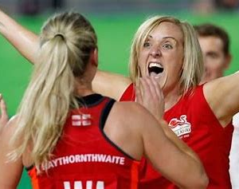
OCR CAMBRIDGE NATIONAL
SPORT STUDIES

Slide 2
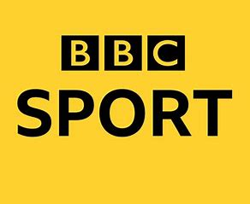
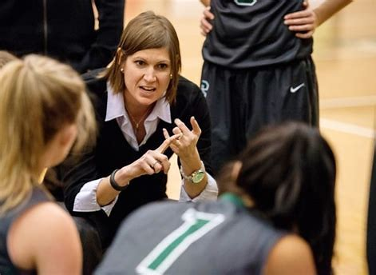
This is the course for you if…..
You really enjoy your PE lessons, especially
the competitive activities
You take part in sport inside or outside of school for example in a club
You enjoy practical subjects where you gain marks for demonstrating skills and not just from an exam
You are interested or already enjoy leading others
You have an interest or would like to take an interest in sport including keeping up with the sports news and/or following your favourite sport, team or athlete

Slide 3
Developing Skills – 25% practical
You will gain marks in this unit for your practical performance in a team sport and individual sport. You will also gain marks for officiating in a sport. Lastly you will complete a training programme for someone to improve their skills in a sport.
Contemporary Issues in Sport – 25% Exam
You will complete a 1 hour exam in year 11 for this unit. Topics include looking at what affects participation in sport, barriers and ways to overcome them. You will learn about the values that are demonstrated in sport as well as looking at examples of the Olympic and Paralympic values. You will also study the benefits and drawbacks of hosting a major sporting event, like Birmingham hosting the Commonwealth games in 2022 and finally you will learn about the organisations that govern sport, what they do to help sports grow.
4 UNITS
Mixture of exam, practical and coursework
The Sports Industry -25% coursework
In this unit we learn about the jobs that are created in the world of sport from professional athletes to merchandise sellers, from grounds keepers to stadium announcers. You will also learn how to write and prepare a cv and interview for a specific role in sport learning about a number of roles in the sports industry. You will gain knowledge on how the sports industry impacts on the economy and the health of the country.
Sports Leadership – 25% Practical and Coursework
In this unit you will learn all about the qualities, skills and knowledge you will need to be a successful sports leader. You will plan and lead a lesson with a younger year group and then evaluate your performance. This unit allows you to develop your confidence, communication skills and planning skills, all really useful for any career in the future.

Slide 4
For more information…
Please see Mrs. Vizor or Miss. Parkinson

