Slide 1
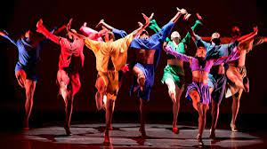
DANCE
KS4 options

Slide 2
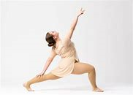
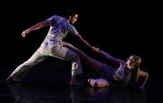
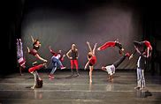
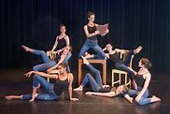
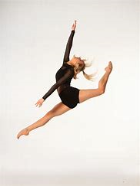
DANCE as an option
In KS4 you have the opportunity to take part in a dance course and gain a vocational qualification. The course is called the RSL level 2 Certificate in Performing Arts (Dance) which is an equivalent GCSE. This means that it is not a GCSE course but is a course that gains equivalent grades.
The course is mainly Practical with some theory work (4 lessons out of 5 are practical). You will be expected to take part in dance classes delivered by your teacher, external dance teachers and tutorial videos. You will also be expected to develop your own creative ideas as well as perform to a range of audiences.

Slide 3
Who should take DANCE as an option?
Anybody can take dance as an option as it is available for all levels. However, you should only choose dance if you have a real passion and interest in the subject. This is not an easy subject and so you should really want to Dance! Some of the skills/qualities needed for this subject;
Creative
Willing to work hard (physically in practical subjects)
Willing to learn new skills and techniques
Takes part in dance outside of school or has a strong interest in Dance
Happy to perform to audiences and in front of others

Slide 4
What does the course involve?
Unit 1- Skills and Techniques -this is followed in Yr 10 and is designed to help you learn and develop a range of dance skills in different dance styles to help you accurately perform set dances. You will also analyse dance repertoire from famous choreographers and music videos, film and musicals.
Unit 2- Dance Ensemble -this will be started towards the end of Yr 10/start of Yr 11 and is a unit which allows you to be creative and work as part of a group to create your own dance pieces, including choosing the music, make up and the costumes.
Unit 3-Live Performance- this is the dance exam that takes place in Yr 11 and consists of you being part of group and planning, performing and evaluating a dance piece based on a theme set by the examining board (for example; hopes and dreams).

Slide 5
Previous Dance Results
Pupils that have studied dance at KS4 have had fantastic results. The last 2 years results were as follows;
2020
100% PASS RATE (Grade 4/5)
100% gained DISTINCTION/DISTINCTION* (Grade 7/8)
2019
100% PASS RATE (Grade 4/5)
70% gained DISTINCTION/DISTINCTION* (Grade 7/8)

Slide 6
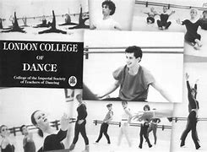
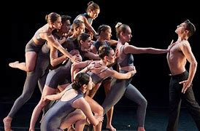
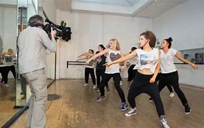
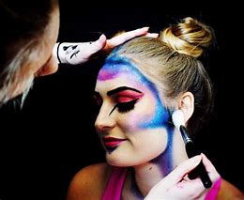
Where could a vocational qualification in Dance take me?
Progress on to a vocational dance course at college/university
Aid development to becoming a professional dancer
Aid development to a job in Performing Arts (e.g, make-up designer)
Progress on to any Level 3 courses as it counts as one of your 5 GCSE’s at grade 4 and above

